Slide 1
CIP 2020 Class #1: Navigating TxDOT Website & NTTA Marketplace
DBEs, HUBs, MBEs, Prime Contractors, SBEs, Sub-contractors, WBEs and Veterans
January 17, 2020

Slide 2
Doing Business with TxDOT
TxDOT offers contracting opportunities in many areas, including but not limited to:
Airports
Heavy Highway Construction
Professional Services
Public Transportation
Building Construction
Goods and Services

Slide 3
TxDOT Website https://www.txdot.gov/
Go to TxDOT Website
Then Click on Business

Slide 4
Aviation Division
Aviation Opportunities:
Procures and contracts for Professional Services, Heavy Construction Services and Building Construction Services.
Useful Certifications: DBE/HUB/SBE
For more information about Aviation opportunities Contact the Aviation Division at 512-416-4500

Slide 5
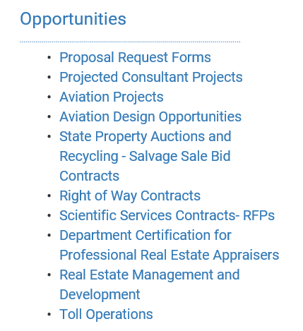
Aviation Projects/Aviation Design Opportunities
Click on Aviation Projects to get in-depth aviation information
Click on Aviation Design Opportunities
(Upcoming Design Projects)

Slide 6
Construction Division (CST)
CST procures and contract through a low bid system.
Construction Opportunities
Highway Improvement
Building Contract
Maintenance Contract
Useful Certifications: DBE/HUB/SBE
For more information about prequalification, letting, bids, or construction and maintenance opportunities Contact the Construction Division at 512-416-2584

Slide 7
Maintenance Division (MNT)
MNT procures and contracts through a low bid system.
Maintenance Division contract opportunities include:
Routine Maintenance
Preventive Maintenance
Emergency Contracts
Purchasing Services
Vegetation Management
Bridge Preventive Maintenance
Routine Facilities Contracts
Useful Certifications: DBE/SBE/HUB
For more information about prequalification, letting, bids, or construction and maintenance opportunities, Contact the Maintenance Division at 512-416-2584.

Slide 8
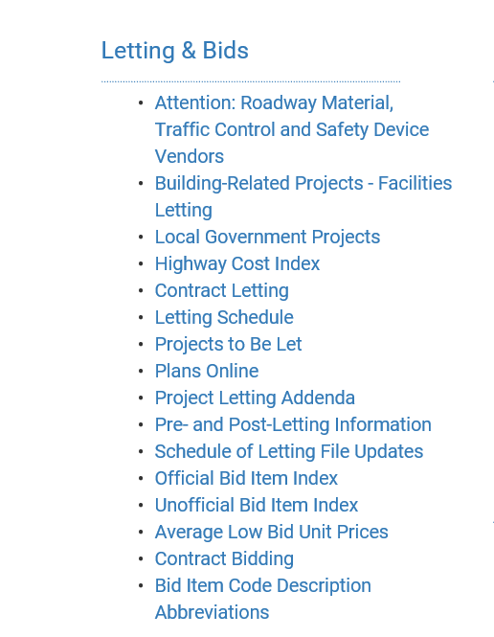
Letting & Bids
Click on Letting & Bids
(All Contractors MUST be on E-Verify)
Click on Letting Schedule

Slide 9
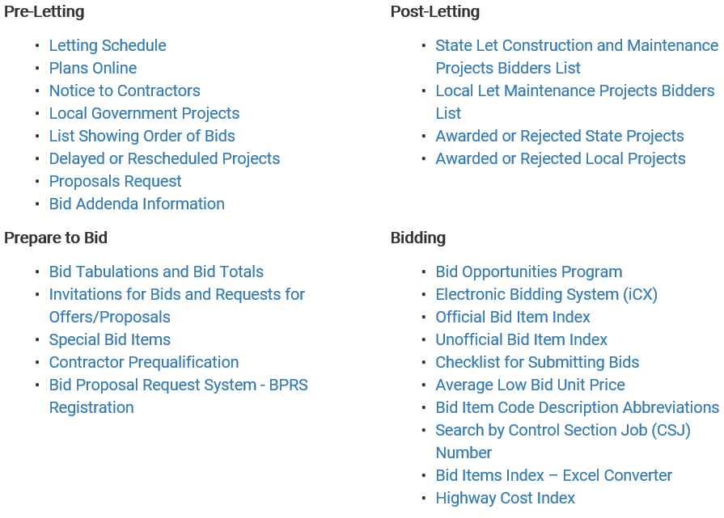
Pre-Letting, Post-Letting, Prepare to Bid, and Bidding

Slide 10
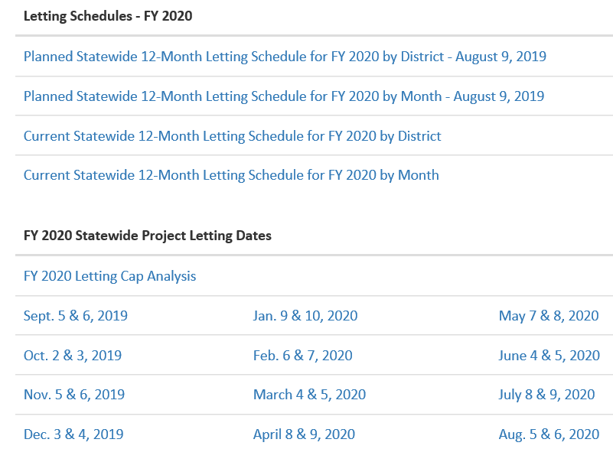
Letting & Bids
For Upcoming Projects
Click Either Current Statewide 12-Month Letting Schedule or FY 2020 Statewide Project Letting Dates

Slide 11
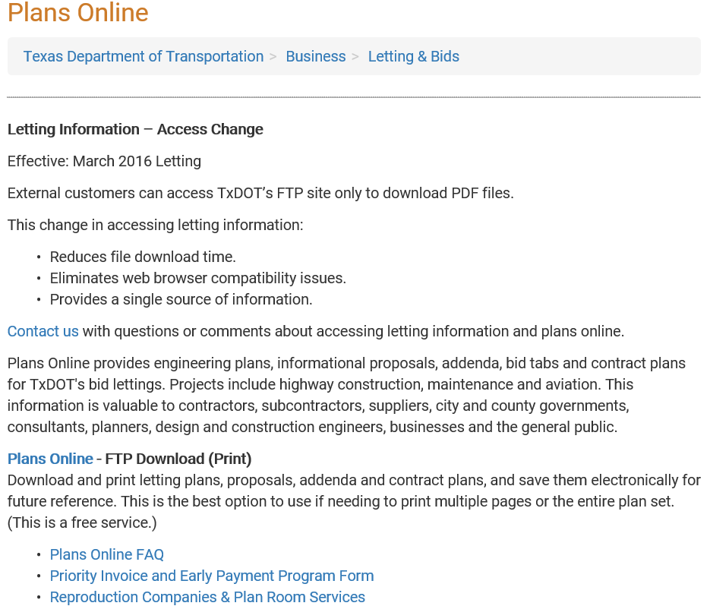
Plans Online
Click Plans Online
Click Plans Online-FTP Download

Slide 12
Projects Plans & Proposals
Click – Plans Online – FTP Download (print), then click I agree, then click the button Click here
This will get you to the FTP site. Will look for and click on State-Let-Construction then 2019.
Click a Date– then you have the choose to choose Plans, Proposal, Proposal Addenda Etc.
If you click plans then you will get all the projects for the State that are letting in that Month. It very important that you know the CSJ# and the County you are looking for.
Look for CSJ# : Click on it and it will get you to the Title sheet of the plans
On the left side, it will give you each sheet.
Look for Estimate & Quantity, this page is the Estimate Summary sheet, it will show all the item and description for the project.
You will need to go through them to find your item of work.
The Summary of quantities roadway sheets is the plans sheet where the location is show where the item will be installed or removed.
Pull the proposal as well to make sure the quantities are the same.

Slide 13
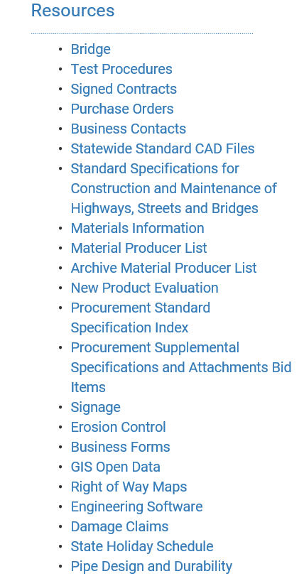
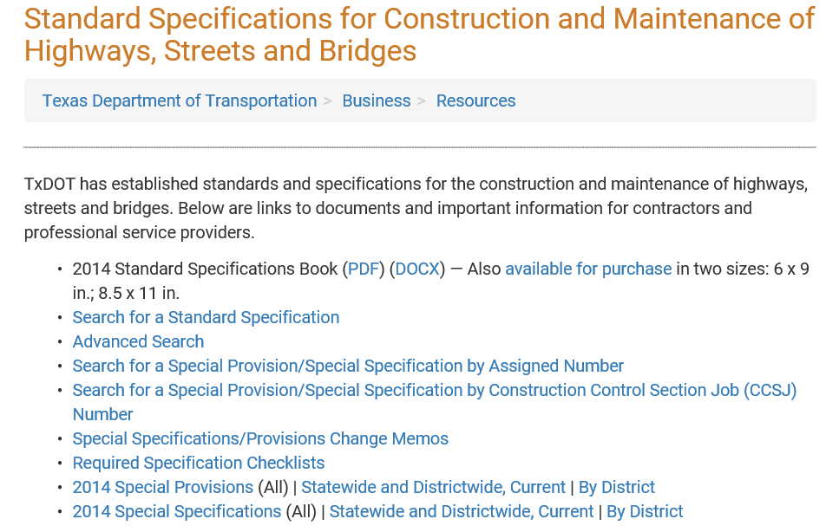
Spec Book
Click Standard Specifications for Construction and Maintenance of Highways, Streets and Bridges
Click PDF or DOCX for Digital Copy of 2014 Spec Book

Slide 14
Professional Engineering Procurement Services Division (PEPS)
Project opportunities for Professional Service under PEPS contracts may include preliminary engineering, design or plan work, specifications and estimates (PS&E) as well as:
Construction Engineering and Inspection
Bridge Inspection and Design
Geotechnical
Materials, Traffic, Environmental, and Utility Engineering
Architectural Design and Observation
Surveying and Mapping
Useful Certifications: DBE/HUB
For more information about procurement opportunities at TxDOT, Contact the Procurement Division at 512-416-2400

Slide 15
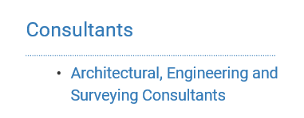
PEPS Opportunities
Click Architectural, Engineering and Survey Consultants
Click Fiscal Year 2020 Procurement Plan
or
2020 Fiscal Year

Slide 16
Procurement Division (PRO)
PRO is the central purchasing office for the department who procures goods and non-professional services under the State Purchasing ACT.
Procurement Opportunities:
Manufactures, suppliers, and other vendors wishing to furnish materials, equipment, supplies, and non-professional services to the state of Texas.
Apply to be on the Centralized Master Bidders List (CMBL)
Useful Certifications: DBE/HUB (strongly encourages to become HUB certified)
For more information about procurement opportunities at TxDOT, Contact the Procurement Division at 512-416-2400.

Slide 17
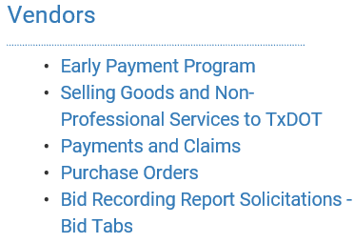
Procurement Division (PRO) Opportunities
Click Selling Goods and Non-Professional Services to TxDOT

Slide 18
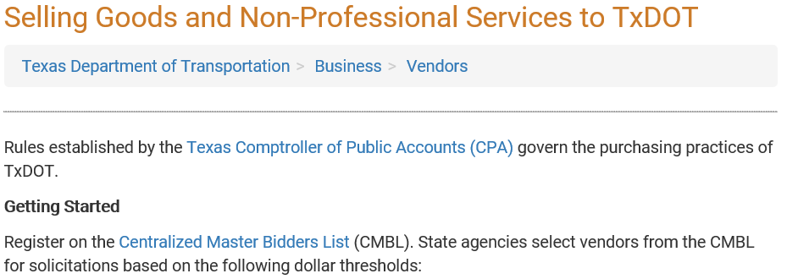
Selling Goods and Non-Professional Services
Click Centralized Master Bidders List (CMBL) to go to Apply
https://comptroller.texas.gov/purchasing/vendor/cmbl/

Slide 19
Public Transportation Division (PTN)
PTN coordinates with the Federal Transportation Administration (FTA), non-profits, and local government entities to promote the use and development of public transportation throughout the state.
Examples of Contracting Services Include:
Construction of a Facility
Fleet Maintenance
Administrative and Operational Supplies
Useful Certifications: DBE/HUB/SBE
For more information about public transportation opportunities at TxDOT, Contact the Public Transportation Division at 512-486-5969.

Slide 20
Support Services Division (SSD)
Support Services opportunities:
Professional Services
Special Trades and Building Construction Services
Facility Maintenance
Security Operations
Materials Inventory for Road Maintenance Operations
Useful Certifications: HUB
SSD Opportunities are advertised on the Texas Comptroller of Public Accounts Electronic State Business Daily (ESBD) at http://txsmartbuy.com/sp
For more information about building construction and facility maintenance opportunities at TxDOT, Contact SSD’s Business Operations at 512-416-2458, or email at SSD_ContractLettings@txdot.gov

Slide 21
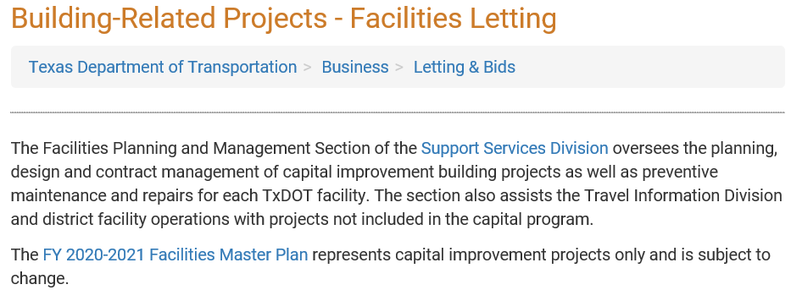
Support Services Division (SSD) Opportunities
Click Building-Related Projects-Facilities Letting
Click FY 2020-2021 Facilities Master Plan

Slide 22
State Entity Updates
Click Building-Related Projects-Facilities Letting
Click Subscribe to Updates

Slide 23
TxDOT districts
Dallam
Sherman
Hansford
Ochiltree
Lipscomb
Hartley
Moore
Hutchinson
Roberts
Hemphill
Oldham
Potter
Carson
Gray
Wheeler
Deaf Smith
AMARILLO
Collings- worth
Randall
Armstrong
Donley
Parmer
Castro
Swisher
Briscoe
Hall
Childress
Hardeman
Bailey
Lamb
Hale
Floyd
CHILDRESS
Wilbarger
Wichita
Motley
Cottle
Foard
Clay
Lamar
Red River
Cochran
Lubbock
Dickens
WICHITA FALLS
Montague
PARIS
Hockley
LUBBOCK
Crosby
King
Knox
Baylor
Archer
Cooke
Grayson
Fannin
Delta
Bowie
Throck- morton
Jack
Wise
Denton
Collin
Franklin
Titus
Morris
ATLANTA
Yoakum
Terry
Lynn
Garza
Kent
Stonewall
Haskell
Young
Rockwall
Hunt
Rains
Hopkins
Camp
Cass
Marion
Gaines
Dawson
Shackelford
Stephens
Palo Pinto
Parker
Tarrant
DALLAS
Wood
Upshur
Borden
Scurry
Fisher
Jones
FORT WORTH
Dallas
Kaufman
Van Zandt
Smith
Gregg
Harrison
Andrews
Martin
Howard
Mitchell
Nolan
ABILENE
Callahan
Eastland
Hood
Johnson
Ellis
Henderson
TYLER
El Paso
Taylor
Erath
Somer -vell
Navarro
Rusk
Panola
EL PASO
Hudspeth
Loving
Winkler
Ector
Midland
Glasscock
Sterling
Coke
Runnels
Coleman
Brown
Comanche
Bosque
Hill
Anderson
Cherokee
Nacogdoches
Shelby
Culberson
Ward
ODESSA
SAN ANGELO
BROWNWOOD
Hamilton
Mc Lennan
Limestone
Freestone
LUFKIN
San Augustine
Reeves
Crane
Upton
Reagan
Irion
Tom Green
Concho
Mc Culloch
Mills
Coryell
WACO
Falls
Leon
Houston
Angelina
Sabine
Pecos
Schleicher
Menard
San Saba
Lampasas
Bell
Milam
Robertson
Madison
Trinity
Polk
Tyler
Jasper
Newton
Jeff Davis
Crockett
Mason
Llano
Burnet
Williamson
BRYAN
Brazos
Grimes
Walker
San Jacinto
Sutton
Kimble
Gillespie
Blanco
Travis
Lee
Burleson
Montgomery
Liberty
Hardin
Orange
Presidio
Terrell
Kerr
AUSTIN
Bastrop
Washington
Waller
BEAUMONT
Jefferson
Brewster
Val Verde
Edwards
Kendall
Hays
Caldwell
Fayette
Austin
Harris
Chambers
Real
Bandera
Comal
Guadalupe
Colorado
HOUSTON
Kinney
Uvalde
Medina
Bexar
Gonzales
Lavaca
Wharton
Fort Bend
Galveston
SAN ANTONIO
Wilson
Dewitt
YOAKUM
Brazoria
Maverick
Zavala
Frio
Atascosa
Karnes
Goliad
Victoria
Jackson
Matagorda
Dimmit
La Salle
Mc Mullen
Live Oak
Bee
Refugio
Calhoun
Jim Wells
San Patricio
Aransas
Webb
Duval
Nueces
LAREDO
CORPUS
CHRISTI
Kleberg
Zapata
Jim Hogg
Brooks
Kenedy
Starr
Hidalgo
Willacy
PHARR
Cameron

Slide 24
CIP Upcoming Schedule
CIP Professional Workshop I- Host NTTA 8am-12pm-February 19th, 2020
NTTA, 5900 W. Plano Pkwy, Suite #200-Board Room, TX 75093
CIP Class#2 NCTRCA DBE Certification/TxDOT DBE Compliance 8am-12pm-March 22nd, 2020 TxDOT at DAL-Trans, Mesquite, TX
CIP Heavy Highway Construction Workshop 8am-12pm-April 17th, 2020
CIP- Class #3 TxDOT Prequalification/NTTA Bidding 8am-12pm-May 22nd, 2020 TxDOT at DAL-Trans, Mesquite, TX
CIP Professional Workshop II- Host NTTA 8am-12pm-July 17th, 2020
NTTA, 5900 W. Plano Pkwy, Suite #200-Board Room, TX 75093
CIP Heavy Highway Construction Workshop 8am-12pm-October 16th, 2020

Slide 25
CIP Contact Information
Debra Wells
CIP Resource Specialist
Dallas District Construction Office
4777 E. US Highway 80
Mesquite, TX 75150-6642
214-319-3553
debra.wells@txdot.gov
Noraima (Nora) Perez
DBE Coordinator
Dallas District Construction Office
4777 E. US Highway 80
Mesquite, TX 75150-6642
214-319-6456
noraima.perez@txdot.gov
CIP Committee Members: AGC, AACATX, NTTA, RHCA and TxDOT.
www.keepitmovingdallas.com

