Slide 1
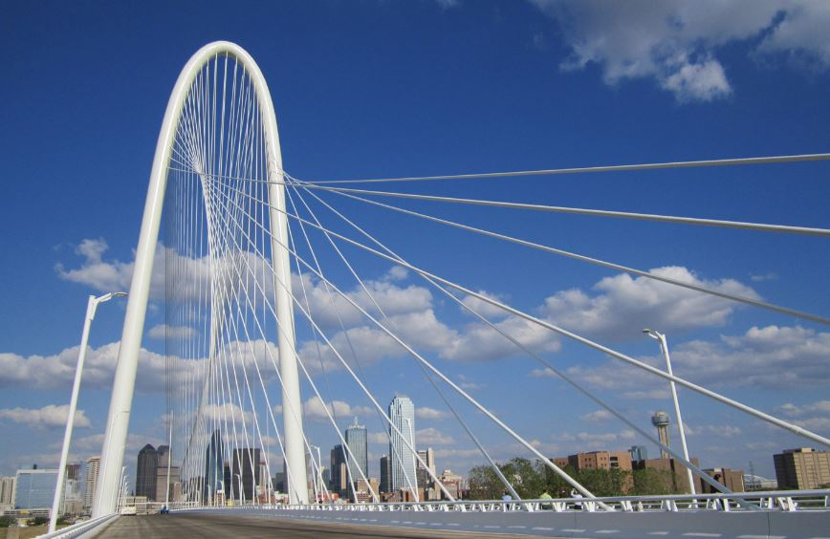
Welcome
to
Cooperative Inclusion Plan
(CIP)
Class #3: TxDOT Construction Prequalification (Prequalification Division-Austin, TX) & NTTA Bidding (Procurement Team-Dallas, TX)- May 15th, 2019

Slide 2
CIP Overview

Slide 3
Continued CIP Overview

Slide 4
Cooperative Inclusion Plan (CIP) Contacts:
Debra Wells 214-319-3553: CIP Resource Specialist
Debra.Wells@txdot.gov
Nora Perez 214-319-6456: DBE Coordinator
Noraima.perez@txdot.gov
CIP Information:
www.keepitmovingdallas.com
Thank You For Coming

Slide 5
Contact Information
Texas Department of Transportation (TxDOT)
Contract & Letting Division-Austin, TX
CST-Prequalification
200 E. Riverside Drive Michelle Casellas
Austin, TX 78704 michelle.casellas@txdot.gov
512-416-2584
CST_PREQUALIFICATION@TxDOT.gov
North Texas Tollway Authority (NTTA)
Procurement Services
5900 W. Plano Parkway, Suite 100
Plano, TX 75093
214-461-2000

