Slide 1
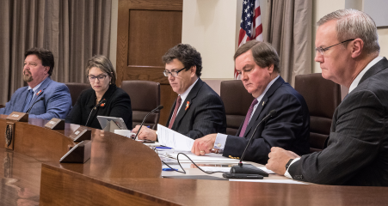
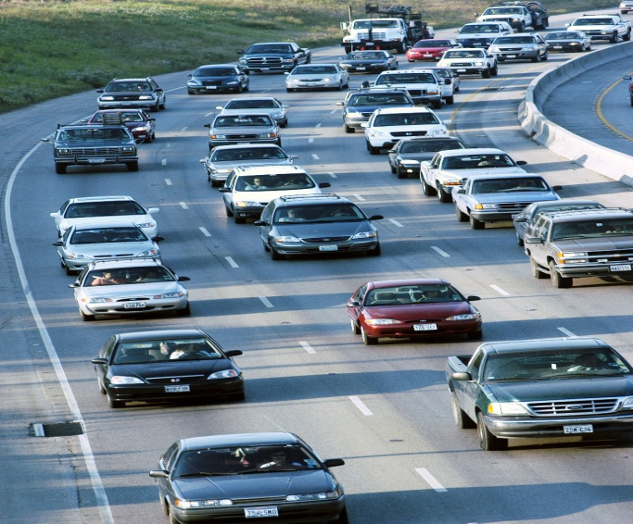
Txdot field inspection
Jimmy Davis & Gerald Waltman
6/20/19

Slide 2
TxDOT Field Inspection
1
Safety
2
SW3P (Storm Water Pollution Prevention Plan)

Slide 3
Safety Something Everyone Can Live With

Slide 4
SAFETY
Traveling Public & Worker Safety
Traffic Control
Dallas District S.O.P.
Worker Safety
Proper PPE
Housekeeping
General Appearance of Project (Safety and SW3P)

Slide 5
SAFETY

Slide 6
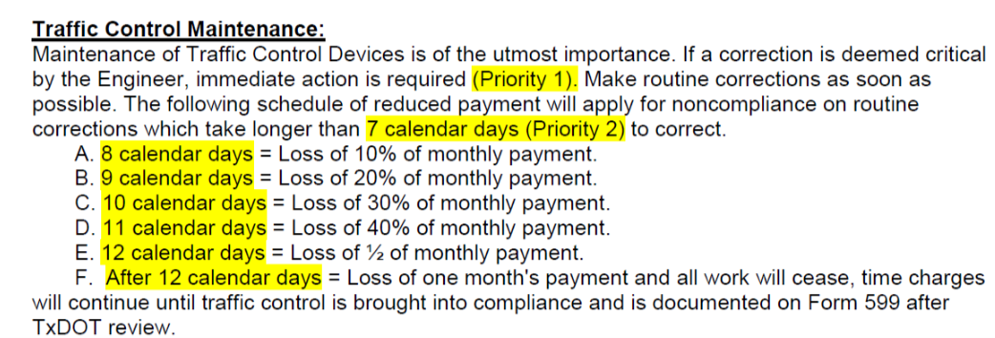
SAFETY

Slide 7
SW3P
Storm Water Pollution Prevention Plan
Inspection Form 2181
Low: Address within 7 days or before next rain event.
Medium: Address as soon as practical or as directed.
High: Must be addressed immediately, all work to cease until corrections are made.

Slide 8
SW3P

Slide 9
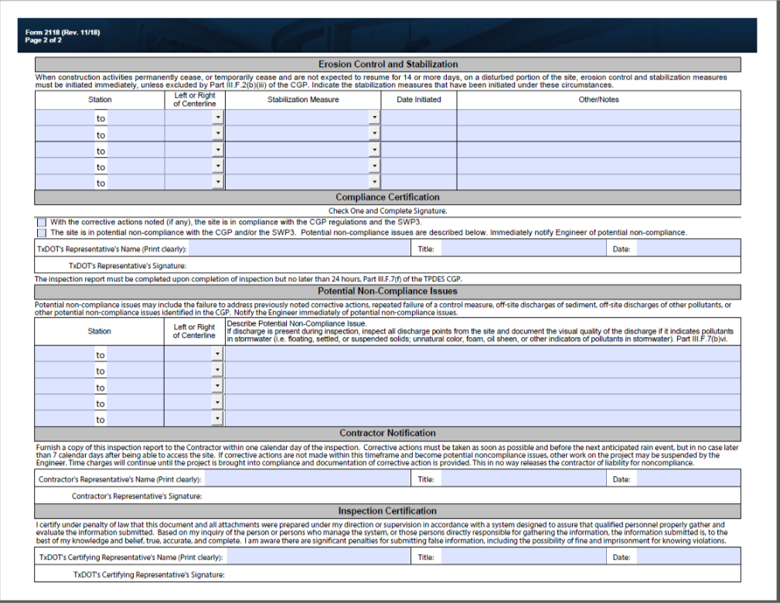
SW3P

Slide 10
SW3P

Slide 11
TxDOT FIELD INSPECTION OF CONSTRUCTION
1
Spec. Book
2
Plans
3
General Notes
4
Proposal
5
Shop Drawings
6
Materials
7
Communication

Slide 12
TxDOT FIELD INSPECTION OF CONSTRUCTION
Spec. Book
STANDARD SPECIFICATIONS FOR CONSTRUCTION AND MAINTENANCE OF HIGHWAYS STREETS, AND BRIDGES
Current Version Adopted November 1, 2014
Contains: Description, Materials, Construction, Measurement, Payment
Online version can be found online at: https://www.txdot.gov/business/resources/txdot-specifications.html
Read and understand applicable specs to work being performed

Slide 13
TxDOT FIELD INSPECTION OF CONSTRUCTION
Plans:
Table of contents
Project Layout
Quantity summaries for project items
Traffic Control Plan / Project Phasing
SW3P
May contain notes or specifics that are not found in the Spec. Book
May contain Miscellaneous Standards that apply to certain areas of work specifically for that project
Typical TxDOT Standards

Slide 14
TxDOT FIELD INSPECTION OF CONSTRUCTION
General Notes:
General Notes are found in the Proposal as well as in the Plans.
District specific details
Will contain information specific to that item number.
Information pertains to methods, payment, materials, etc.
This information is not found in the Spec Book.

Slide 15
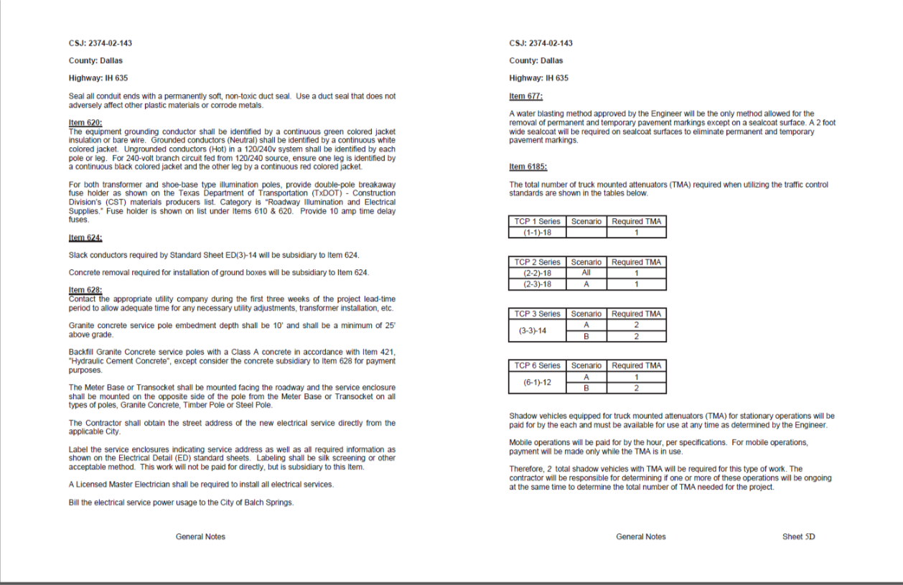
TxDOT FIELD INSPECTION OF CONSTRUCTION
General Notes

Slide 16
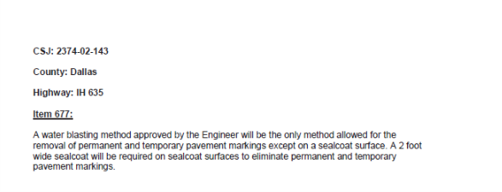
TxDOT FIELD INSPECTION OF CONSTRUCTION
General Notes
Date

Slide 17
TxDOT FIELD INSPECTION OF CONSTRUCTION
Proposal
Schedule of Bid Items
Contains Project General Notes per Item Number
List of all Specifications and Special Provisions applicable to that project
Contains Special Provisions per item number that override Spec Book sections as noted
Contains Special Specifications

Slide 18
TxDOT FIELD INSPECTION OF CONSTRUCTION

Slide 19
TxDOT FIELD INSPECTION OF CONSTRUCTION
Hierarchy :
Special Specs /Special Provisions
Plans & General Notes
Standard Specifications (Spec. Book)

Slide 20
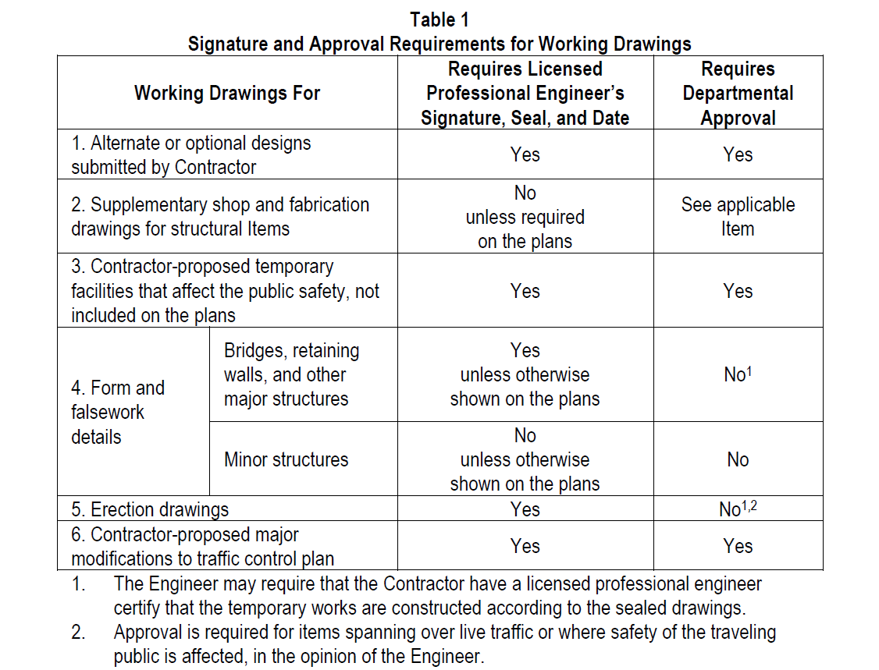
TxDOT FIELD INSPECTION OF CONSTRUCTION
Shop Drawings
2014 Spec. Book Article 5.2
Supplements the plans with necessary details not included in contract plans

Slide 21
TxDOT FIELD INSPECTION
Material Producer List
https://www.txdot.gov/inside-txdot/division/construction/producer-list.html
Each file contains:
Products
Materials
Manufacturers
Producer Codes
Files are updated often

Slide 22
TxDOT FIELD INSPECTION OF CONSTRUCTION
Have a schedule
2014 TxDOT Spec. Book article 8.5.5
Preliminary Schedule: submitted 7 days before Preconstruction Meeting.
Baseline Schedule: develop and submit within first 45 calendar days from the work start date.
Progress Schedule: submit monthly no later than the 20th calendar day of the following month.
Some Districts may differ on Progress submission date

Slide 23
TxDOT FIELD INSPECTION OF CONSTRUCTION
Communication
Daily Schedule (Provide the day before)
Talk to TxDOT Inspector
Discuss expectations
Discuss potential issues
Notify of any change of daily plan

Slide 24
Summary
Know Your Project
Have a set of Plans/Proposal
Know what kind of Certification is needed (example: flagging)
Approved Materials: https://www.txdot.gov/inside-txdot/division/construction/producer-list.html
Approve submittals (mix designs, shop drawing)
Have a schedule:
2014 TxDOT Spec. Book 8.5.5
Preconstruction Meeting:
Encourage for everyone to go

Slide 25
TXDOT Contact
Jimmy Davis
(214) 320-4409
Jimmy.Davis@txdot.gov
Gerald Waltman
(972) 542-2345
Gerald.Waltman@txdot.gov

Slide 26
Questions??
Thank you

