Slide 1
Diversity management system (DMS)

Slide 2
Diversity Management System
On February 2017, TxDOT implemented the contract compliance module of the Diversity Management System.
DMS is used for DBE commitments, contract management, and prompt payment.
All contractors on federal-aid contracts are required to use DMS in order to do work with TxDOT. All primes and DBE subcontractors must have an account in DMS.

Slide 3
Contract Letting

Slide 4
Contract Letting
TxDOT determines the DBE project goal prior to letting a construction project.
Prime contractors make a commitment to meet the goal by signing the proposal and submitting a bid.
Bidders are required to submit a DBE Utilization Plan or GFE documentation no later than 5 days after bid opening.
Prior planning will help to ensure the prime contractor is prepared to attain the DBE goal if awarded the contract.

Slide 5
Good Faith Efforts
Utilization Plan (UP)
TxDOT creates a UP record in DMS and assigns it to the apparent low bidder.
Prime contractor’s main contact in DMS is notified when the UP record has been released.
Prime contractor is required to submit the UP through DMS within five calendar days of notification that they are the apparent low bidder, unless the fifth day is a weekend or holiday, in which case the deadline moves to the next business day.
Civil Rights will either:
Return the plan.
Conditionally approve the plan.
Approve the plan.
Deny the plan.

Slide 6
Submitting a UP in DMS
Overview
The following steps are used to submit a UP in DMS:
Step | Party | Action
1 | TxDOT Civil Rights | Releases UP to prime contractor
2 | Prime Contractor | Adds subcontractor(s) to the UP
3 | DBE Subcontractor | Confirms participation
4 | Prime Contractor | Attaches GFE form and documentation (if it does not meet the DBE contract goal)
5 | Prime Contractor | Signs and submits completed UP
6 | TxDOT Civil Rights | Reviews and approves the UP

Slide 7
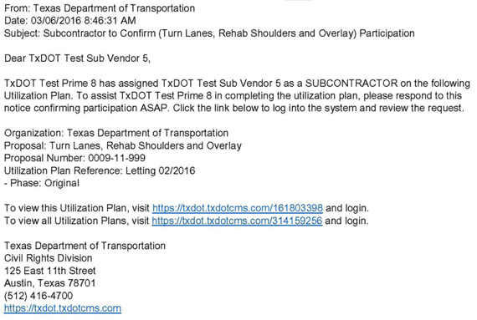
Confirm Participation Using DMS
Step 1: Notification via Email to DBE Subcontractor
Once the prime contractor has saved each commitment, the DBE subcontractor will receive the following e-mail notice from DMS.

Slide 8
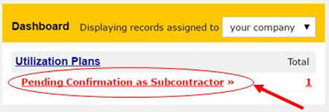
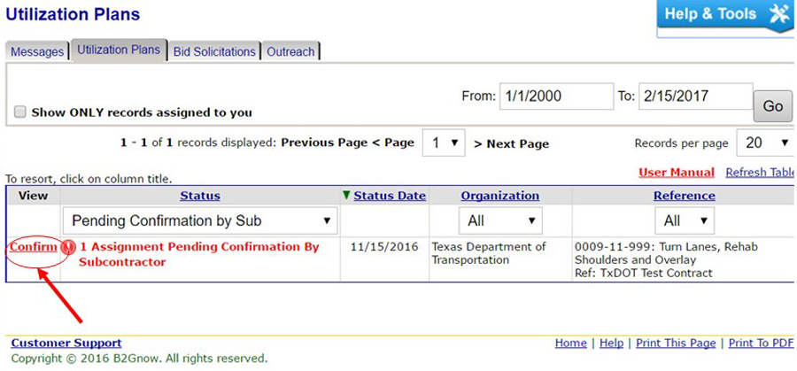
Confirm Participation Using DMS
Step 3: Navigate to Utilization Plans: Confirm Participation
Log in to DMS and find the Utilization Plans, Pending Confirmation as Subcontractor icon.
1: Click Pending Confirmation as Subcontractor.
2: Click Confirm.

Slide 9
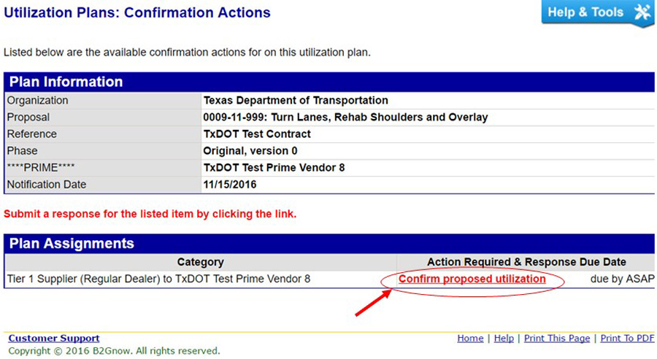
Confirm Participation Using DMS
3: Click Confirm proposed utilization.

Slide 10
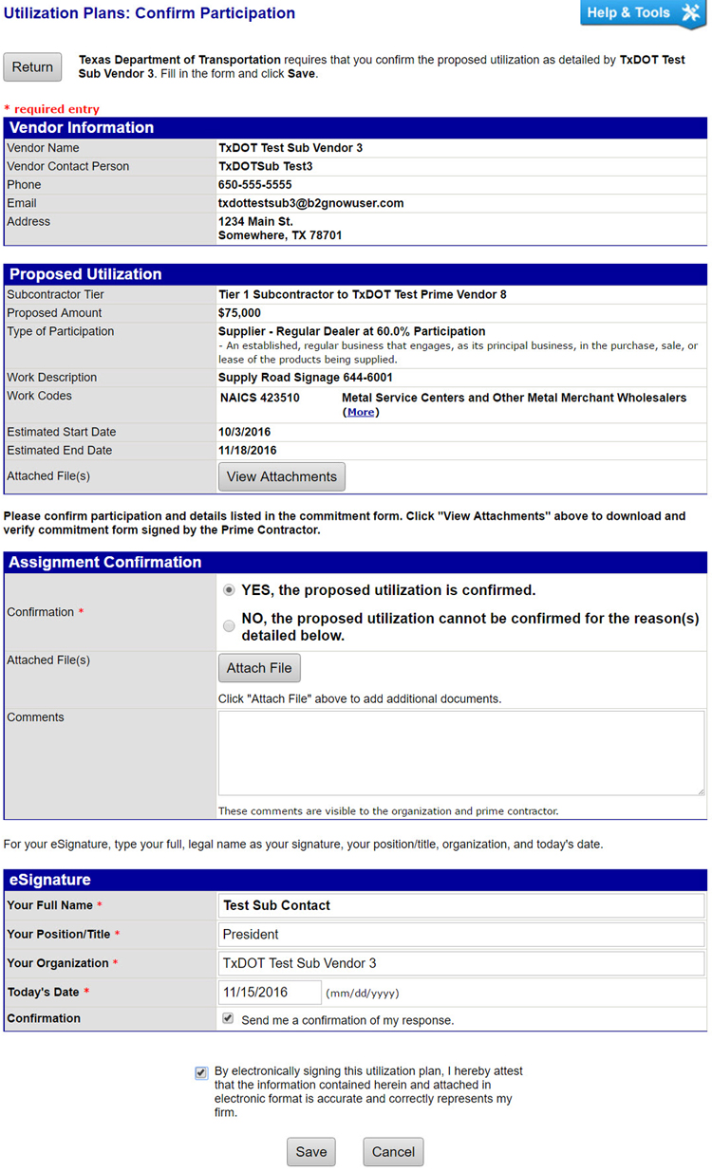
Confirm Participation Using DMS
Step 4: Confirm Participation
The DBE firm is required to confirm the commitment is correct and to e-sign.

Slide 11
Submitting a UP in DMS
The prime contractor can monitor the status of this confirmation process and send a reminder.

Slide 12
DMS Subcontractors

Slide 13
DMS Subcontractors
During the course of a project, a prime contractor may want to add additional DBE subcontractors.
The prime contractor must request approval by adding the subcontractor in DMS.
Requests must include the subcontracting firm name and contact information, a description of the work to be performed, bid items, and the total dollar amount of the subcontract.

Slide 14
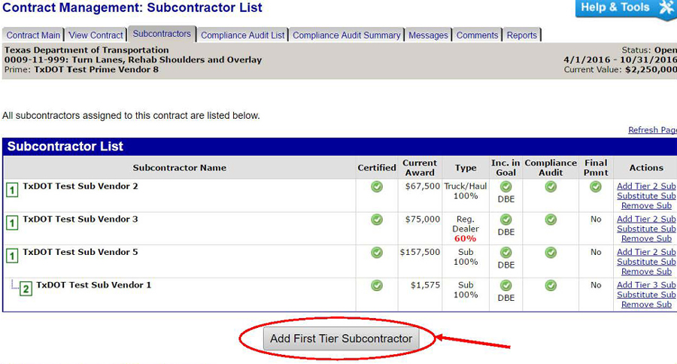
Add a DBE Firm in DMS
Steps to add a DBE firm in DMS.
Step 1: Log in to DMS.
Step 2: Navigate to Page: Contract Management: Subcontractor List.
Step 3: Click Add First Tier Subcontractor.

Slide 15
Add a DBE Firm in DMS
Step 4: Fill out required fields on the Contract Management: Add Subcontractor. Selecting the goal, and credit type will also be required.
Step 5: Click Review.
Step 6: Review for accuracy and click Submit.
DMS will automatically notify TxDOT of the prime contractor’s request to add a subcontractor. Any changes to DMS may not be visible until the request is approved.

Slide 16
Payments

Slide 17
Payments
Prompt Payment
TxDOT specifications requires prime contractors to pay all subcontractors, material suppliers, and truckers within 10 days from when a prime contractor receives a payment from TxDOT.
Prime contractors must also pay any retainage on subcontractor’s work within 10 days after satisfactory completion.
Satisfactory completion is accomplished when:
The subcontractor fulfills the contract requirements of TxDOT and subcontracted work, including submittal of all information required by the contract and TxDOT.
TxDOT has inspected and approved the subcontractor’s work.

Slide 18
Payments
Final Reimbursement to Prime Contractor
TxDOT cannot make the final reimbursement to the prime contractor until TxDOT :
Approves the completion of the project construction.
Receives and reviews all necessary documentation, including the DBE Program requirements.
Prompt Payment – Non-Compliance
TxDOT may pursue actions against the prime contractor for failure to execute prompt payment requirements.

Slide 19
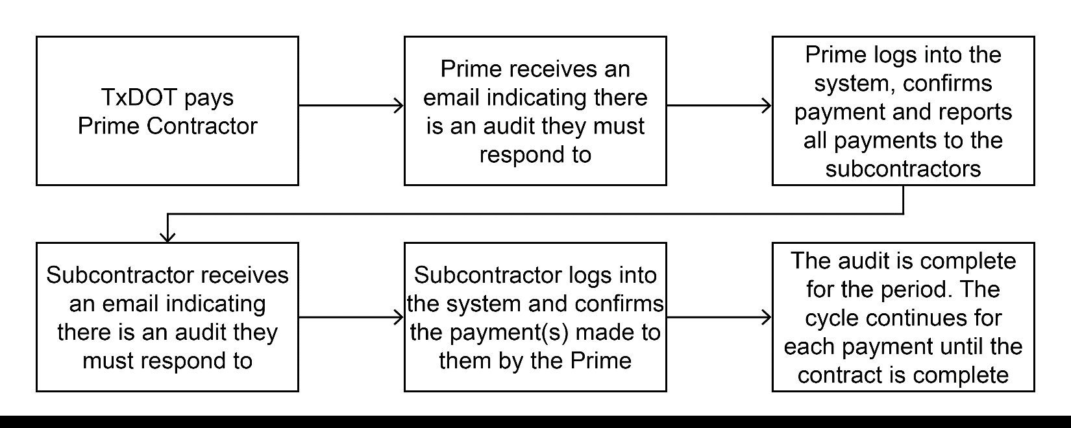
Payment Reporting in DMS
Understanding the Audit Process
TxDOT maintains a running tally of DBE attainments (commitments and payments).
Payments are tracked in DMS.
A contract is ready for auditing once TxDOT begins making payments to the prime contractor.
Auditing is generated on a monthly basis using the following audit process:

Slide 20
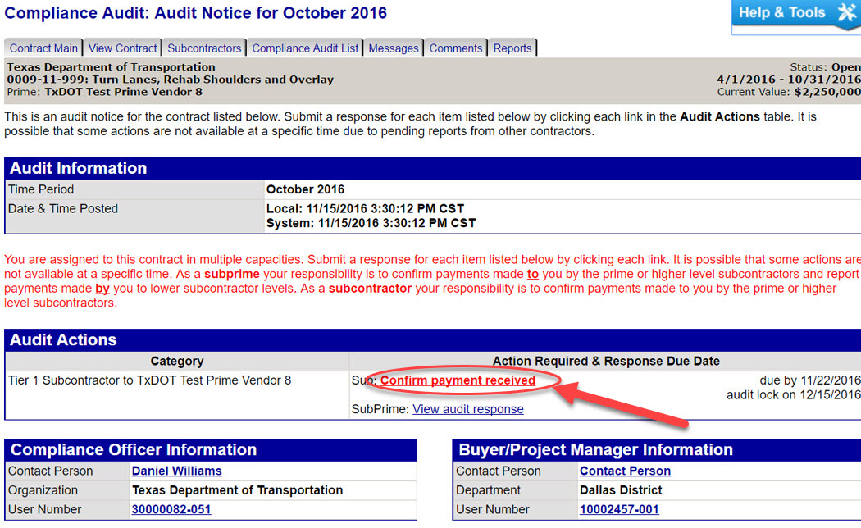
Payment Reporting in DMS
Step 3: Click Confirm payment received.

Slide 21
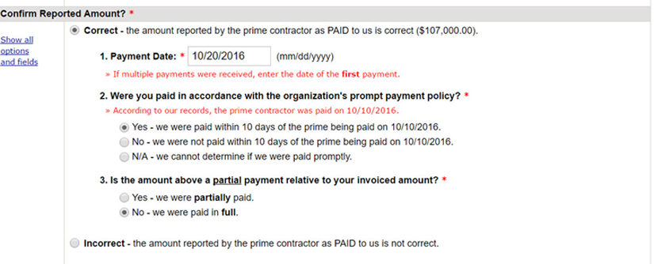
Payment Reporting in DMS
Step 4: Verify the payment amount and details provided by the prime contractor.
If the subcontractor selects Correct for the payment, it then enters the payment date, and confirms if it was paid within ten days of the prime being paid.

Slide 22
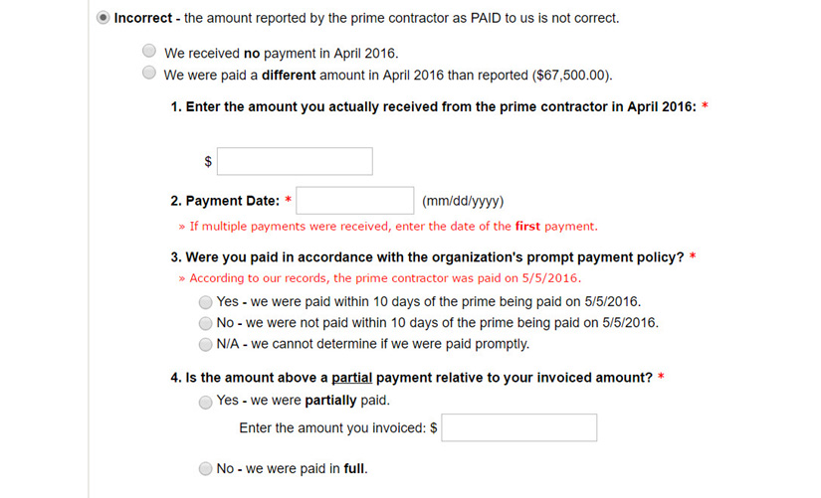
Payment Reporting in DMS
If the subcontractor selects Incorrect for the payment amount, DMS will prompt the subcontractor to enter the amount it was paid. The subcontractor is then asked to enter the payment date and if it was paid within ten days of the prime contractor being paid.

Slide 23
Payment Reporting in DMS
Step 4: Verify the payment amount and details provided by the prime contractor.
If the subcontractor selects Correct for the payment, it then enters the payment date, and confirms if it was paid within ten days of the prime being paid.

Slide 24
Payment Reporting in DMS
If the subcontractor selects Incorrect for the payment amount, DMS will prompt the subcontractor to enter the amount it was paid. The subcontractor is then asked to enter the payment date and if it was paid within ten days of the prime contractor being paid.

Slide 25
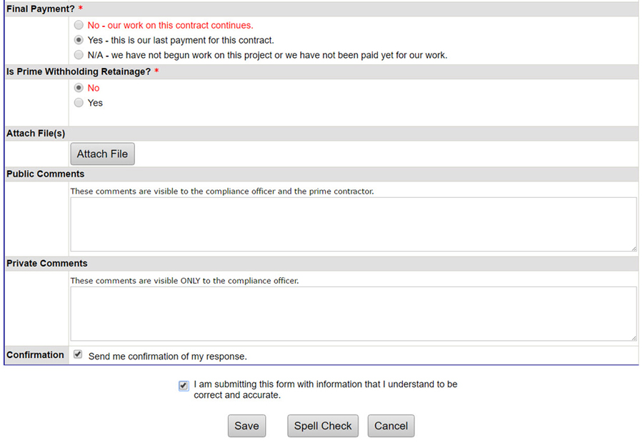
Payment Reporting in DMS
Step 5: Identify if payment is final or not.
Step 6: Identify if the prime contractor is withholding retainage.
Step 7: Attach necessary files by clicking Attach File.
Step 8: Provide any public or private comments.
Step 9: Check the confirmation statement.
Step 10: Click Save.

Slide 26
Training

Slide 27
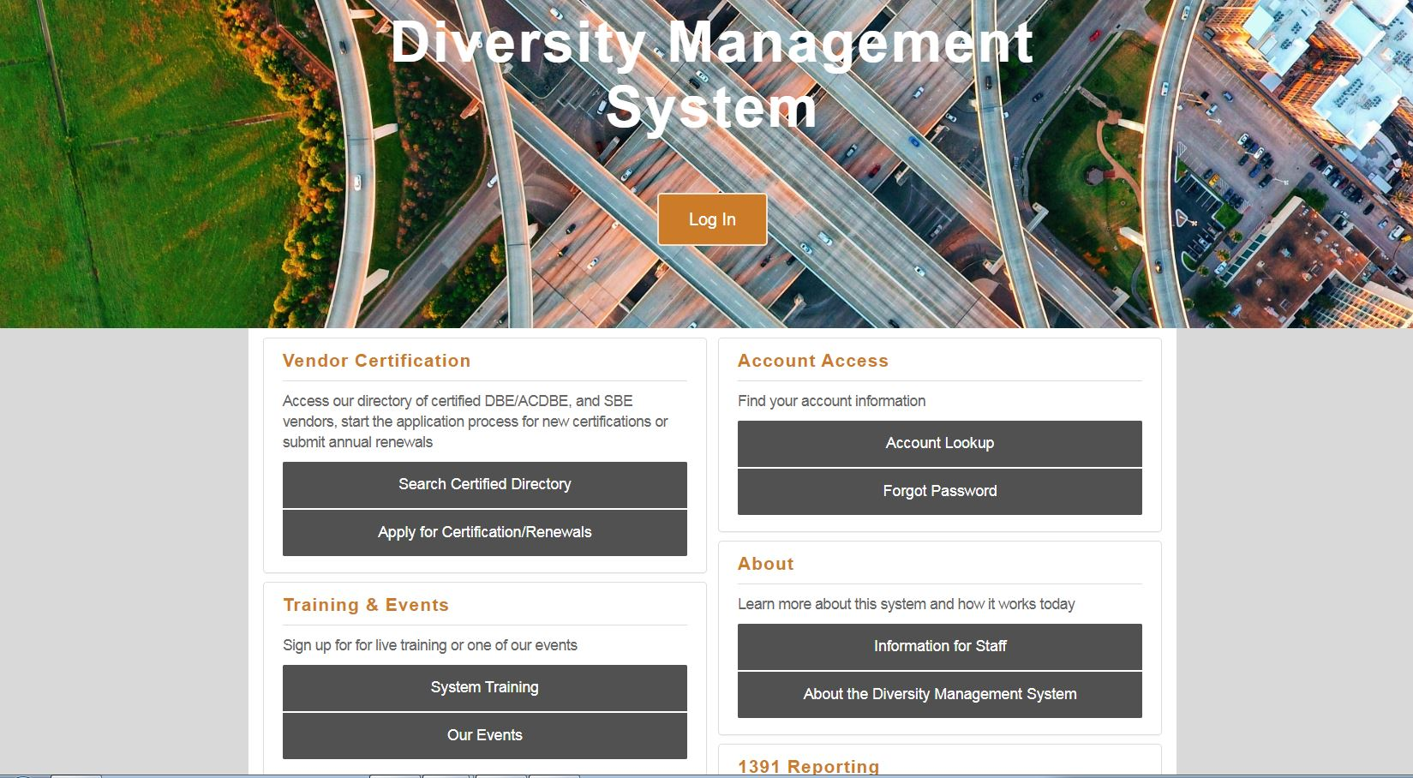
Training
Diversity Management System
Training provided by B2Gnow.
Courses include:
Vendor registration and questionnaire
An introduction to the system
Utilization plan and contract compliance reporting

Slide 28
Additional TxDOT References
Diversity Management System Guides

Slide 29
Questions?

Slide 30
Contact Information
Texas Department of Transportation
Civil Rights Division
125 East 11th St.
Austin, TX 78701
(512) 416-4700
CivilRights@txdot.gov
www.txdot.gov

