Slide 1
Cooperative Inclusion Plan – Workshop Texas Department of Transportation (TxDOT) Dal Trans Building, 4625 East Hwy 80, Mesquite, Texas 75150 Thursday, May 25, 2017 9:00 AM – 11:00 AM Presenter: Anthony Coleman, Director of Business Diversity Phone: (214) 224-2288 Email: acoleman@ntta.org

Slide 2
PROCUREMENT SERVICES 5900 W. Plano Parkway Plano, TX 75093 (214) 461-2000 Monday – Friday 8 a.m. – 5 p.m. www.NTTA.org

Slide 3
What Does NTTA Purchase?
Roadway:
Construction
Maintenance
Infrastructure
Professional Services:
Architecture
Engineering
Temporary Contract Labor
Training
Information Technology:
Services
Hardware/Software
Other:
Vehicles
Building Improvements
Materials & Supplies
Tools
Landscaping
Uniforms
Advertising & Marketing
NTTA Annual Spend
$250M - $450M

Slide 4
Responding to an Opportunity
Register on eBids
Earn D/M/W/SBE certified, if applicable
Download solicitation package ntta.org/procurement
Attend pre-submittal conference
Ask questions if something isn’t clear
Be comprehensive: Answer all requirements and complete every form
Be responsive: Have required bonds, insurance, etc.

Slide 5
Responding to an Opportunity
Know
Solicitation
Types
Know
Solicitation
Types
Meet
Deadlines
Be
Competitive
Request for Qualifications
Request for Bid
Request for Proposal
Informal Bids
Late responses will NOT be considered
Offer your most competitive bid/proposal

Slide 6
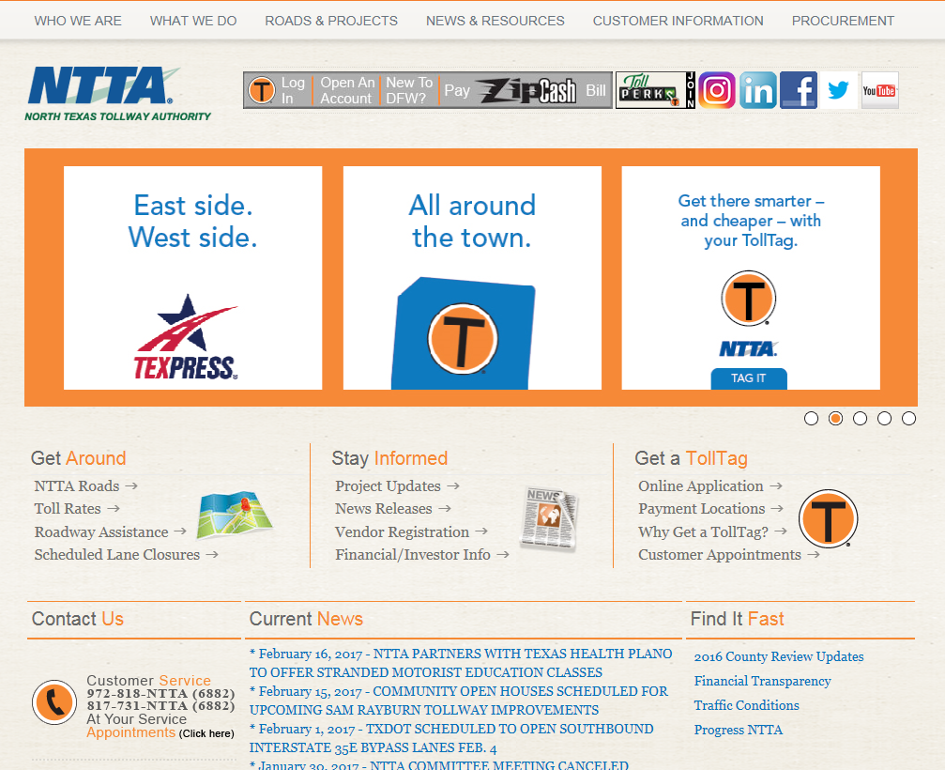
Finding Us
Go to NTTA.org
Select Procurement
Tab
Select Opportunities

Slide 7
Identifying Upcoming Opportunities

Slide 8
Contacting Procurement
Brandy Adamson
(214) 224-3041
Badamson
@ntta.org
Customer Service
HR
Information Technology | Infrastructure
Legal
Christi Ikeda
(214) 224-2274
cikeda@ntta.org
Informal Purchases
Cooperatives
Exempt Purchases <$300K
Beatriz Eduardo (214) 224-2299
Beduardo
@ntta.org
Informal Purchases
Reginald Valentine
(469) 608-6840
Rvalentine
@ntta.org
Project Delivery
Farouk Hashem (469) 276-4336
Fhashem
@ntta.org
Audit
Maintenance
System Incident Management
Carolyn Schwartz
(214) 224-2140
Cschwartz
@ntta.org
Collections/TER
Public Affairs
Finance
Information Technology | Operations

Slide 9
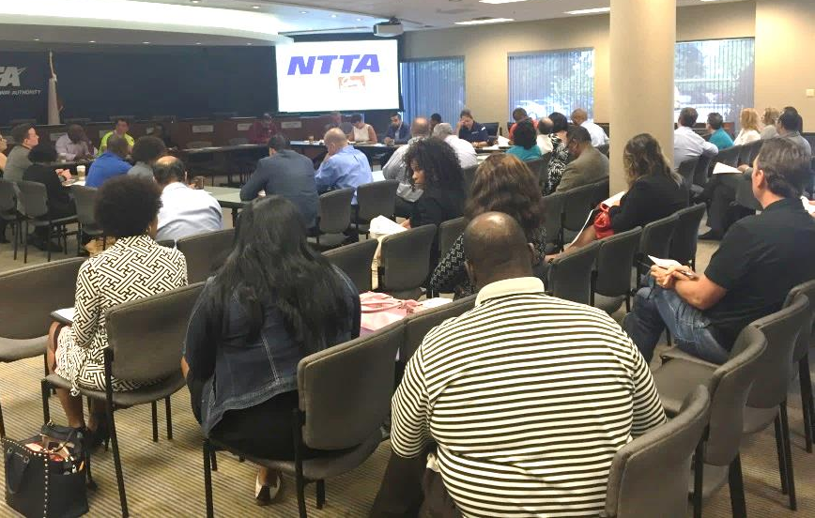
Getting Connected
2nd Wednesday Business Chats
Learn about NTTA procurement opportunities
Find out how to register as a vendor
Meet NTTA stakeholders
Get to know NTTA
Next Business Chat:
Wednesday, June 14th
10 – 11 a.m.
NTTA Boardroom
5900 West Plano Parkway
Plano, Texas 75093
To RSVP, send an email to:
vendoroutreach@ntta.org

Slide 10
Getting Connected
More Ways
Business Diversity Advisory Council
Cooperative Inclusion Plan

Slide 11
Purpose of the ROAD Program Relationships and Opportunities Advancing Diversity (ROAD) Program seeks to promote and facilitate relationships between prime and consultants to foster opportunities for disadvantaged, minority and women business enterprises to participate in large NTTA contracts.
How the program works
Primes and professional representatives from their firm
will work directly with the consultant firm to develop a plan
to build capacity and commit to exposing the consultant to
major aspects of business relevant to his/her firm, access to
resources and training in agreed upon areas that can include
business development, technical and managerial proficiency,
human resource development, management
strategies, marketing, and project management.
During the program period, consultants will participate
in seminars, workshops and networking events that expose
them to the most competitive firms in the industry.

Slide 12
ROAD Program Objectives
NTTA promotes and facilitates relationships through the ROAD Program
Expand consultants’ scope and specialization of services and capabilities
Develop the consultants’ bidding capabilities
Broaden the consultants’ exposure to the process, execution and management of larger, more complex contracts
Develop more robust accounting procedures and reporting
Create a dialogue that includes coaching, innovation, guidance and best practices
Notes:
Facilitating growth of D/M/W/SBEs is important as the NTTA looks to have greater participation among D/M/W/SBEs on larger-scale projects. The NTTA implemented the Relationships and Opportunities Advancing Diversity (ROAD) Program that follows a mentor-protégé model used by other transportation organizations in the country. The program focuses on providing opportunities for ready, willing and able D/M/W/SBEs to increase business management, organization and professional skills through partnerships with established contractors that provide similar services
There will be an informational session and kick-off event conducted at the NTTA on June 27th starting at 6:00 p.m., all interested firms should schedule to attend this event. For more information, contact the Business Diversity Department.

Slide 13
ROAD PROGRAM Selection Process (at a glance)
The ROAD Program Oversight Committee
will approve all interested primes and consultants.
Participants will complete an application and submit business plan/company profile for consideration in the program. Submissions will be evaluated on the basis of their responses to all provisions of this document.
The Authority may use some or all of the criteria in its evaluation and comparison of proposals submitted. Once approved, consultants are paired with primes based on developmental need.

Slide 14
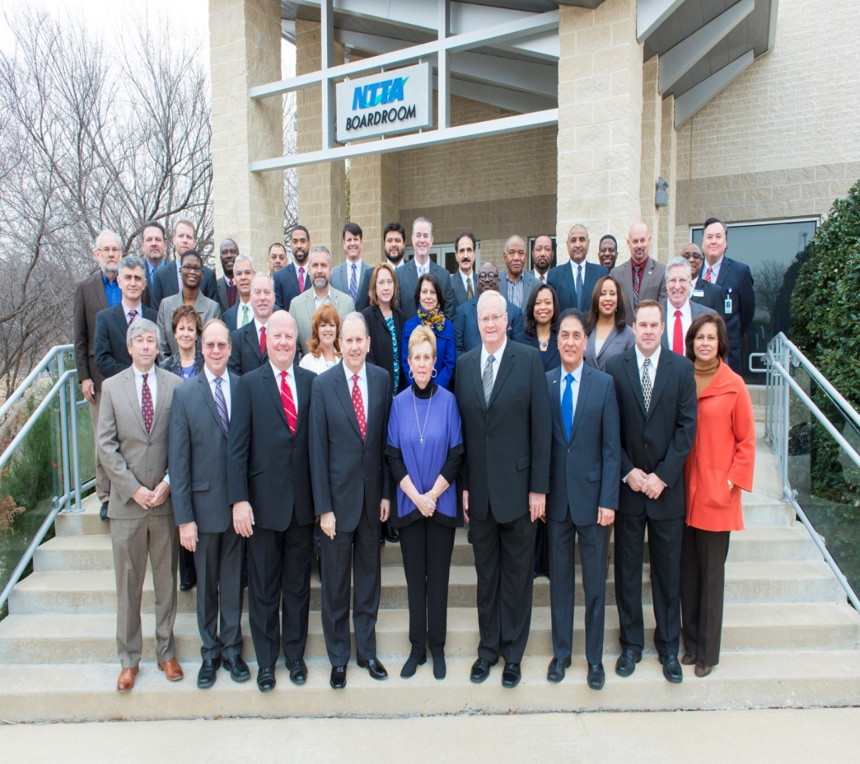
2016 – 2018 ROAD Program Participants
Notes:
The 2016 – 2018 ROAD Class was introduced the Board of Directors , January of this year.
2016-2018
ROAD Program Participants

Slide 15
2016 – 2018 ROAD Program Participants
PRIME | CONSULTANT
AECOM Technical Services, Inc. | PSA Constructors, Inc.
Atkins, Inc. | Foster CM Group, Inc.
Austin, Bridge, and Road | EJ Smith Construction Company, LLC.
Burns & McDonnell Engineering Co., Inc. | Project Management Associates, PLLC.
C&M Associates, Inc. | Consumer Market Insights (CMI)
Notes:
These are the 10 teams – and 20 companies – that comprise the 2016 through 2018 class

Slide 16
2016 – 2018 ROAD Program Participants
PRIME | CONSULTANT
EJES, Inc. | M. Vassigh & Associates
HNTB Corporation | Dikita Engineering
Kimley-Horn and Associates | LCA Environmental, Inc.
Michael Baker International | Hayden Consultants, Inc.
Notes:
Here are the next five and last teams for the 2016 – 2018 ROAD program participants.

Slide 17
Interested in the North Texas Tollway Authority’s next
Relationships and Opportunities
Advancing Diversity (“ROAD”) Program?
At the ROAD Informational Workshop, interested parties will find out:
NTTA Business Diversity Department “ROAD PROGRAM!” Informational Session
* Structure of the program
*Requirements of each participant
*Benefits of participation
*Instructions for applying to the program
*Information about program oversight and governance
*Details about other NTTA business diversity initiatives and contracting opportunities
Tuesday, July 25th 6:15 p.m. – 7:30 p.m. NTTA Boardroom 5900 West Plano Parkway, Suite 200 Plano, TX 75093
To RSVP, please send an email to: vendoroutreach@ntta.org with your company’s contact information. NOTE: Applications will not be available until
after the workshop has been conducted.

Slide 18
Questions?

