Slide 1
Virtual House Keeping Rules
Microphones will be automatically muted upon entry
Please turn off video if it’s activated
You can ask questions in the Q & A area on the right of your screen (directly to panelist and/or to other attendees)
There will be a Q & A additional section at the end of the presentation.

Slide 2
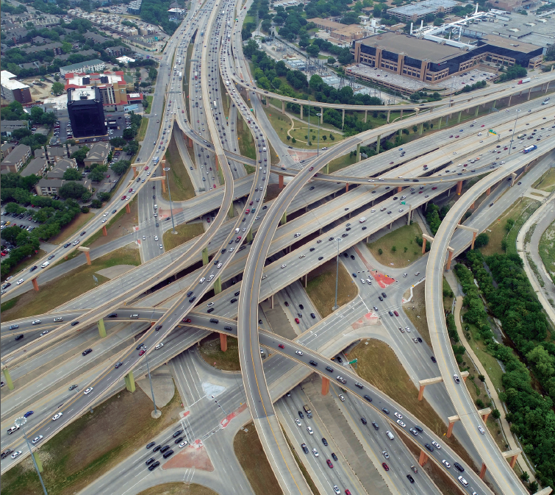

Cooperative Inclusion Plan
(CIP)
Host: Debra Wells
CIP Resource Specialist-TxDOT Dallas District
Co-Host: Noraima (Nora) Perez
DBE Coordinator-TxDOT Dallas District

Slide 3
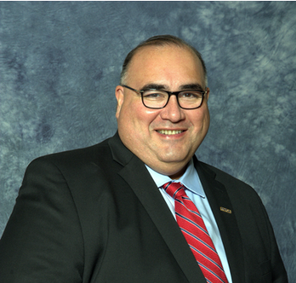


CIP Welcome
John H. Martinez-D.
President & CEO
Regional Hispanic Contractors Association (RHCA)

Slide 4

Cooperative Inclusion Plan
Debra Wells
CIP Resource Specialist
Texas Department of Transportation

Slide 5
What is (CIP)?
The Cooperative Inclusion Plan (CIP) is a comprehensive approach to addressing the shortage of disadvantaged, minority, women, and small businesses and historically underutilized businesses (D/M/W/SBE and HUB) firms in heavy highway contracting.
The CIP Team holds free workshops/trainings, open to the public for contractors and consultants who perform work in the heavy highway construction industry. The target audiences are minority contractors, consultants and providers of goods and services from the heavy highway construction industry.

Slide 6
Six (5) CIP Partners:
Texas Department of Transportation (TxDOT)
North Texas Tollway Authority (NTTA)
Regional Hispanic Contractors Association (RHCA)
Associated General Contractors of Texas (AGC)
Asian American Contractors Association of Texas (AACATX)

Slide 7
CIP Goals:
Expand pool of qualified D/M/SBE and HUB Firms certified to perform heavy highway construction.
Increase dollars spending with local D/M/W/SBE and HUB Firms in heavy highway construction.
Grow bonding capacity of D/M/W/SBE and HUB Firms.
Increase number of D/M/W/SBE and HUB Firms serving in prime roles.

Slide 8
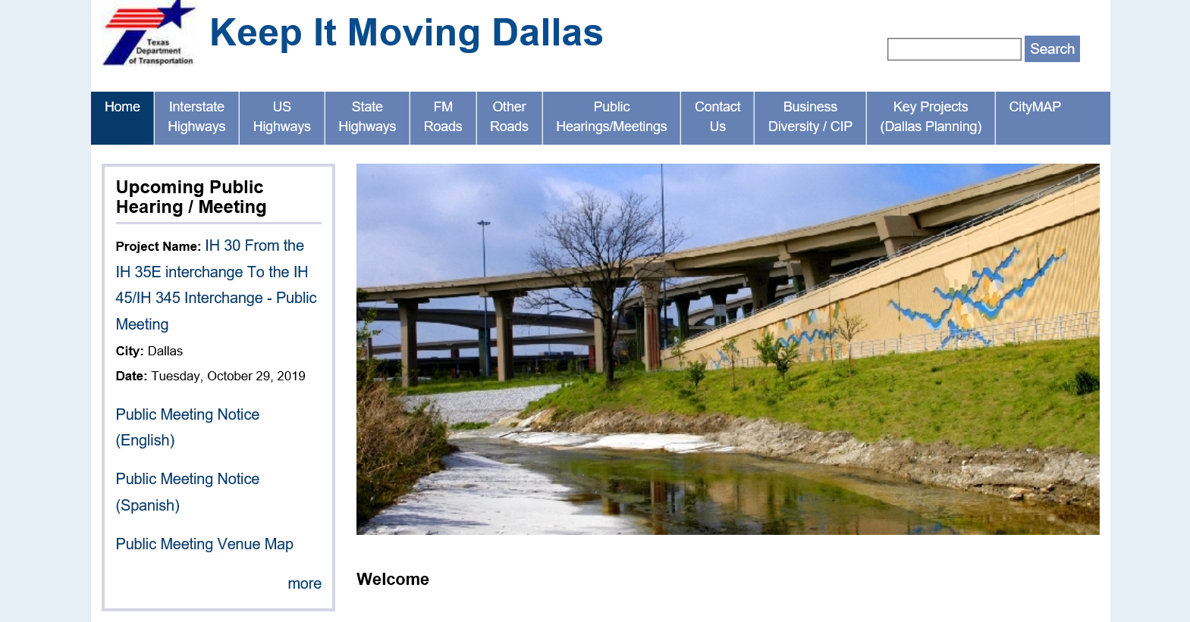
CIP Website: www.keepitmovingdallas.com

Slide 9
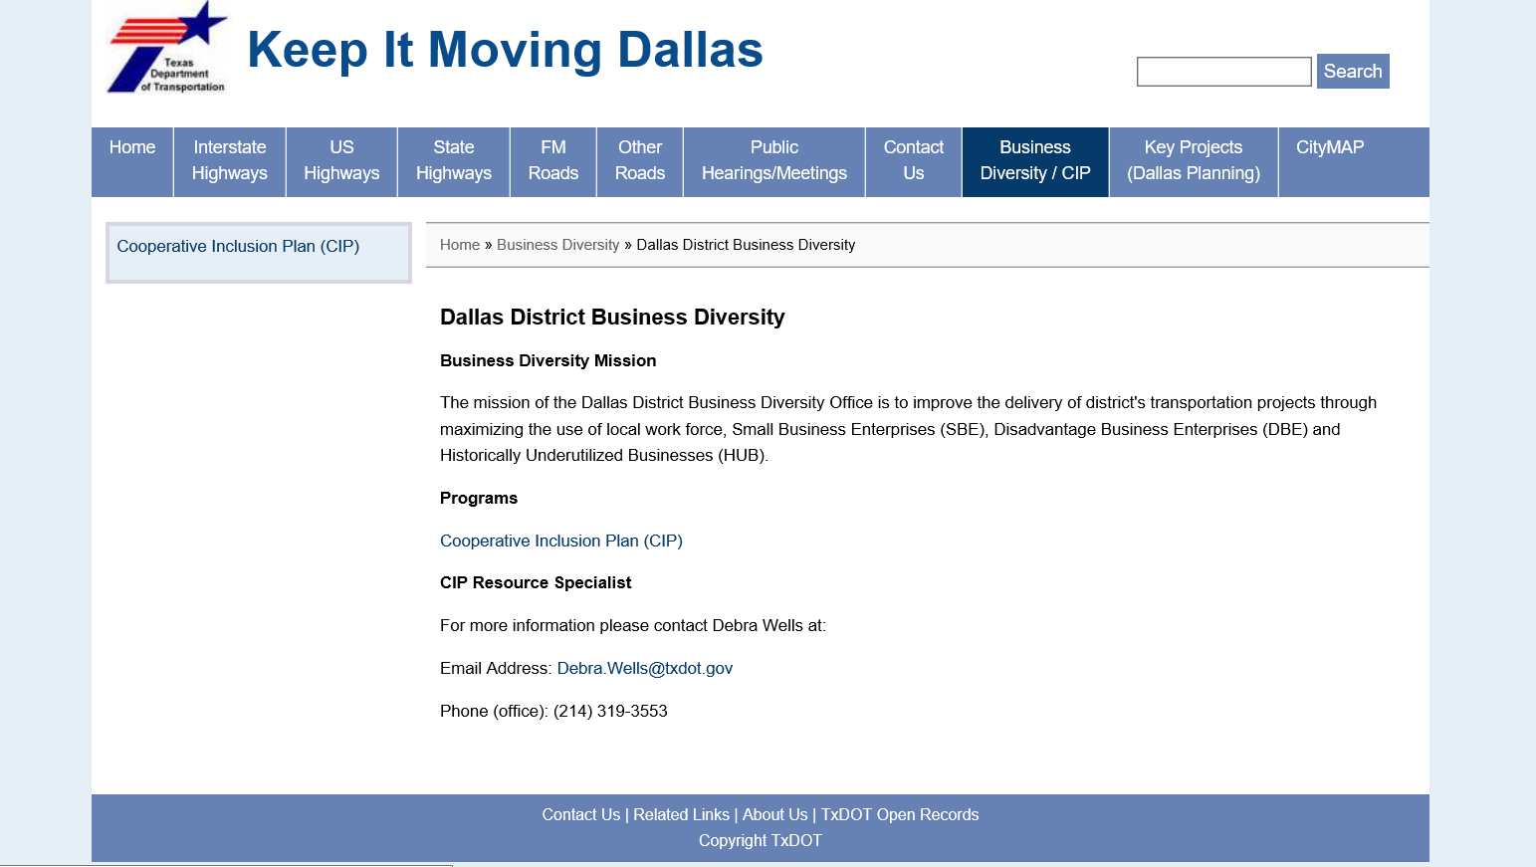
Cooperative Inclusion Plan Information:

Slide 10
Cooperative Inclusion Plan (CIP) Contacts:
Debra Wells 214-319-3553: CIP Resource Specialist
Debra.Wells@txdot.gov
Nora Perez 214-319-6456: DBE Coordinator
Noraima.perez@txdot.gov
CIP Resource Guide on
www.keepitmovingdallas.com

Slide 11
Polling Question #1
Have you attended a CIP event in the past?
Yes
  Workshop
  Class
No

Slide 12
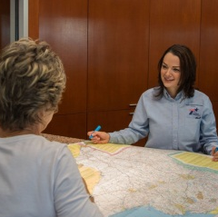
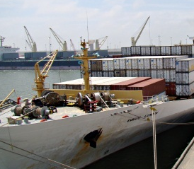

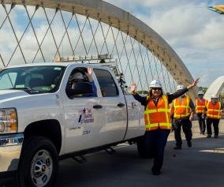

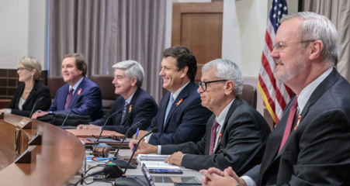
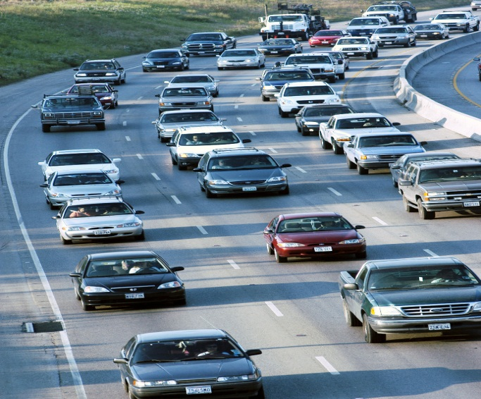
Prequalification
Instructions for New Contractors
Construction Division
July 30, 2020

Slide 13

Visit www.txdot.gov

Slide 14
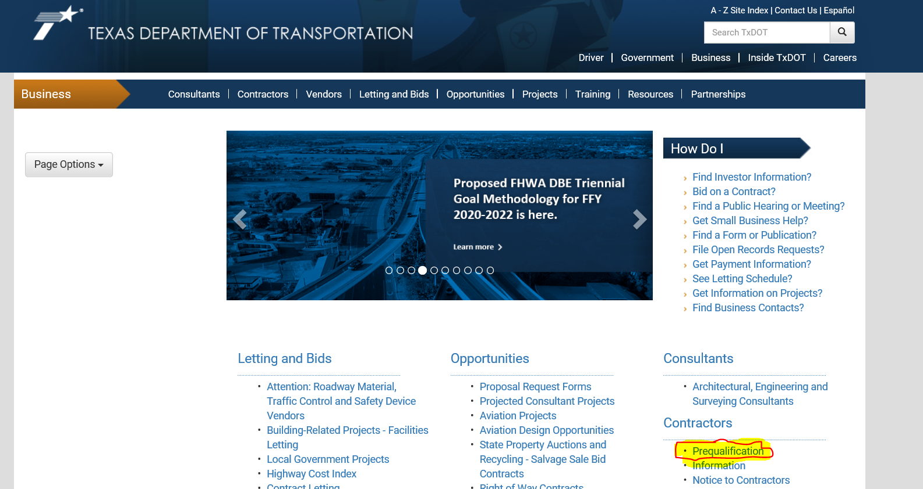

Slide 15
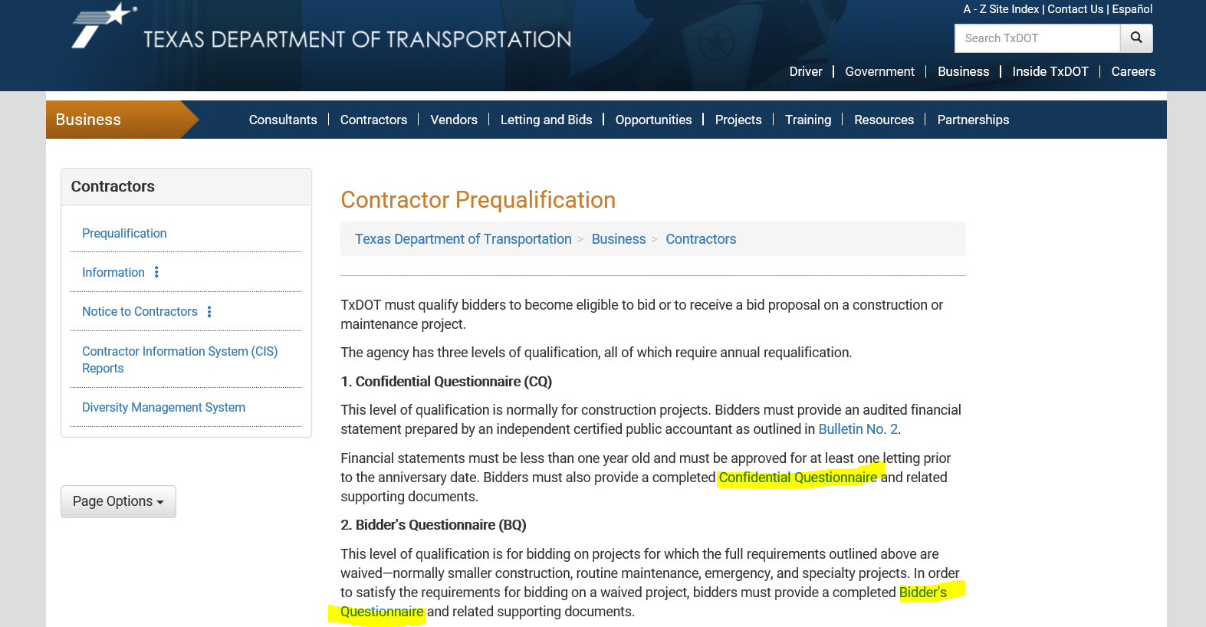

Slide 16
General information
All prime contractors must be prequalified by TxDOT.
Subcontractors do not need to be prequalified.
TxDOT determines contractor bidding capacity based on multiple factors.
Qualification lasts for one year from submission date or financial statement date if submitted.

Slide 17
Confidential Questionnaire
Standard requirement on most Construction projects.
Requires audited financial statements.
Bidding Capacity is derived from the contractor’s net working capital (current assets – current liabilities) multiplied by a factor determined by the department.

Slide 18
Bidder’s questionnaire
Qualifies contractor to bid on Waived projects.
  Waived projects include small construction, routine maintenance, emergency, and specialty projects.
Default bidding capacity of $300,000.
  If financials are submitted this number can substantially raise depending on working capital and completed projects.

Slide 19
Completing the questionnaire
The questionnaire you choose to complete must be read in full and every question requires a response.
The Confidential Questionnaire requires the financial data to be organized within the document in addition to the audited financial statement. This is to ensure an expeditious analysis by our staff.
Financial statements must be prepared for the qualifying entity. If they are prepared for the parent company, there must be a consolidating balance sheet reflecting the qualifying entity’s numbers separately.
Bidding Capacity is set solely based on the qualifying entity’s financial data

Slide 20
Process and timeframe
Contractors are required to submit their prequalification paperwork 10 days in advance of a project they wish to bid.
If financial statements are included, they must be prepared by a CPA firm and must be no older than one year.
Upon receipt, TxDOT will reach out and walk you through the process:
  Revising the paperwork to correct any deficiencies,
  Setting up an ICX (integrated contractor exchange) account,
  Requesting or submitting bids.

Slide 21
Filing Requirements
Filing of Assumed Name Certificates,
Registration with the Texas Secretary of State

Slide 22
CPA License
For the lowest level of qualification, financials are not a requirement.
All financials submitted must be prepared by an independent CPA firm.
In-house or self prepared financials are not acceptable.
Use the Texas State Board of Public Accountancy to locate and verify CPAs.

Slide 23
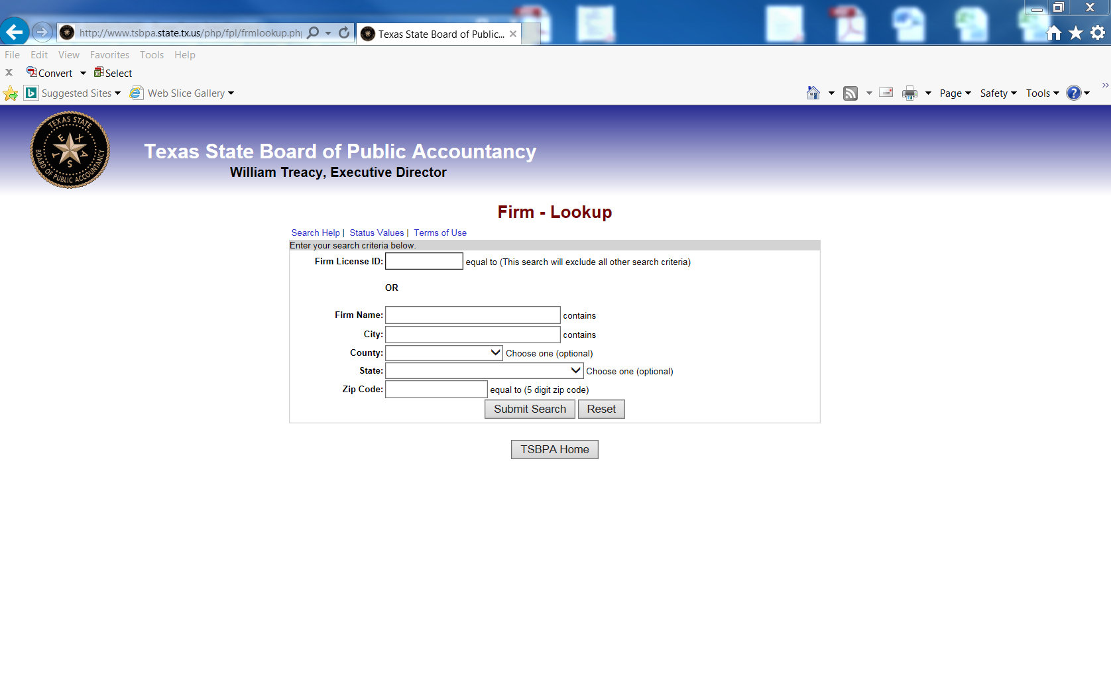
CPA license
All Financial statements submitted must be prepared by an independent CPA firm. You can validate a CPA firm’s license by visiting the Texas State Board of Public Accountancy website.

Slide 24
Electronic bidding system
During the qualification process, an electronic bidding system account will be created
This will allow contractors to request bid authorizations, regardless of whether they choose to bid by paper or electronically
This will also allow contractors to submit bids electronically

Slide 25
Electronic bidding system
TxDOT uses the Integrated Contractor Exchange (iCX) as the TxDOT Web-based Electronic Bidding System.
No updates/installations on the contractor side.
Easy to use system.
No setup required.
Functional system.
Alerts and notifications.
Allows contractors to login and request authorization to bid.
Allows contractors to bid electronically should they be inclined.
Allows contractors to set user role authority, such as solely allowing an employee to request proposals, view bid items, or full authority on behalf of their account.

Slide 26
Bidding by Electronic vs. Paper
Substantially increased chance of bid being deemed successful.
Functionally easier to receive and submit bid.
Ability to withdraw or revise your bid anywhere.
Automatic notifications are provided to contractors whom are set up to bid electronically.

Slide 27
For questions please contact us:
By Phone at 512-416-2584,
or Email: cst_prequalification@txdot.gov

Slide 28
Polling Question #2
How did you hear about today’s event?

Slide 29
Project Delivery
NTTA 5-Year Capital Plan
and Construction Opportunities
Mark A. Bouma, P.E.

Slide 30
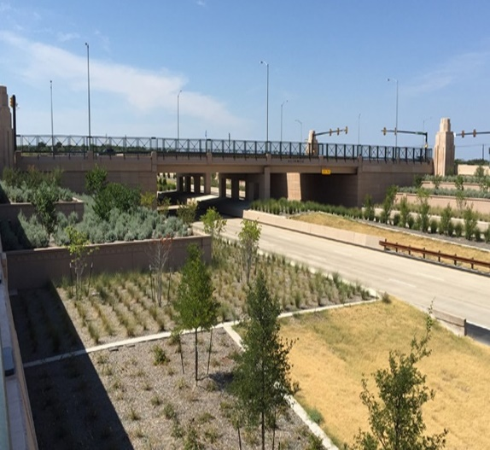

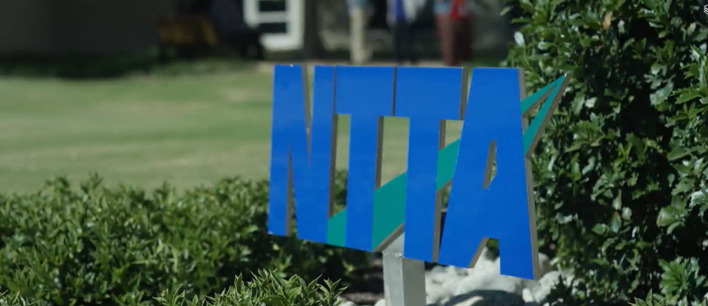
NTTA’s Five Year Capital Plan
  Expansion
  Maintenance/renewal
  Safety Improvements

Slide 31
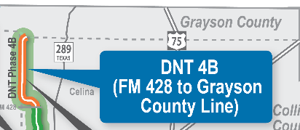
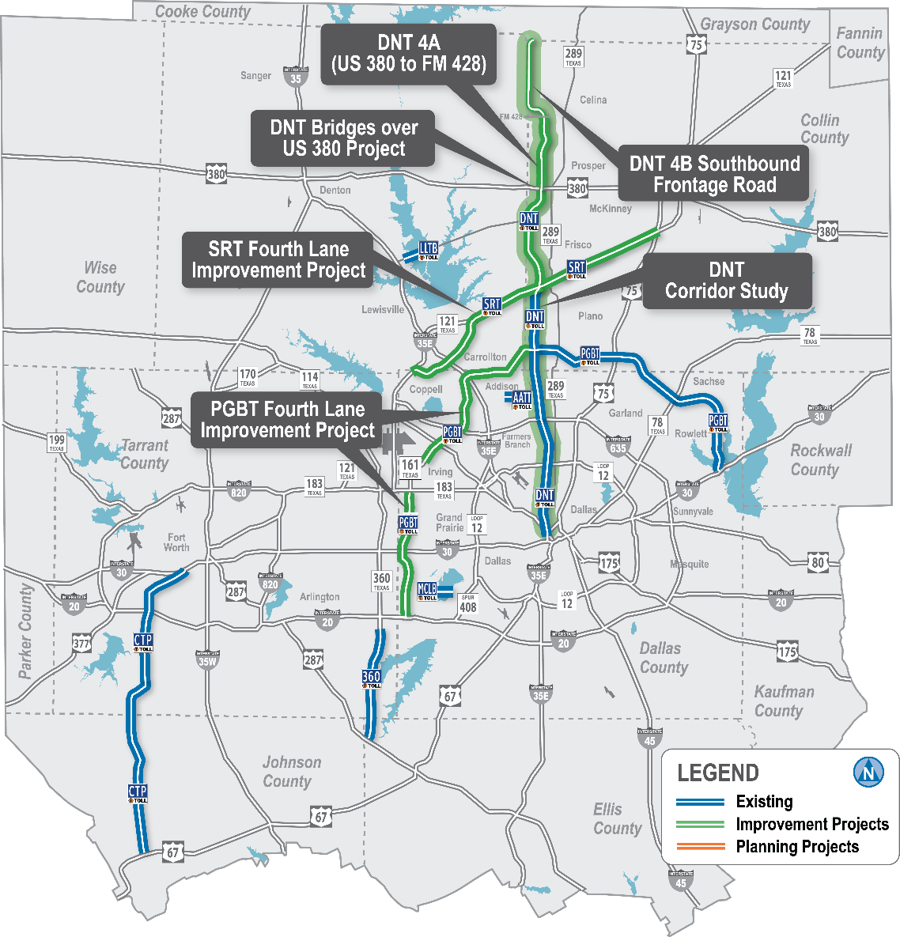
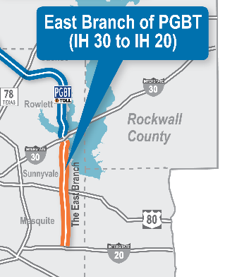
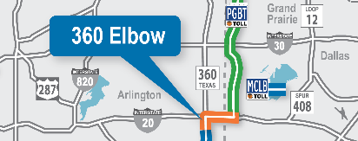

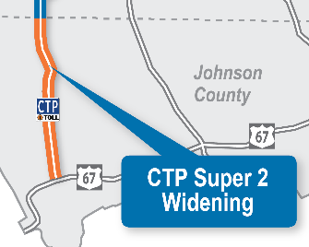
Five-year
Capital plan
2020-2024

Slide 32

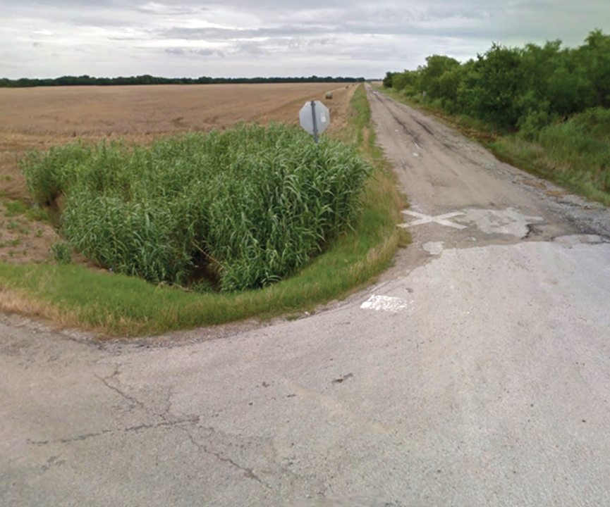

DNT 4B Frontage Rd
(FM 428 to Grayson Co. Line)
Construction
Pre-Bid Mtg: July 28, 2020
Letting: Aug 20, 2020

Slide 33
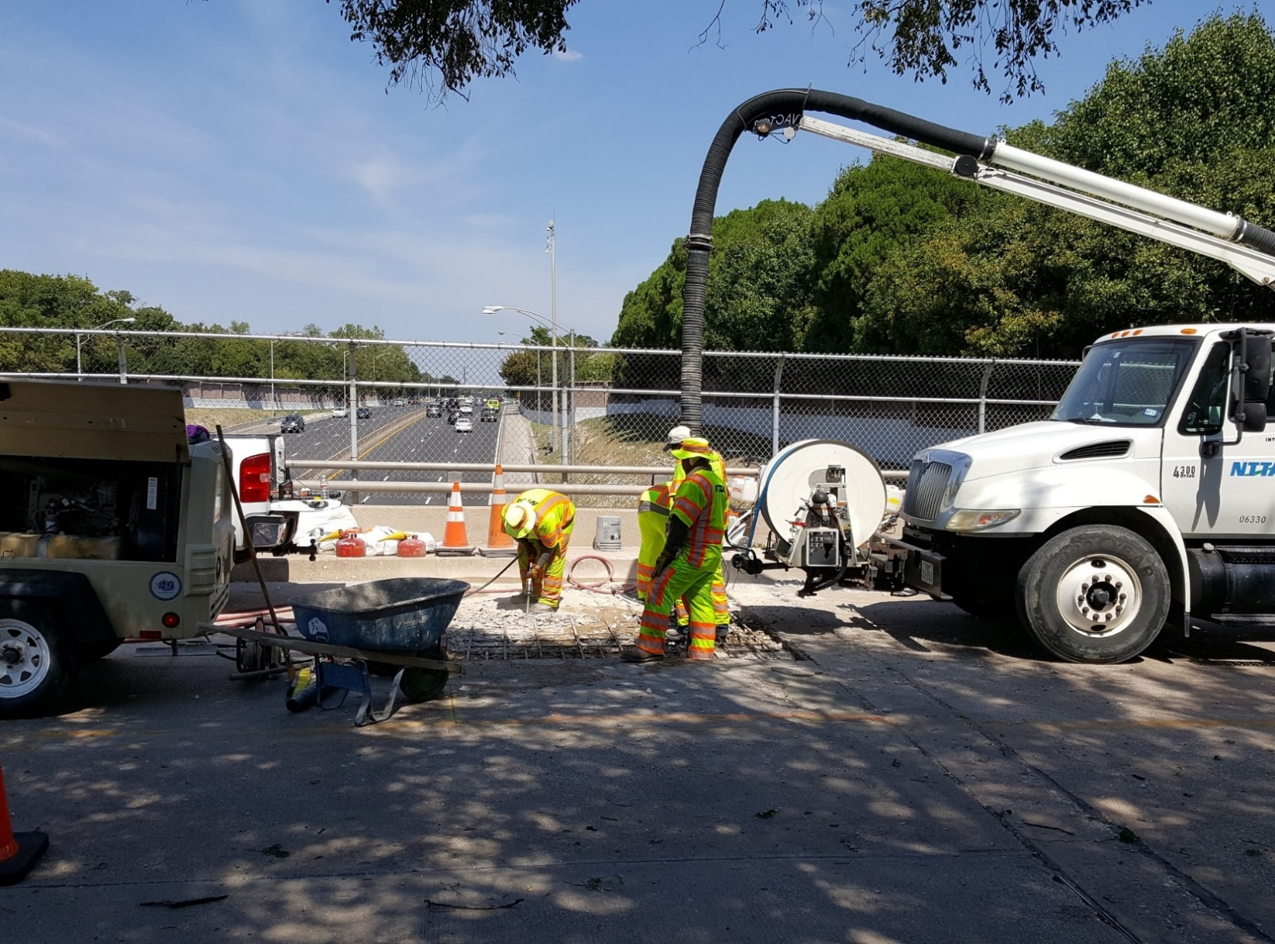
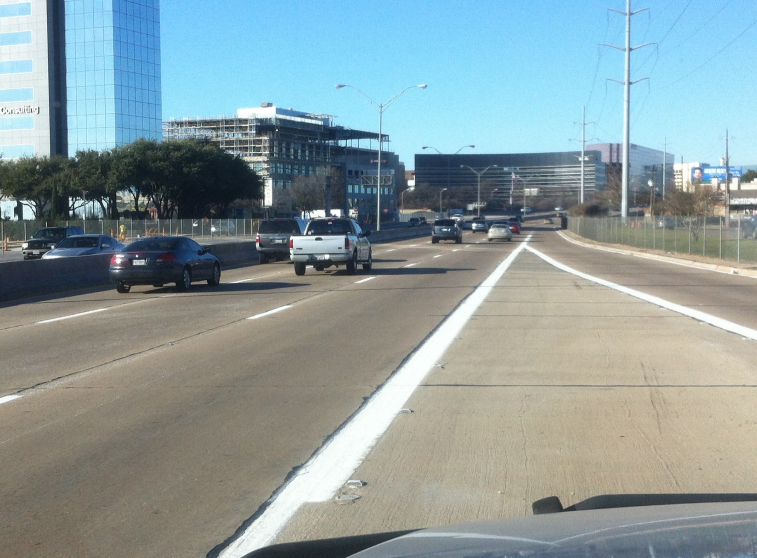
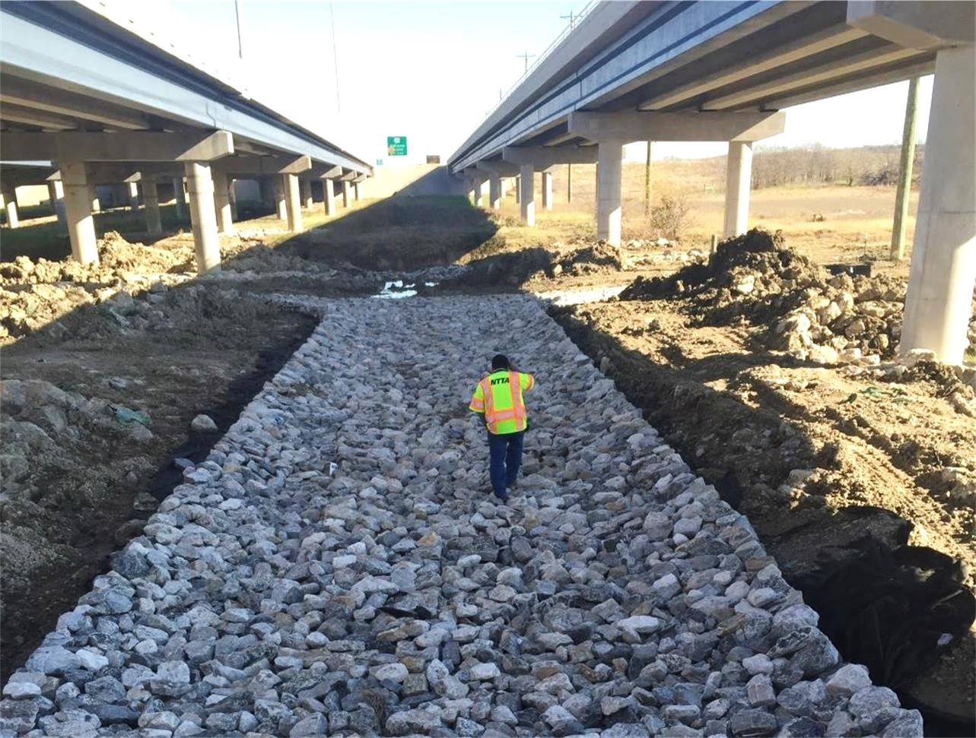
Routine Maintenance
Projects
Striping
Erosion Control
Sign Replacements
Pavement Repair
Issued throughout the year

Slide 34
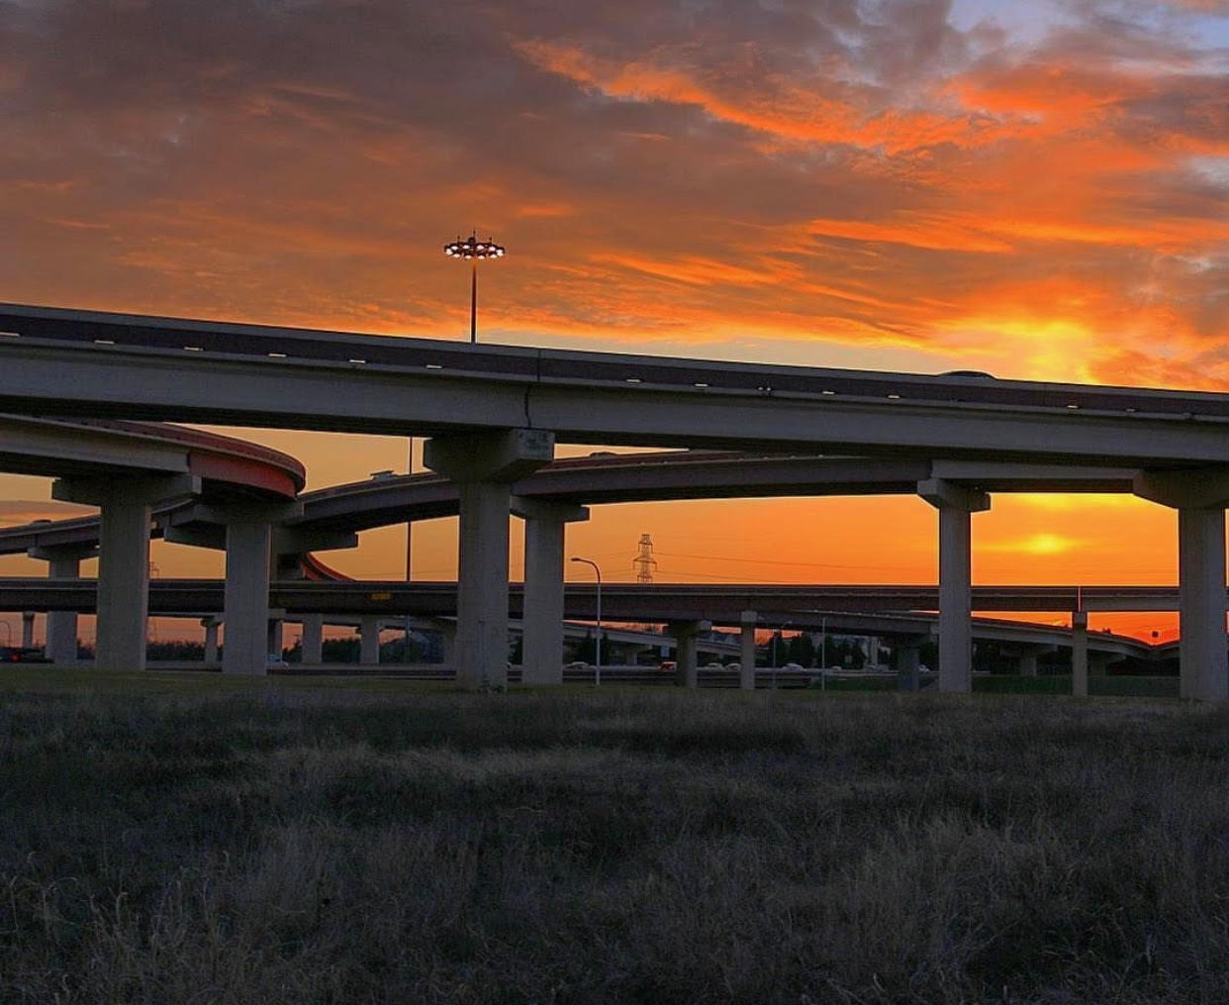
Maintenance Management Consultant
January 2021
Extension of Staff:
Planning, budgeting & design of routine maintenance and rehabilitation projects
Development of maintenance management systems
Review of GEC annual inspection
Specialized inspections of major assets
GASB 34 reporting
Maintenance Rating Program inspections

Slide 36
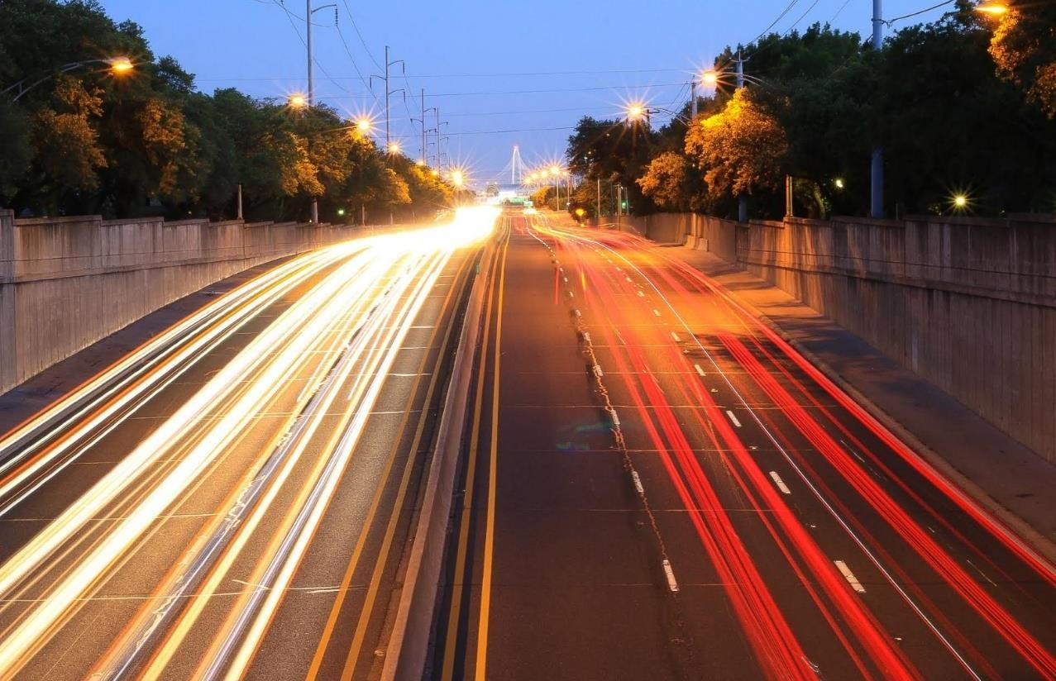
QUESTIONS

Slide 37
NTTA Electronic Response and
Attending Virtual Meetings
Daylon Carroll
Procurement Services

Slide 38
NTTA Marketplace

Slide 39
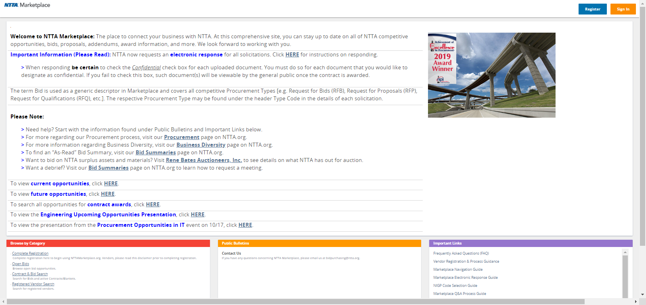

Slide 40
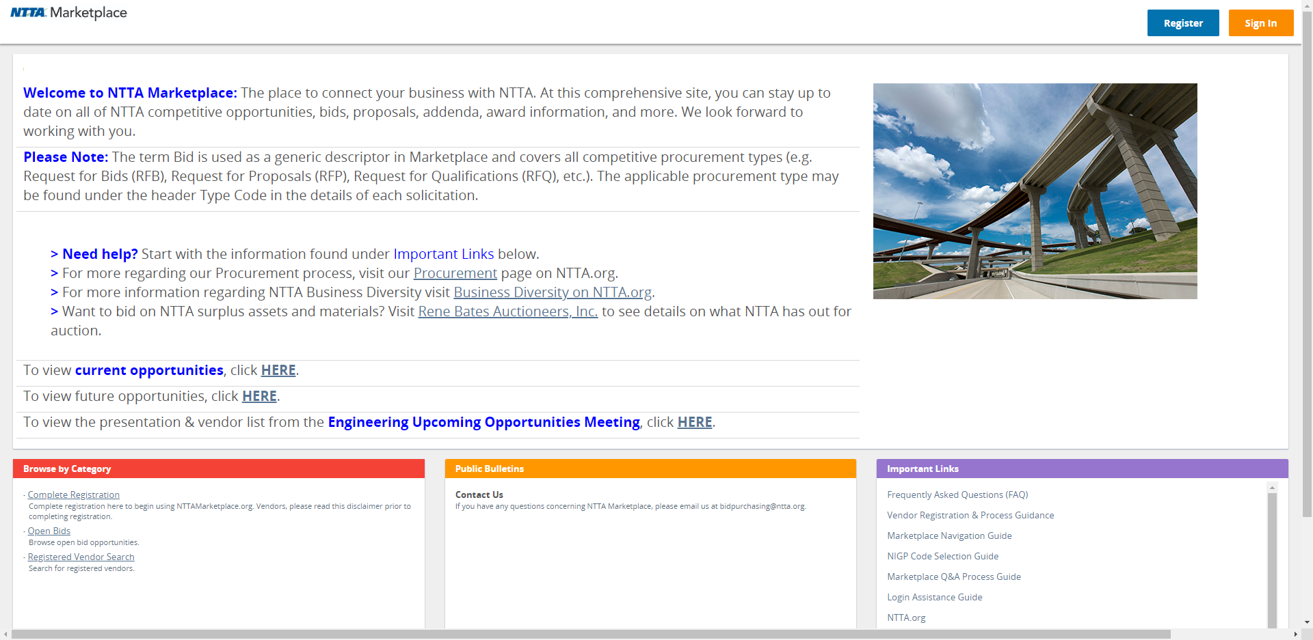

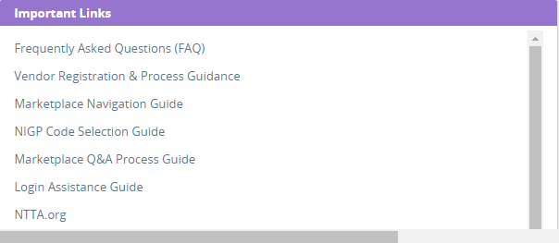
Marketplace Assistance
The registration process begins with the “Register” button in the top-right corner of the screen.
The “Important Links” section contains guidance documents for your reference.
nttamarketplace.org
“Important Links” contains the following:
Registration help
NIGP code selection guidance
Site navigation assistance
Directions on submitting questions
Directions on electronic response

Slide 41
Solicitation Participation
In order to participate in a solicitation, prospective vendors must register in Marketplace
The following are possible once you have a vendor account:
Responding electronically
Submitting clarifying questions
Receiving notifications of amendments
Being added to the bid holder list for a solicitation
Visibility into closed solicitation information and awards
nttamarketplace.org

Slide 42
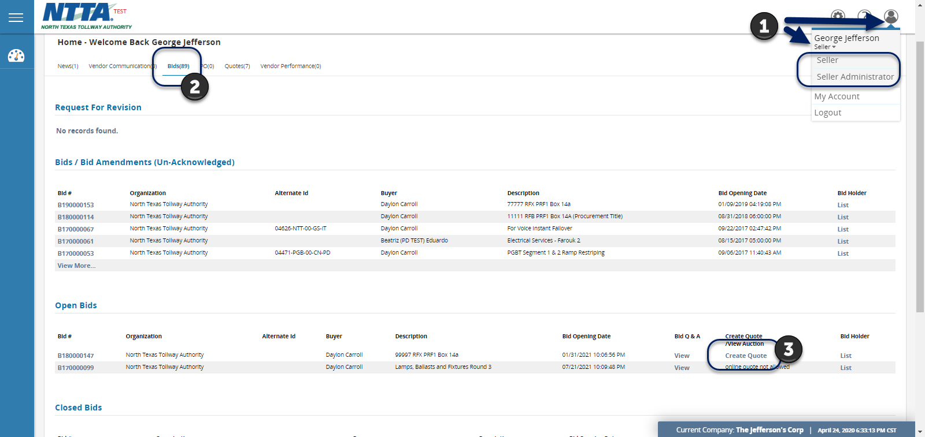
Responding Electronically
Quick Steps for Responding Electronically through Marketplace:
Change to the “Seller” view for your vendor account
Go to the “Bids” tab and find “Open Bids”
Click the “Create Quote” link for the opportunity
You must register and log into a vendor account to respond electronically.
For more help responding, download the Marketplace Vendor Response guide from the file attachments for the solicitation or from the login page.

Slide 43
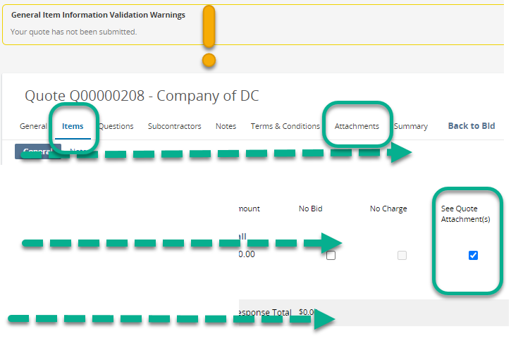
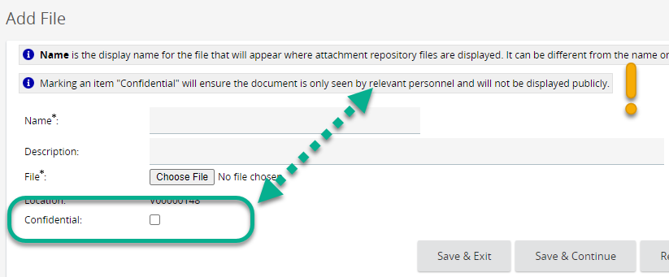
Electronic Response – Important Steps
While on the Items Tab
You will need to check the “See Quote Attachment(s)” box for us.
This is a system workaround that we need your help accomplishing
While on the Attachments tab
The “Confidential” check box controls whether a document can be seen by the general public once the contract is awarded.
If “confidential” only NTTA staff will see the attachment

Slide 44
Attending Virtual Meetings
Microsoft Teams

Slide 45
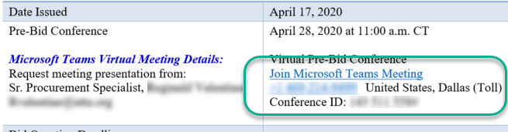
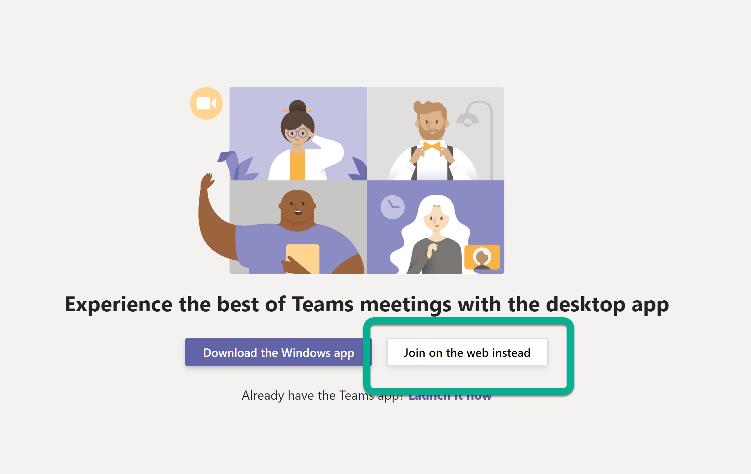
Locating & Joining Virtual Meetings
Any meeting information related to NTTA procurement opportunities can be found on the respective solicitation packet cover sheet.
Each procurement will have separate meeting information for its planned pre-conference and bid opening, if applicable.
Once on the meeting webpage, clicking “Join on the web instead” will enable you to enter the meeting.

Slide 46
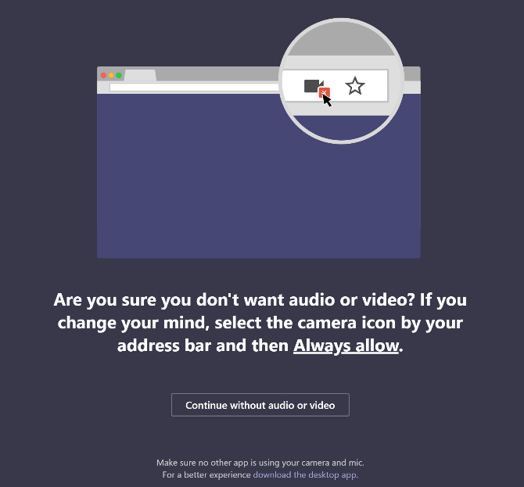
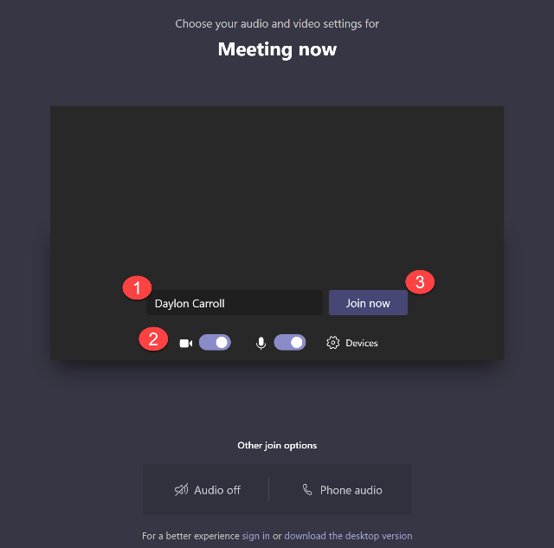
Accessing the Meeting & Settings
As the meeting is launching the application may ask for permission to access your computer’s microphone and camera.
This access is not mandatory, and totally at the discretion of the meeting attendee.
1) Enter the name you would like to display
2) Select your camera and microphone settings
3) Click to Join

Slide 47
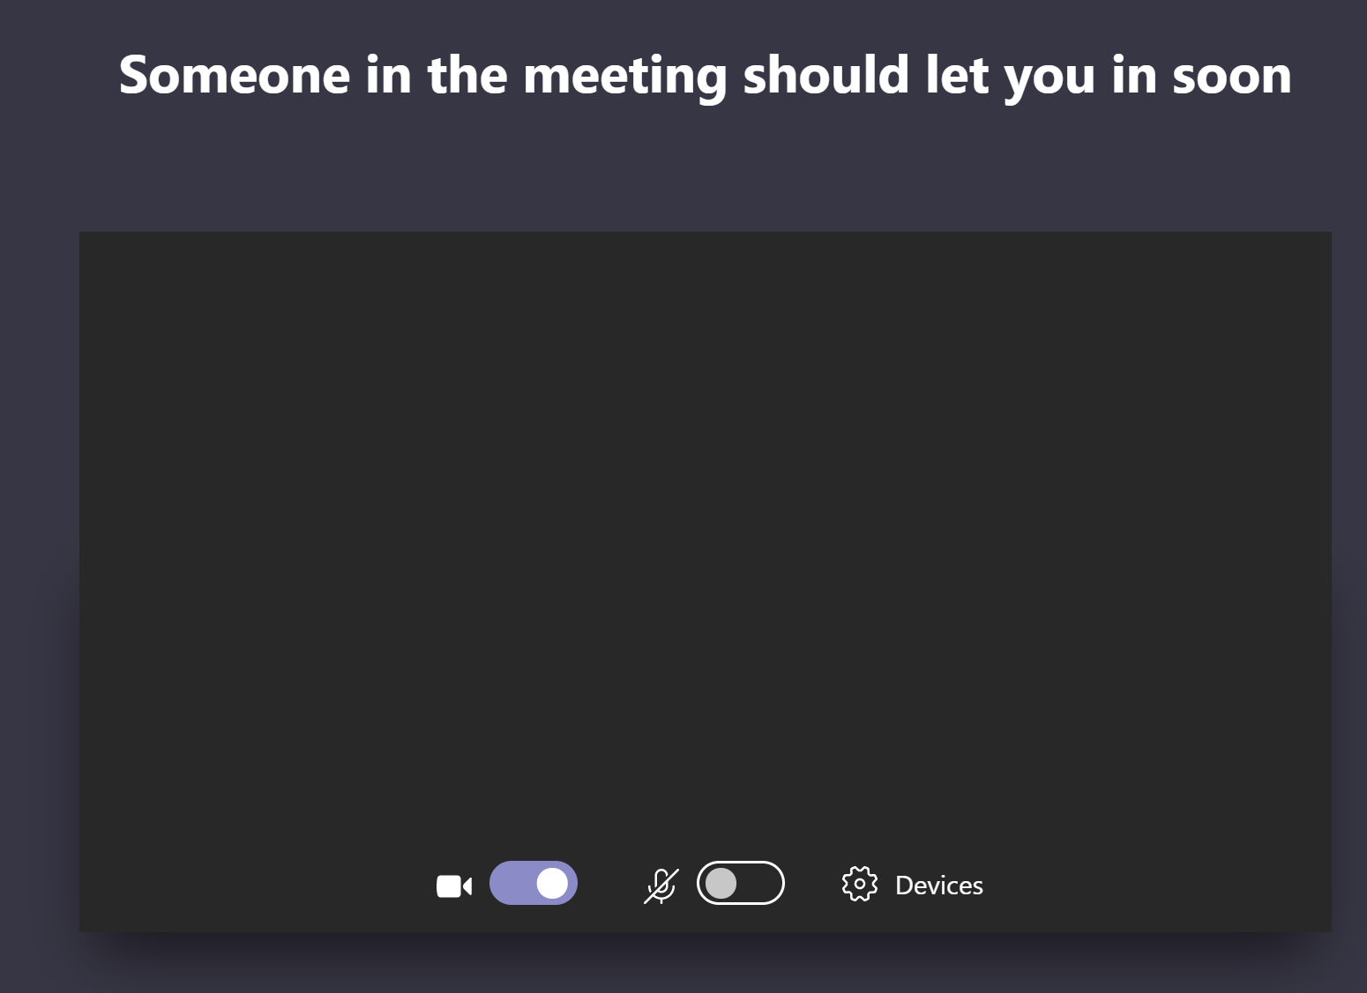
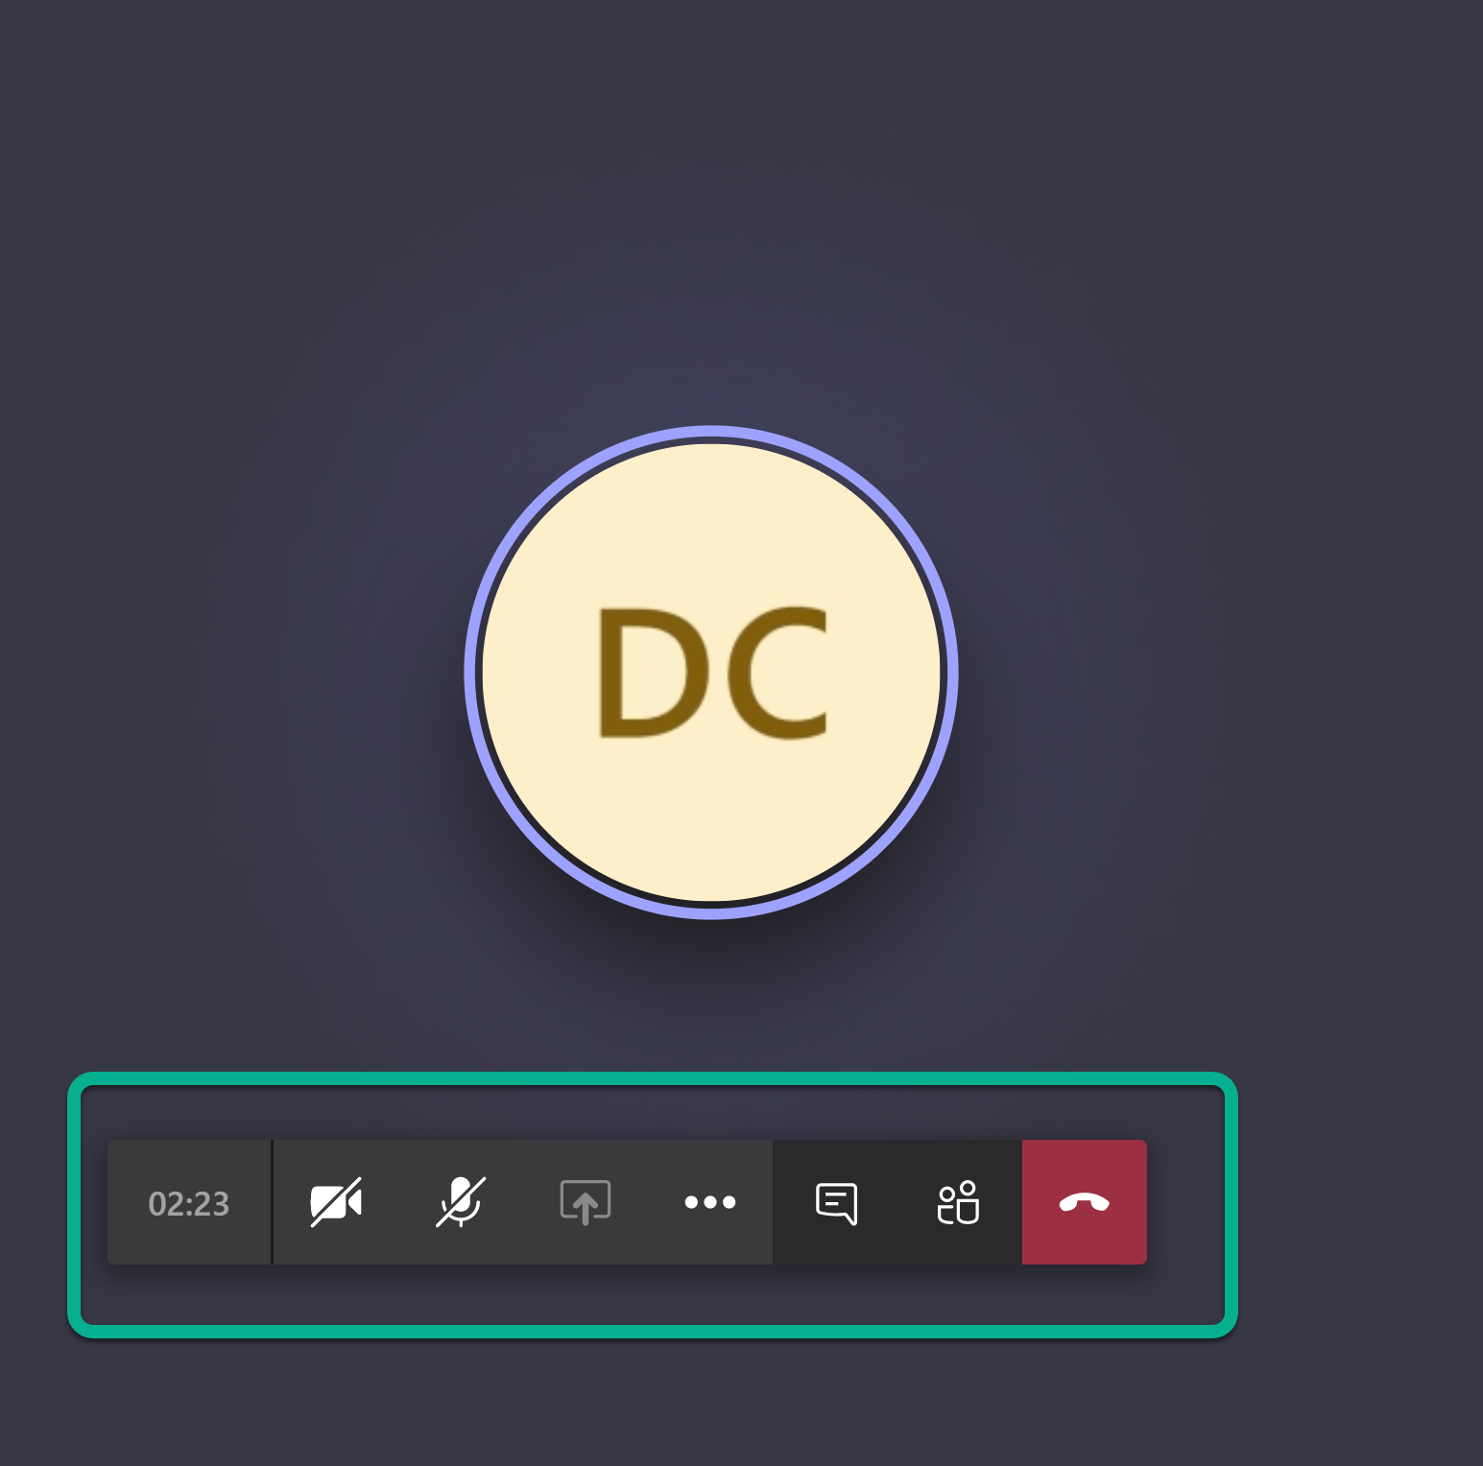
Accessing the Meeting & Settings
When you join, you may have to wait in the lobby for the organizer to let you into the meeting.
Once you are in the meeting, the toolbar menu will allow you access to your mic, camera, and ability to leave the meeting.

Slide 48
Polling Question #3
Any other topics that should be considered for upcoming CIP event?

Slide 49


TxDOT 635 East Project
CIP Webinar
July 30, 2020
Spring 2020

Slide 50

What is the 635 East Project?
A roadway construction project by the Texas Department of Transportation to improve mobility, operations and safety along Interstate 635 in Dallas County
Construction: 2020-2024
Approx. 11 miles
A Texas Clear Lanes Initiative

Slide 51
Need for Roadway Improvements
1969: I-635 opens with the capacity to handle about 180,000 cars daily
2020: Average daily traffic is expected to reach 230,000 cars
Roadway design is outdated
Discontinuous frontage roads

Slide 52

Goals for the Project
Improve safety
Accommodate projected growth in region
Relieve congestion
Provide reliable travel time
Provide local connectivity

Slide 53




Project Team

Slide 54

Third Party Coordination
Dallas County
Cities of Dallas, Garland and Mesquite
Utility Companies
Dallas Area Rapid Transit & KCS Railway Co.
Area Businesses
Area Residents
Community Organizations

Slide 55

Project Overview
Project cost: $1.7 billion
Delivery method: Design-Build
Contract Term: Five Years
Project Awarded: 2019
Timeframe for construction: 2020 to 2024

Slide 56
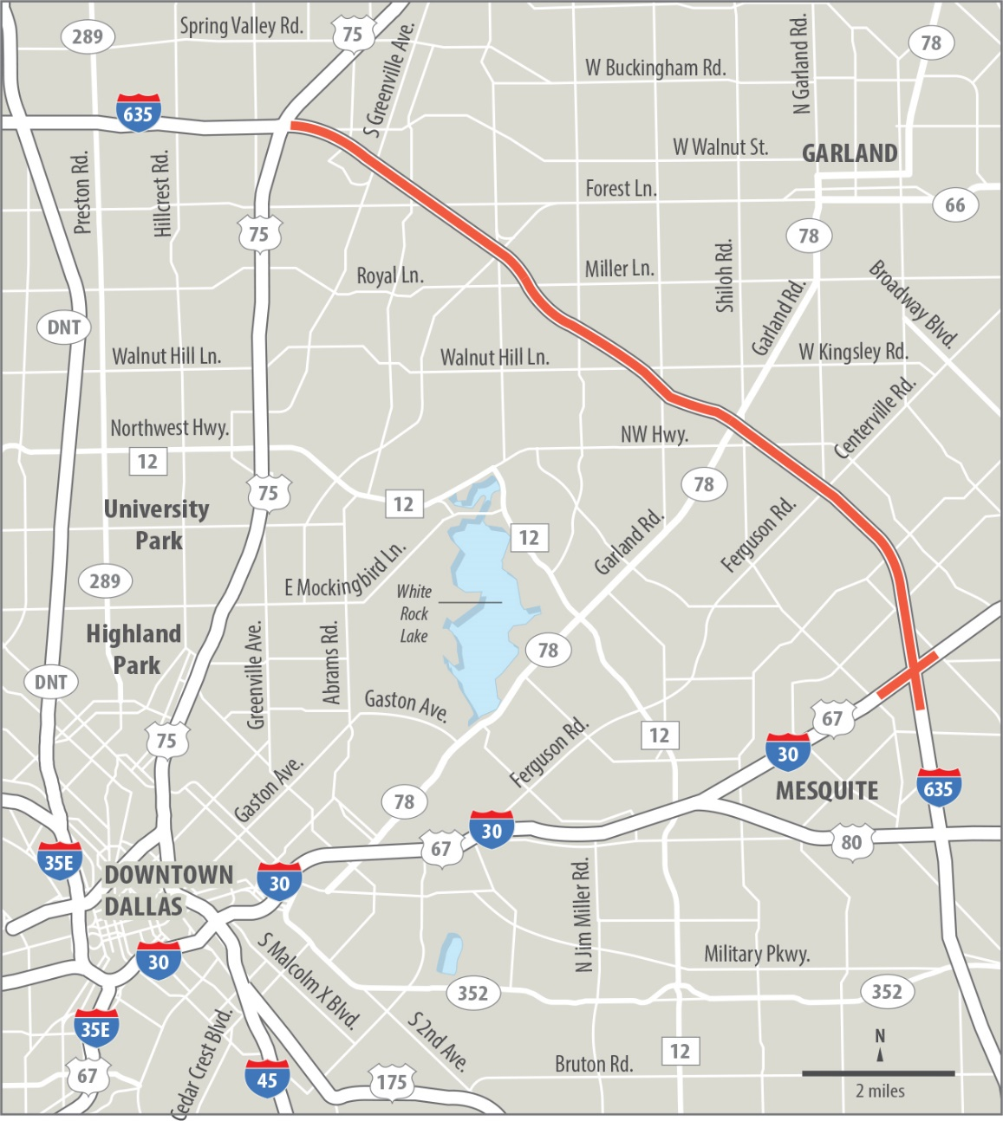
Project Limits
Approx. 11 miles
Dallas County
Begins just east of U.S. 75 and will continue past I-30
Cities of Dallas, Garland and Mesquite
Will include reconstruction of two-mile section of I-30 to accommodate the
I-30 / I-635 interchange

Slide 57
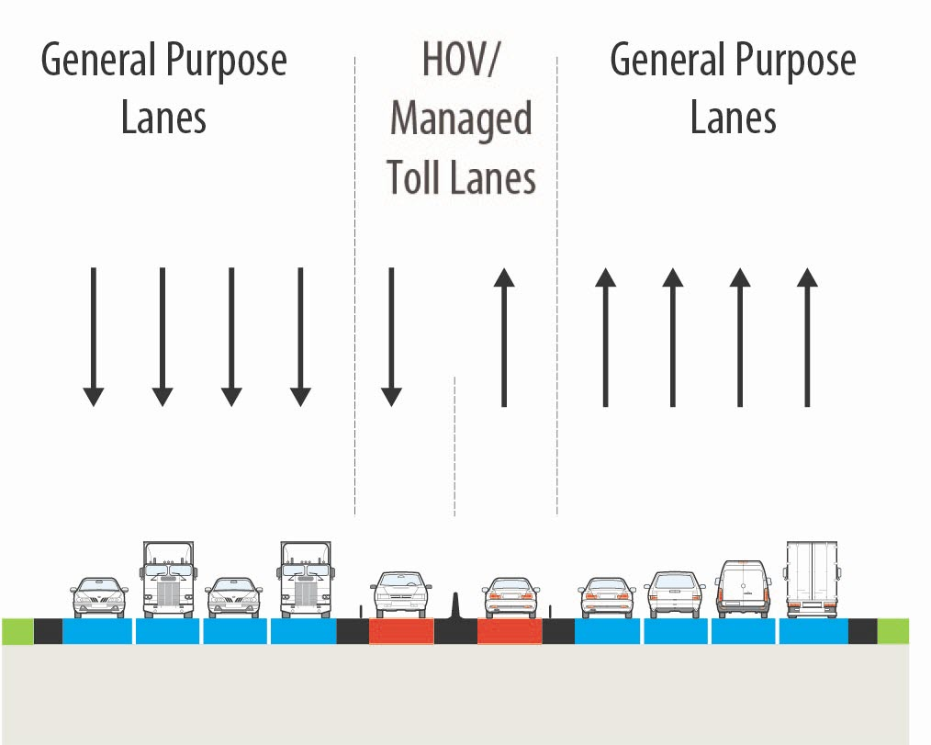
Existing Lanes
The existing 635 East has:
Four general purpose lanes in each direction
One HOV/Managed Lane in each direction, separated by delineators from the general purpose lanes
Discontinuous frontage roads

Slide 58
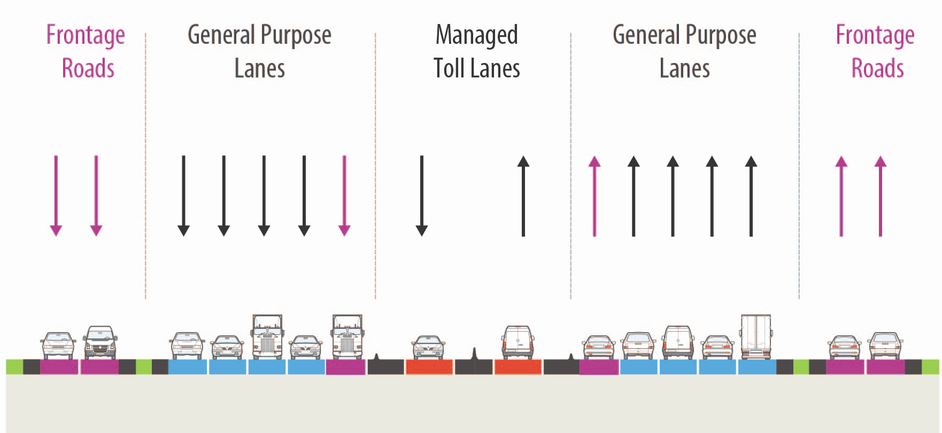
Proposed Lanes
When construction is complete, 635 East will have:
Five general purpose lanes in each direction
Managed toll lanes (TEXpress) with shoulders, and separated from the general purpose lanes by concrete barriers
Continuous frontage roads

Slide 59
Project Schedule
May 2019 | TxDOT awards the project to PLC
August 2019 | Start of project design and contract execution
Spring/Summer 2020 | Start of construction and utility work/relocations
Late 2024 | Substantial completion

Slide 60
Subcontracting Opportunities
MSE Walls
Precast Post and Panel Noise Walls
Cast-in-place Retaining Walls and Noise Walls
Slip-form Concrete Barrier
Metal Beam Guard Fence
Cross Street Civil Construction Packages
Bridge Decks
Storm Drains
Concrete Paving
Other small, miscellaneous goods and services
Sidewalks and ADA ramps
Misc. Concrete flatwork (riprap)

Slide 61
Bidding Process
Company Profile
Complete Bidders Questionnaire (www.635east.com)
RFP
Bid Package will be sent via email to all potential bidders
Bid
Follow Instructions to Bidders & Submit Bid/Proposal
Evaluation
PLC Evaluation of Bid/Proposal – Qualifications & Pricing
Award
PLC Award

Slide 62
Registering for Solicitations– FILL OUT THE BIDDERS QUESTIONNAIRE!
Register via project website at www.635east.com
Email to bids@plclbj.com
Contact Adrienne Williams
for additional support at:
Adrienne.Williams@plclbj.com

Slide 63
Doing Business with Pegasus Link Constructors, JV (PLC) Team
You must be pre-qualified
Bid Submission Review Process
  Past Performance
  Experience performing the scope of work
  Safety Record: EMR, loss time
Bonding Requirements may apply
Insurance Limits must be met
Federal Flow-down clauses
  Certified Payroll, EEO, Buy America

Slide 64
DBE Program Information
DBE Project Goal: 8% ($138,105,066)
DBE Certification
DBE Compliance
  49 CFR Part 26
    NAICS code
    Self-performance
    Employees
    Responsibilities include actually performing, supervising, and managing
    the work
    CUF Review

Slide 65
DBE Outreach Efforts
Website updates
Bid information available via local contractors association newsletters
Attend, sponsor and support other agency industry related events, i.e. Cooperative Inclusion Program (CIP)
Current and future bidding opportunities

Slide 66

Questions?

Slide 67
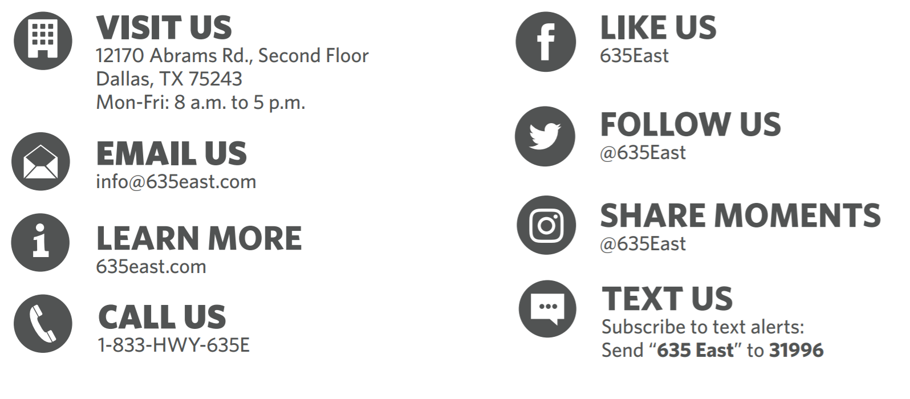
How to Stay Informed

Slide 68

Thank you for joining us!

Slide 69
Polling Question #4
How easy was it to use the WebEx platform for today’s event?
Very Easy
Easy
Difficult
Very Difficult

Slide 70
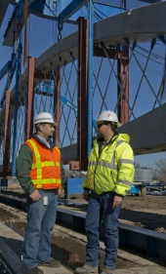
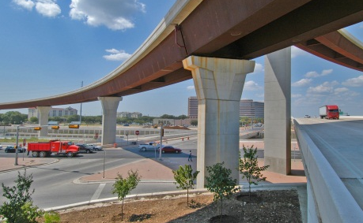
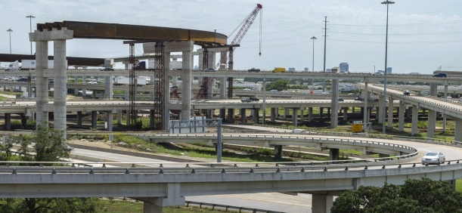
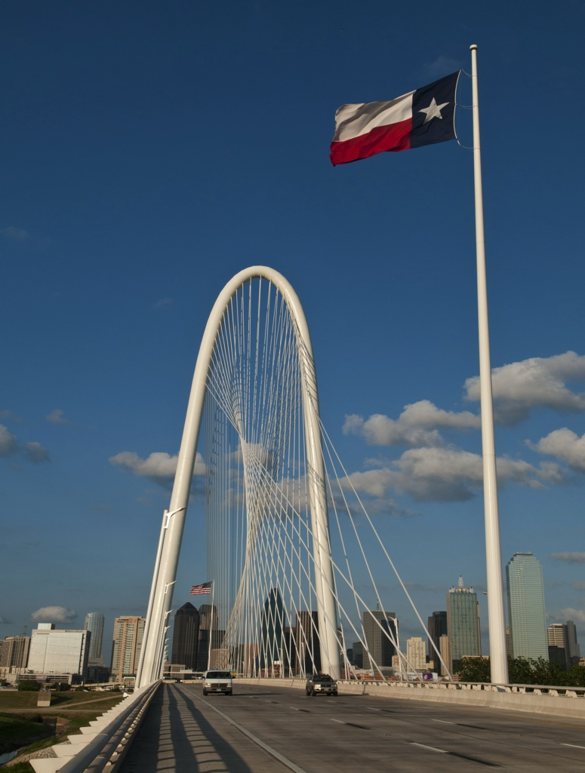
DISADVANTAGED BUSINESS ENTERPRISE (DBE) program
Heavy Highway Construction
Noraima Perez
Noraima.Perez@txdot.gov
214-319-6456

Slide 71
Regulatory Authority
Code of Federal Regulations (CFR)
Title 49 - Transportation
Subtitle A – Office of the Secretary of Transportation
Part 26—Participation By Disadvantaged Business Enterprises in Department of Transportation Financial Assistance Programs
49 CFR Part 26

Slide 72
Disadvantaged business enterprise
Disadvantaged Business Enterprise (DBE)
  A for profit small business concern certified through the Texas Unified Certification Program, that is at least 51% owned by one or more individuals who are both socially and economically disadvantaged, and
  Whose management and daily business operations are controlled by one or more of the socially and economically disadvantaged individuals who own it.

Slide 73
Texas unified certification program (TUCP)
Texas Unified Certification Program (TUCP)
certifying entities:
  City of Austin
  City of Houston
  Corpus Christi Regional Transportation Authority (CCRTA)
  North Central Texas Regional Certification Authority (NCTRCA)
  South Central Texas Regional Certification Authority (SCTRCA)
  Texas Department of Transportation (TxDOT)

Slide 74
Texas unified certification program (TUCP)
The TUCP provides “one stop shopping” for firms seeking certification in the federal DBE program in Texas.
A DBE certified by any one of the TUCP member entities is automatically DBE certified with TxDOT.
Only those DBEs listed in the TUCP DBE Directory are eligible to be used for DBE goal attainment.

Slide 75
Texas unified certification program (TUCP)
The TUCP Directory lists the firm’s name, address, phone number, and the most specific North American Industry Classification System (NAICS) code to describe the principal goods or services the DBE will provide.
The TUCP Directory is located in the Diversity Management System (DMS) located on TxDOT’s website at https://txdot.txdotcms.com/.

Slide 76
NAICS Codes
  49 CFR Part 26.71(n)(1-2)
  The types of work a firm can perform must be described in terms of the most specific available NAICS code for that type of work.
  In addition to NAICS code, a descriptor from a classification scheme of equivalent detail and specificity may be applied.
  A correct NAICS code is one that describes, as specifically as possible, the principal goods or services which the firm would provide to DOT recipients. Multiple NAICS codes may be assigned where appropriate.
  Firms and recipients must check carefully to make sure that the NAICS codes cited in a certification are kept up-to-date and accurately reflect work which the UCP has determined the firm's owners can control.

Slide 77
TXDOT WORK CATEGORIES
Asphalt – includes hot-mix, seal coats, surface treatments, etc.
Aviation
Banks Owned By Minorities
Concrete Paving & Incidentals – includes joint concrete pavement, continuously reinforced concrete pavement
Earthwork, Base and Subbase – includes preparing ROW, clearing, removing old concrete, roadway and channel excavation, embankments, etc.
Fencing – includes wire, chain link, & metal beam guard fence, metal bridge railing, etc.
Hauling – includes hauling of base material, gravel, sand, hot-mix, etc.
Illumination – includes placement of conduit and wire, poles, roadway and bridge lights, etc.
Landscaping – includes roadside planting, erosion control, sodding, seeding, etc.
Major Structures – includes structural excavation, drill shafts, piling, concrete for columns, bents, abutments, slabs, structural steel, rebar, etc.

Slide 78
TXDOT WORK CATEGORIES
Material Suppliers – supplier of construction materials, safety supplies, etc.
Minor Structures – includes reinforced concrete pipe, inlets, manholes, sewers, box culverts, sidewalks, driveways, riprap, curb and gutter, concrete bridge railing, etc.
Miscellaneous
Painting – includes painting of structural steel and concrete structures
Professional Services – Engineering, Architecture, and Surveying
Public Transit
Rest Areas – includes steel, masonry or wood fabrication and erection, electrical wiring, plumbing, etc.
Traffic Control Devices includes traffic signals, signs, barricades, pavement markers, buttons, striping, etc.
Truck Owner-Operators
Underground and Utility Work – includes PVC pipe, underground conduit, utility telephone lines, etc.

Slide 79
UTILIZATION PLANS
Prime contractors are required to submit DBE Utilization Plans (UP) through the Diversity Management System (DMS) no later than five (5) calendar days after letting (bid day).
The prime contractor shall utilize the DBEs listed in the prime’s Utilization Plan (UP).
  Race-conscious DBE participation.
  The DBE must be certified at the time of the commitment.
  The DBE must be certified in the NAICS code applicable to the kind of work the firm would perform on the contract.
The DBE must confirm its participation through DMS.
Notes:
Enter information from spec book regarding prime’s default of contract

Slide 80
UTILIZATION PLANS
Prime enters into a contractual arrangement with the DBEs listed in the UP specifying the work to be performed and the compensation for the work.
  Subcontract Agreement or Purchase Order (P.O.).
  The DBE must be certified at the time the subcontract or P.O. is executed.
Subcontract Agreements or Purchase Orders must be made available upon request.
Notes:
Enter information from spec book regarding prime’s default of contract

Slide 81
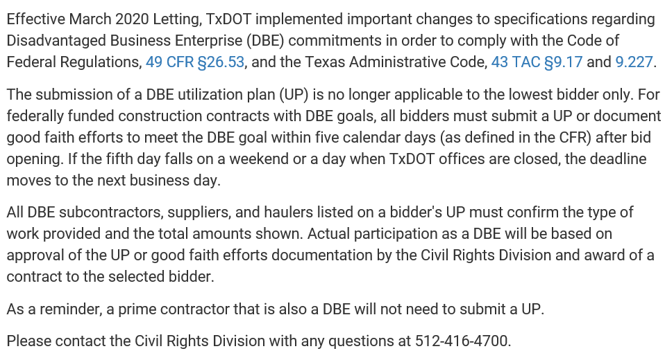
Submission Deadlines: DBE Utilization Plans-Fiscal Year 2020

Slide 82

Remaining FY 2020
Letting Dates and Utilization Plan Due Dates
*UP submissions are due in DMS by11:55 p.m. on the date listed.
https://www.txdot.gov/inside-txdot/division/construction/contractors/letting/utilization-plan-deadlines.html

Slide 83
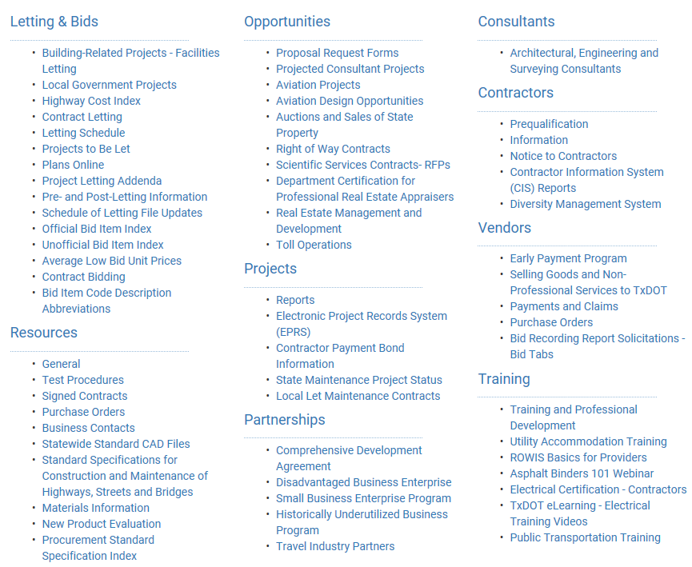
RESOURCES
TxDOT web page: txdot.gov/business.html

Slide 84
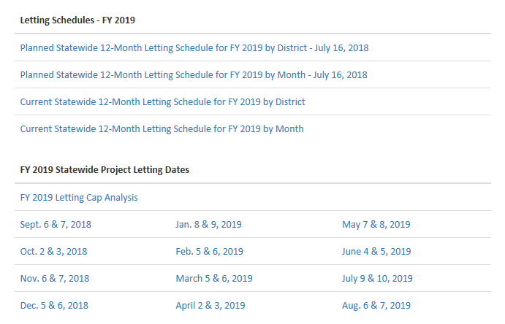
RESOURCES
Letting Schedule

Slide 85
QUESTIONS
QUESTIONS?

Slide 86

End of Survey Reminder
Connor VanSteenberg
North Texas Area Manager
The Associated General Contractors of TX (AGC)

Slide 87

Closing Remarks
Moses Aito
Director of Business Diversity, NTTA

Slide 88

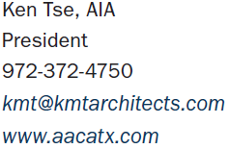

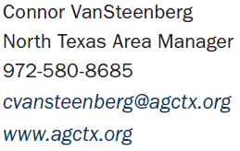
CIP Committee Members Contact Information

Slide 89





CIP Committee Members Contact Information

Slide 90




CIP Committee Members Contact Information

Slide 91
Virtual Networking Session
The webinar session will stay open for 15 minutes to network:
Share information and direct contact information amongst each other
Ask and answer questions that are private or in public chat
Engage with each other beyond CIP platform

