Slide 1
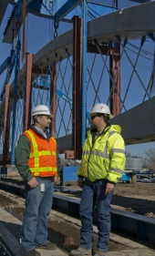
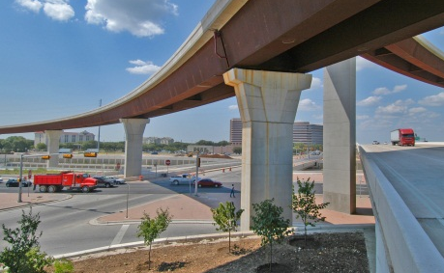
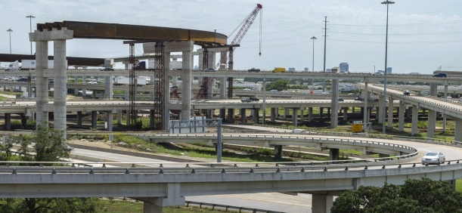
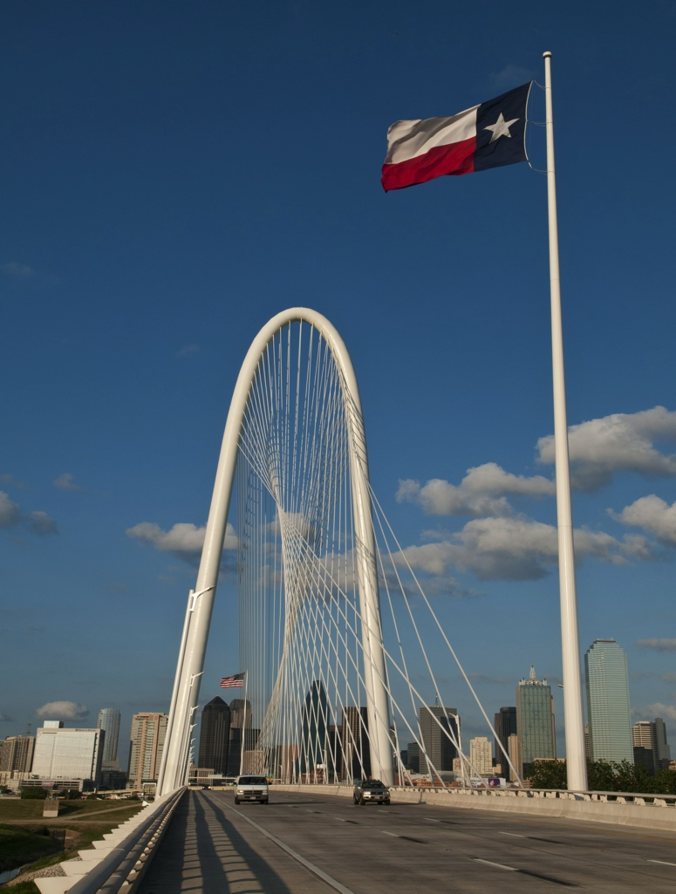
COOPERATIVE INCLUSION PLAN
PEPS DIVISION UPDATE
Joseph S. Jancuska, P.E., CFM
PEPS Dallas Service Center Manager
May 25, 2017

Slide 2
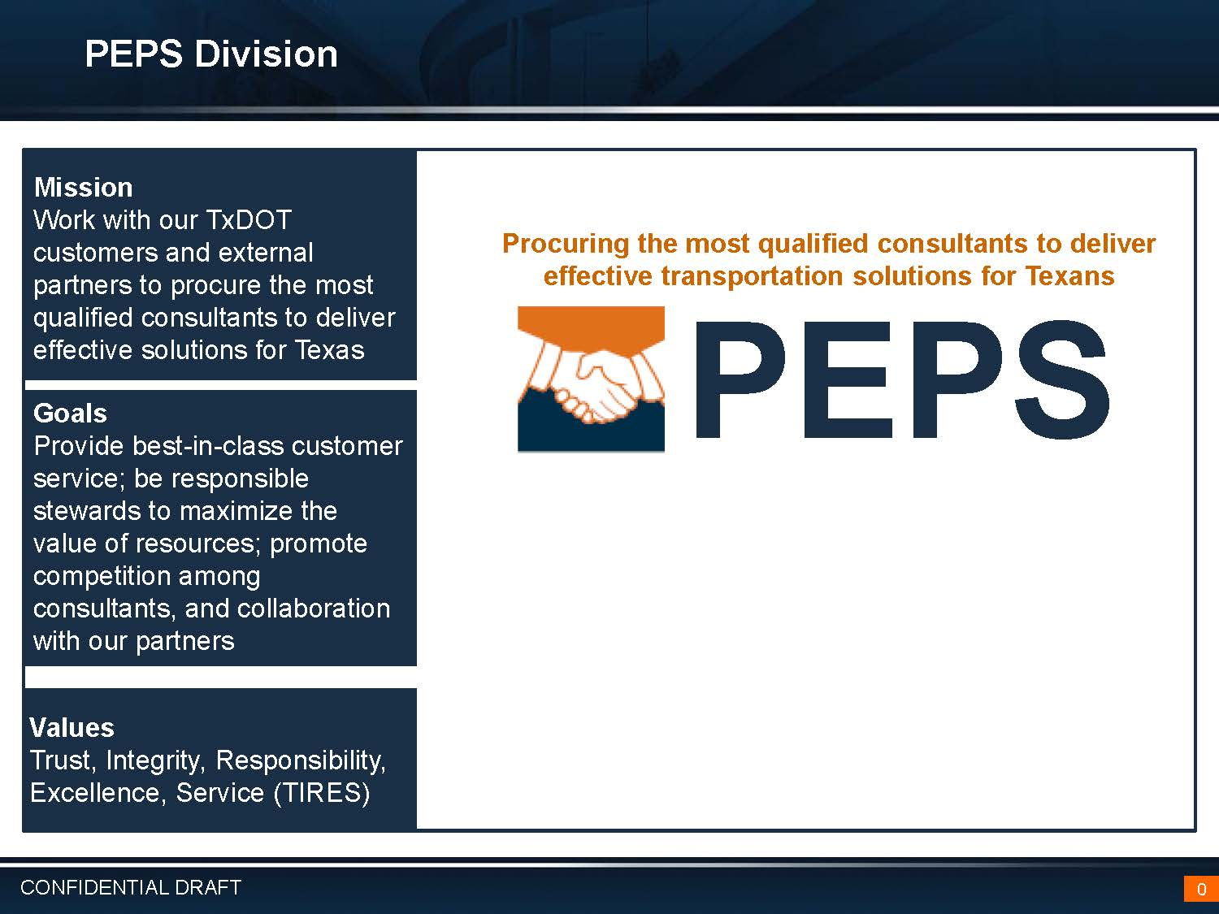
Mission
Mission
Work with our TxDOT customers and external partners to procure the most qualified consultants to deliver effective solutions for Texas
Goals
Deliver the right projects; Focus on the Customer; Foster Stewardship; Optimize System Performance; Preserve our Assets; Promote Safety, and Value our Employees
Professional Engineering Procurement Services represents the consolidated procurement organization supporting engineering, architectural and surveying contracts
Values
People, Accountability, Trust, Honesty

Slide 3
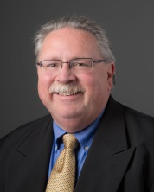
Functional Organization
Division Director: Martin L. Rodin, PE
FTE Allocation: 100
Actual FTEs: 106
PEPS Division
Director:
Martin Rodin
Deputy Director
Lucio Vasquez, PE
Executive Assistant
Kristina Kottke
Center of Excellence Manager
Dan Neal, PE
Austin Service Center Manager
Charles Davidson, PE
El Paso Service Center Manager
Efrain Esparza, PE
Business Operations Manager
Roy Gonzales
District Central Service Center Manager
Jaime Vela, PE
Ft. Worth Service Center Manager
Norma Glasscock, PE
Service Center for Divisions Manager
Kori Rodriguez, PE
Houston Service Center Manager
Gail Morea, PE
Dallas Service Center Manager
Joe Jancuska, PE
San Antonio Service Center Manager
Larry Wenger, PE

Slide 4
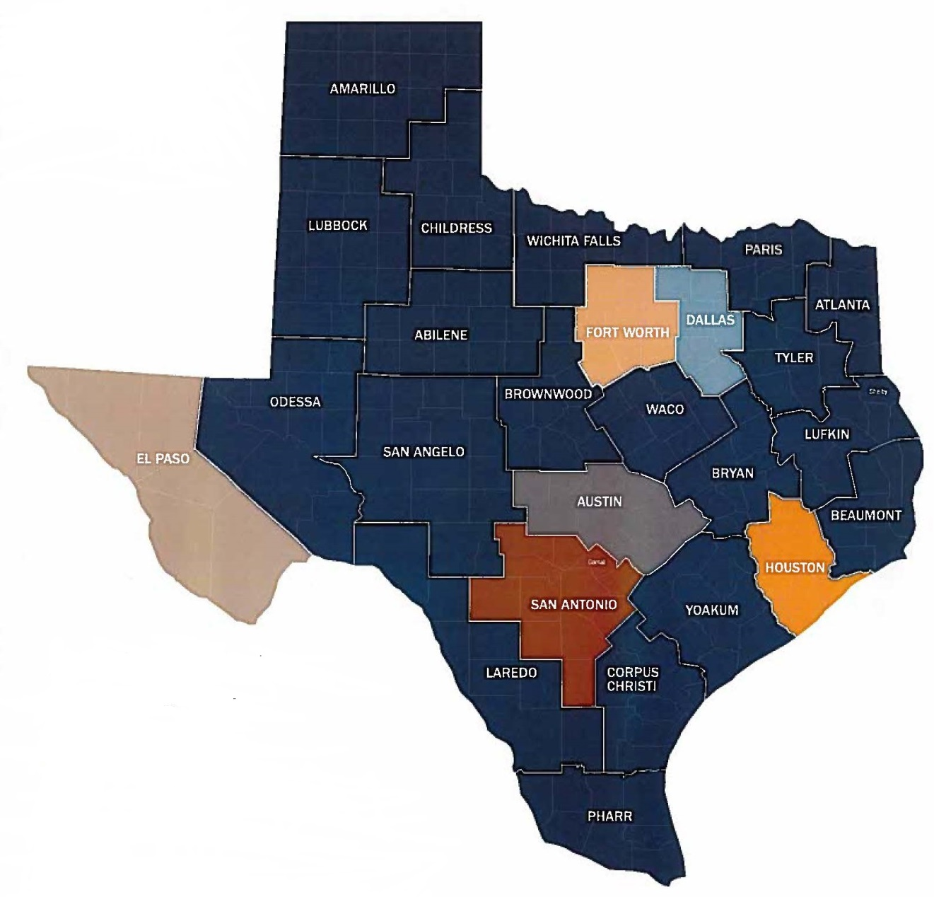
Leadership Organization
Austin Service Center – Charles Davidson
Dallas Service Center – Joseph Jancuska
Fort Worth Service Center – Norma Glasscock
Houston Service Center – Gail Morea
San Antonio Service Center – Larry Wenger
El Paso Service Center – Efrain Esparza
Central Service Center – Jaime Vela Jr.
Service Center for Divisions – Kori Rodriguez
Division Director – Martin L. Rodin
Deputy Division Director – Lucio Vasquez
Center of Excellence – Dan Neal
Business Operations Center – Roy Gonzales

Slide 5
FY16 Procurement Results
Procurement Status
The original FY2016 procurement plan approved in AUG 2015 provided for 60 solicitations for a total of 279 contracts totaling $789 million.
The modified FY16 procurement plan provided for 71 solicitations for a total of 398 contracts totaling $1.37 Billion.
34% of prime firms in FY16 are HUB/DBE; 63% of all firms selected are HUB/DBE.
$1.37 B
$789 M

Slide 6
Future Letting – FY17 to FY25
Prop 7 Will Significantly Increase Letting Volume
$6.5 Billion Average Letting (FY 2017 – 2025)
$4.3 Billion Average Letting (FY 2012 – 2016)

Slide 7

Future Annual Procurements
Architecture | $6,400,000
Bridge Inspection | $52,000,000
Bridge On/Off Replacement | $9,000,000
Construction, Engineering, Inspection (CEI) | $191,080,000
Critical Path Method Scheduling (CPM) | $6,000,000
Engineering | $1,000,000
General Engineering Consultant (GEC) | $40,000,000
Geotechnical | $19,000,000
Hydraulic | $18,000,000
Other (describe in Comments) | $16,000,000
Planning | $17,000,000
Plans, Specifications and Estimates (PS&E) | $412,568,500
Procurement Engineering (PcE) | $20,000,000
Schematic | $25,000,000
Schematic / Environmental | $200,000,000
Schematic/Environmental/PS&E | $44,860,000
Survey | $58,000,000
Traffic Engineering | $16,000,000
Traffic Signal Timing | $5,000,000
Utility Engineering | $12,000,000
Materials Engineering | $12,000,000
Facilities Engineering | $6,500,000
Independent Engineer (IE) | $20,000,000
Traffic & Revenue (T&R) | $5,000,000
Grand Total | $1,212,408,500
Actual FY 17 is
$1.41 B

Slide 8
FY 17 - Wave 3 Update
Wave 3 Details
Wave 3 internal kickoff on April 5 and April 11 2017
Total number of twenty two procurement events scheduled consisting of sixty two individual contracts.
CEI 7 $111,200,000
Engineering 2 $ 5,500,000
Geotechnical 1 $ 6,000,000
Hydraulic 1 $ 3,000,000
Materials Engineering 1 $ 3,000,000
Planning 1 $ 5,000,000
PS&E 2 $ 37,055,000
Schematic/Environmental/PS&E 2 $ 69,000,000
Schematic/Environmental 3 $ 17,000,000
Surveying 2 $ 52,000,000
22 $308,755,000

Slide 9
FY 17 - Wave 4 Update
Wave 4 Details
Wave 4 internal kickoff on July 6, 2017
A total of twenty one procurement events scheduled consisting of ninety one individual contracts
CEI 1 $ 15,000,000
CPM 1 $ 6,000,000
Engineering 1 $ 1,500,000
GEC 2 $ 28,000.000
Materials Engineering 1 $ 4,000,000
Planning 1 $ 4,000,000
PS&E 5 $204,500,000
Procurement Engineering 1 $ 20,000,000
Schematic/Environmental/PS&E 3 $ 58,000,000
Schematic/Environmental 1 $ 50,000,000
Surveying 2 $ 12,000,000
Traffic Engineering 1 $ 20,000,000
Utility Engineering 1 $ 12,000,000
21 $435,000,000

Slide 10

Getting Started
HOW DO I
GET STARTED?

Slide 11
How do I get started?
Getting Started
Be registered as a business with the State of Texas
http://comptroller.texas.gov
Be registered as engineering firm with the Texas PE Board
  http://engineers.texas.gov
Obtain precertification with TxDOT http://www.txdot.gov/business/consultants/architectural-engineering-surveying/getting- started/precertification.html
Become administratively qualified with TxDOT http://www.txdot.gov/business/consultants/architectural-engineering-surveying/getting- started/administrative-qualification.html
Check the TxDOT webpage for listing of projected contracts and pre-RFQ meetings
http://ftp.dot.state.tx.us/pub/txdot-info/des/cco/professional_services/projected_contracts.pdf
Submit your qualifications

Slide 12
Procurement Tips
  Check that all mandatory forms are in your package
  Keep alert to amendments
  Ask questions when you have the opportunity
  Showcase your PM and task leaders(if applicable)
  Focus on providing challenges, solutions and lessons learned
  Present innovative ideas or alternatives
  Be clear, concise and technical
  Use space wisely, it is not for marketing
  QA/QC the SOQ by referring directly to the RFQ Cover Page
  Use your best examples and give credit to the firm that did the work

Slide 13
Disqualifications
Improvements
Automation of AQ verification
Automaton of precertification check
Converting NLCs to precertified categories
Earlier DQ notification
Notifying precluded firms in advance
Earlier debrief opportunities
Replacement of PM and TL during solicitation

Slide 14
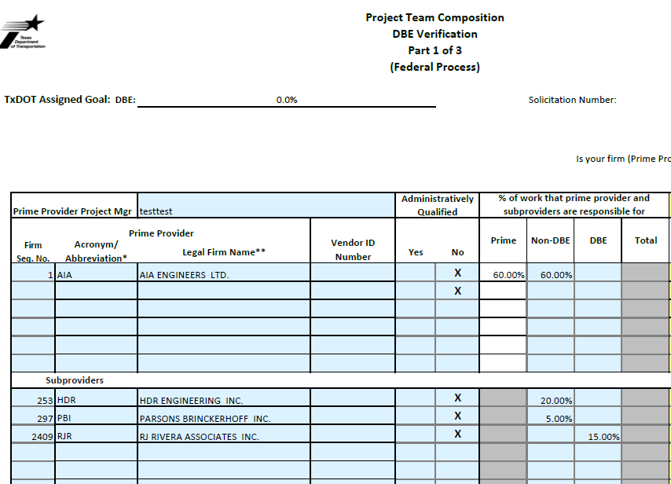
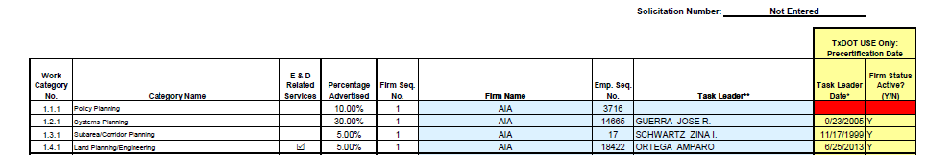

Automation
Updated PTC Form
Populate information on PTC at push of a button
Using Firm Sequence Numbers and Employee Precert numbers
Verifying Administrative Qualifications and Precert status before submittal

Slide 15
Preclusions
Current Practice
Next Steps
Preclusion is primary means to eliminate potential conflict and minimize risk
Precluded firm names published in RFQ and notified by e-mail in advance
Firms may file a challenge on an individual basis to overturn their preclusion
Challenges must be filed with the Executive Director’s office
Pre preclusion requests may be made to PEPS Division Director
PEPS contracted with TTI to investigate and report on design and construction engineering inspection practices nationwide
PEPS recently modified policy for sub consultants to allow non design related firms to pass from PS&E to CEI
PEPS working with CSO, CST and OGC to examine risk of establishing a threshold for Prime firms to clear preclusion

Slide 16
Points of Contact
Project Related Information
District Engineers
District Directors of Transportation Planning and Development (TP&D)
District Design Engineers
Division Directors
Directors of Construction
Procurement Related Information
PEPS Service Center Managers (SCMs)
Pre-RFQ meetings and workshops
PEPS Center of Excellence
PEPS Business Operations Center
PEPS Procurement Engineers

Slide 17
Future PEPS Direction
Future Project Mix (PEPS Steering Committee)
50% Indefinite Deliverable (ID) / 50% Specific Deliverable (SD)
Future CEI will be Specific Deliverable by project
Future CEI will be work authorization on execution
Future GEC will be Specific Deliverable by project
Minimize preclusion between Design and Construction
Improve CST participation
Pilot electronic SOQ submittals in FY 2018
PM will be required to be precertified
Annual and end of project evaluations are required

Slide 18

IS IT WORKING?
YES!
Initial screening is faster
Disqualifications are down
DQ notice is immediate
Debriefs are getting better
Debriefs are starting earlier
Negotiations are improving
WA are monitored weekly
WA are executed sooner
Feedback openly requested

Slide 19
Future News
The very first ever of its kind…
PEPS Division Conference
November 3, 2017
Omni Hotel- Southpark
4140 Governor’s Row
Austin, Texas

