Slide 1
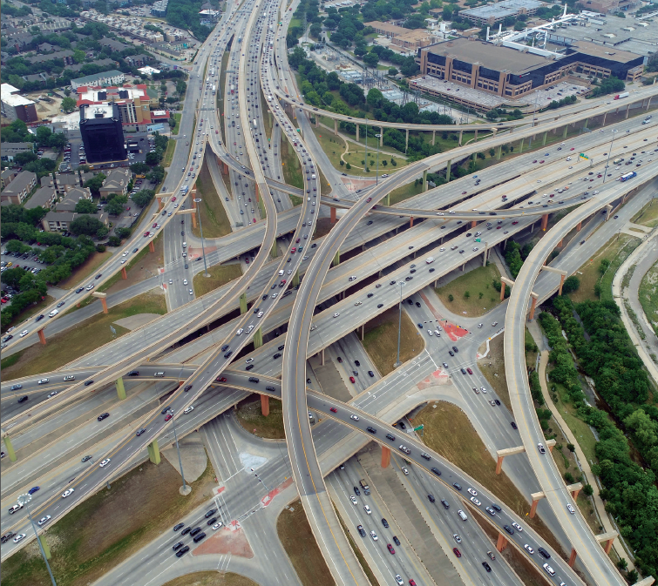
Cooperative Inclusion Plan
(CIP)
“Connecting Regional Highway Transportation Providers and Contractor Associations”

Slide 2
CIP 2019 Class Schedule
Class #1: Navigating TxDOT Website (February 14, 2019)-@ Dallas District TxDOT 9am-10am (Registration 8:30am/Network Opportunities till 11am)
Class #2: TxDOT Compliance (CIV) (March 21, 2019)-@ Dallas District TxDOT 10:30am-11:45am (Registration 10am/Network Opportunities till 11am)
Class #3: TxDOT Construction Prequalification/NTTA Bidding Process
(May 15, 2019)-@ Dallas District TxDOT 9:30am -11am (Registration
9am/Network Opportunities till 11am)
Class #4: TxDOT Spec Book & Field Implementation (June 20, 2019)-@ Dallas District TxDOT 3pm-5pm (Registration 2:30pm/Network Opportunities till 6pm)
Class #5: Working with Diversity Management System (August 22, 2019)- @ Dallas District TxDOT 4:00pm-5:00pm (Registration 3:30pm/Network Opportunities till 6pm)
Class #6: Bonding 101/Understanding Business Credit (September 19, 2019)- @ Dallas District TxDOT 9am-11am (Registration 8:30am/Network Opportunities till 11am)

Slide 3
Cooperative Inclusion Plan (CIP) Contacts:
Debra Wells 214-319-3553: CIP Resource Specialist
Debra.Wells@txdot.gov
Nora Perez 214-319-6456: DBE Coordinator
Noraima.perez@txdot.gov
Information:
keepitmovingdallas.org

