Slide 1
COOPERATIVE INCLUSION PLAN (CIP) University Training
“Connecting the regional highway transportation providers and contractors’ associations”
CIP University Training
October 18, 2013

Slide 2
CIP Overview
Highway Transportation Providers
Contractor Associations
Opportunities

Slide 3
Target Groups
Minority Businesses
Woman-Owned Businesses
Historically Underutilized Businesses
Small Businesses
Disadvantaged Businesses

Slide 4
Five Major Components
Education
Access
Availability
Capacity
Utilization

Slide 5
CIP Partners

Slide 6
Agenda Moderator – John H. Martinez-D., President, RHCA
8:15 AM – 8:30 AM | Registration
8:30 AM | Opening Remarks –William “Bill” Hale, TxDOT, Dallas District
8:35 AM | Welcome – The Honorable, Carolyn R. Davis, Councilmember, District 7
8:40 AM | CIP Dashboard Overview - Anthony Coleman, NTTA
8:45 AM | Workshops Overview - Kimberly Tolbert, NTTA
9:00 AM – 11:15 AM | Workshop Sessions
11:15 AM – 11:30 AM | Networking
11:30 AM | Diversity Strategic Thinking – Clifton Miller, Cemetrics
12:40 PM | Closing Remarks - The Honorable, Carolyn R. Davis, Councilmember, District 7

Slide 7
Workshop Schedule
9:00 – 9:40 AM | Room One | Room Two
 | Scoring a touchdown with bonding and credit risk Facilitator: Anuj M. Patel, P.E., A P Engineering Presenter: Brady Cox, Baldwin-Cox Agency, LLC | Game ticket for becoming a certified DBE Facilitator: Pat Parrish, NTTA Presenter: Albert Titus, North Central Texas Regional Certification Agency
9:45 – 10:25 AM | Gaining first downs navigating TxDOT’s website Facilitator: Denise Prather, P.E., TxDOT, Dallas Presenter: Tony Payberah, P.E., TxDOT, Dallas | Moving from a rookie to becoming a franchise player Facilitator: Andrew Nash, DFW MSDC Presenters: Monica Bailey Jackson, LeVis Group Eduardo Medellin, Todo Construction
10:30 – 11:10 AM | PreGame show for highway construction Facilitator: Kimberly Tolbert, NTTA Presenters: Braylon Lester, Xtra 21 Express Trucking, Eugene Walker Jr., EJ Smith Construction and Sharon Douglas, Douglas Construction | The half-time and locker room report Facilitator: Anthony Coleman, NTTA Presenter: Demetria Wise, 3i Construction

Slide 8
Diversity Strategic Thinking
Six Thinking Hats Exercise

Slide 9
Diversity Strategic Thinking Agenda
Objectives and Desired Outcomes
The Why, What, How and When
Six Thinking Hats Overview and Exercise

Slide 10
Diversity Strategic Thinking
Objectives
Desired Outcomes
Introduce new critical thinking model, ”Six Thinking Hats”, to attendees
“Mental Map” or cognitive focus shift on the part of attendees through engagement in a solutions building exercise to yield practical strategies to increase MWDBE participation in highway construction contracting.
Provide a new problem solving tool
Enhanced Relationships
Enhanced Solutions Development
Ongoing engagement

Slide 11
The Why, What, How and When

Slide 12
Innovation
Innovation | Transform from the traditional “Push” approach with information being delivered from TxDOT/NTTA to the MWDBE supplier community to a “Pull” strategy capturing real-life/real-time direct input from MWDBEs regarding current processes and practices utilized by transportation providers.

Slide 13
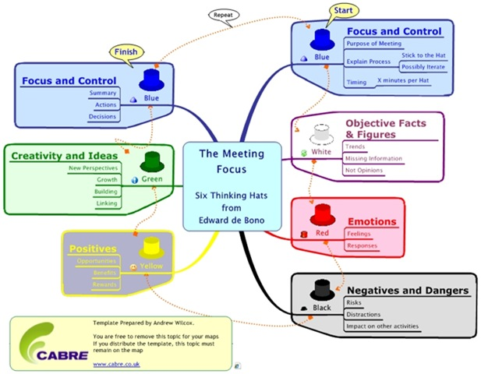
Six Thinking Hats Process

Slide 14
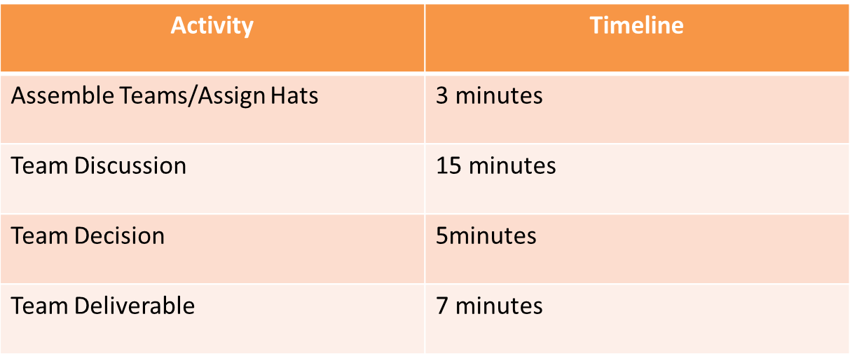
Six Thinking Hats Exercise

Slide 15
Deliverables Template
Team Name | Team members
Barrier | Prime/Causal Factor(s) | Inhibitor(s) | Enabler(s) | Implementable Solutions

Slide 16
Evaluation
Your input is valuable

Slide 17
Closing Remarks
The Honorable
Carolyn R. Davis
Councilmember, District 7

Slide 18
Thank You

