Slide 1


Cooperative Inclusion Plan
(CIP)
November 12th, 2020
10:00 a.m.-12:00 p.m.
Host: Debra Wells
CIP Resource Specialist-TxDOT Dallas District
Co-Host: Noraima (Nora) Perez
DBE Coordinator-TxDOT Dallas District

Slide 2

Event Logistics
Welcome to the CIP Workshop for Heavy Highway Construction Firms Webinar
Microphones will be automatically muted upon entry.
Please turn off video, if it’s activated.
An online survey link will be posted at the beginning, throughout and at the end of the session in the chat box.
Please submit any questions you may have directly to the presenters via the chat box, and it will be answered at the Q & A Session.

Slide 3

Agenda
Event Logistics
Opening Remarks
Cooperative Inclusion Plan (CIP) Overview
NTTA Upcoming Construction Projects
NTTA Electronic Response & Virtual Meetings
North Central Texas Regional Certification Agency (NCTRCA)-Certifications
Webber, LLC- Opportunities
Ferrovial Construction- Opportunities
Pegasus Link Constructors, JV (PLC)-IH 635 LBJ East Project
Question and Answer Session
Survey Completion-Reminder
Closing Remarks
Virtual Networking

Slide 4

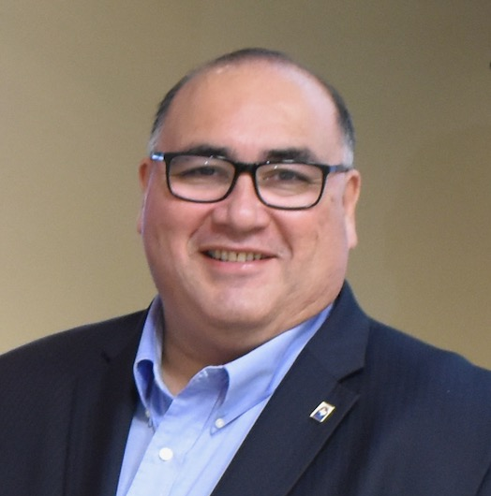

Opening remarks
John H. Martinez-D.
President & CEO
Regional Hispanic Contractors Association (RHCA)

Slide 5

Cooperative Inclusion Plan
Connor VanSteenberg
North Texas Area Manager
The Associated General Contractors of TX (AGC)

Slide 6
What is (CIP)?
The Cooperative Inclusion Plan (CIP) is a comprehensive approach to addressing the shortage of disadvantaged, minority, women, and small businesses and historically underutilized businesses (D/M/W/SBE and HUB) firms in heavy highway contracting.
The CIP Team holds free workshops/trainings, open to the public for contractors and consultants who perform work in the heavy highway construction industry. The target audiences are minority contractors, consultants and providers of goods and services from the heavy highway construction industry.

Slide 7




Six (5) CIP Partners
Asian American Contractors Association of Texas (AACATX)
Associated General Contractors of Texas (AGC)
North Texas Tollway Authority (NTTA)
Regional Hispanic Contractors Association (RHCA)
Texas Department of Transportation (TxDOT)

Slide 8
CIP Goals
Expand pool of qualified D/M/SBE and HUB Firms certified to perform heavy highway construction.
Increase dollars spending with local D/M/W/SBE and HUB Firms in heavy highway construction.
Grow bonding capacity of D/M/W/SBE and HUB Firms.
Increase number of D/M/W/SBE and HUB Firms serving in prime roles.

Slide 9
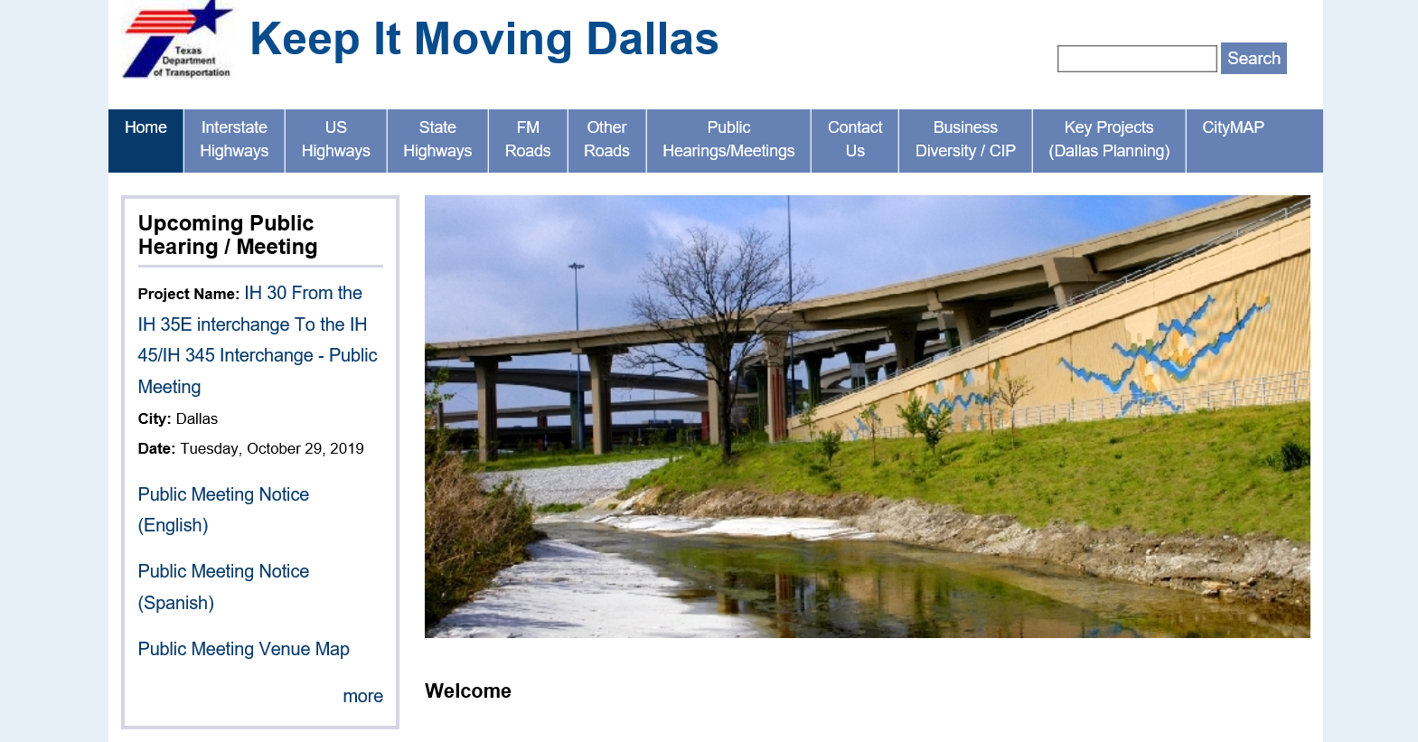
CIP Website www.keepitmovingdallas.com

Slide 10
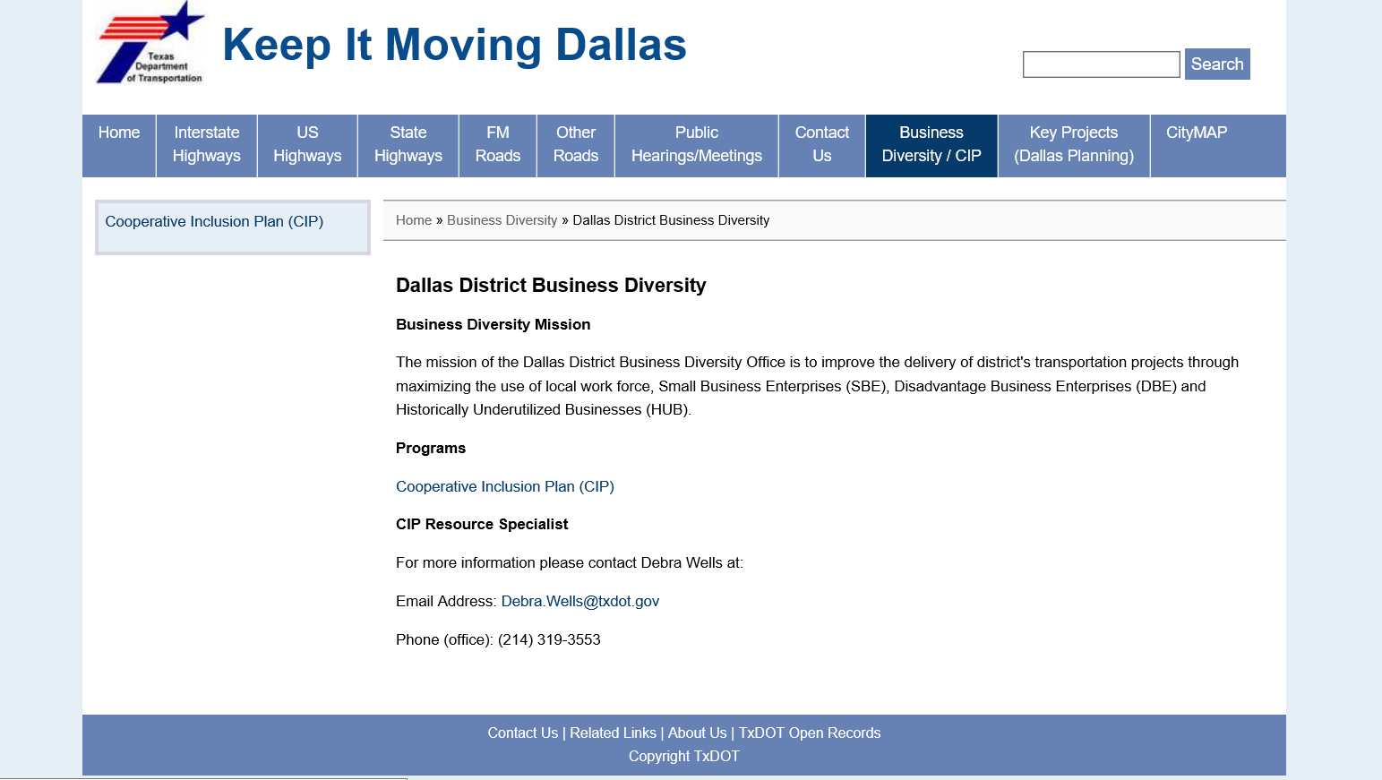
Cooperative Inclusion Plan Information

Slide 11
Cooperative Inclusion Plan
(CIP)
Contacts:
Debra Wells 214-319-3553: CIP Resource Specialist
Debra.Wells@txdot.gov
Nora Perez 214-319-6456: DBE Coordinator
Noraima.perez@txdot.gov
CIP Resource Guide on
www.keepitmovingdallas.com

Slide 12
NTTA Project Delivery
5-Year Capital Plan and Construction Opportunities
Mark A. Bouma, P.E.

Slide 13
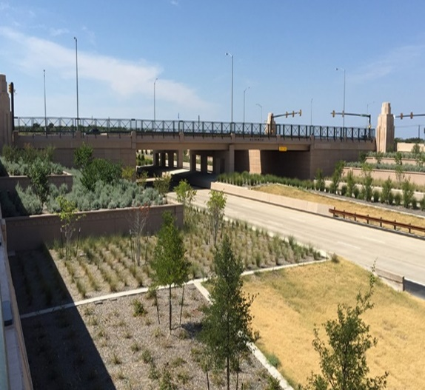

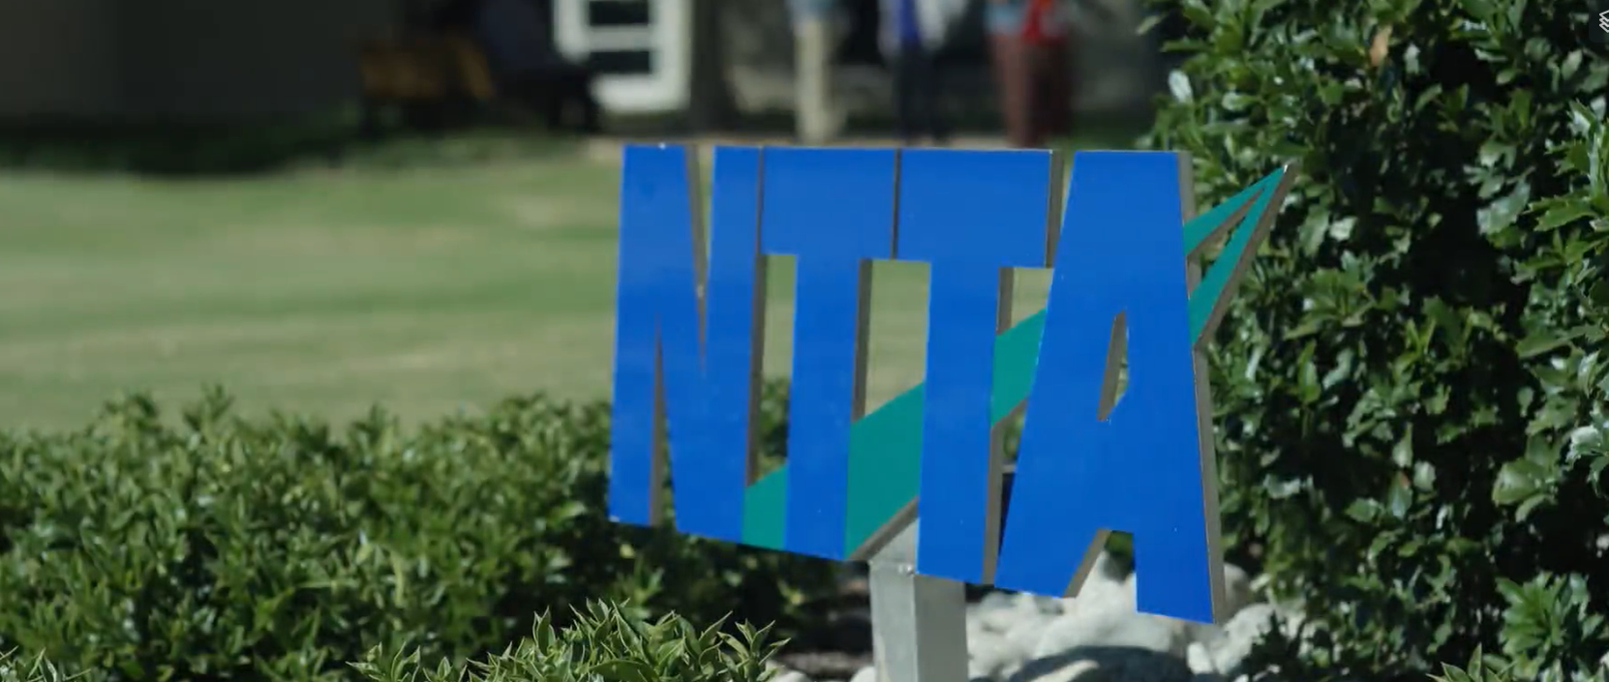
NTTA’s Five Year Capital Plan
  Expansion
  Maintenance/renewal
  Safety Improvements
2

Slide 14

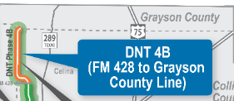
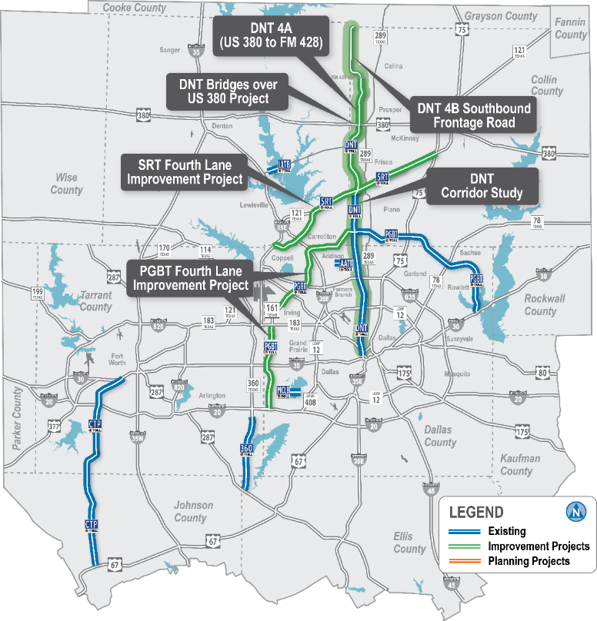
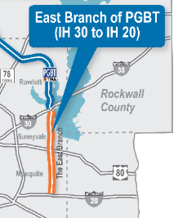
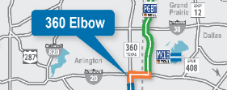
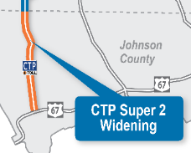
$1.1B
www.ntta.org
Go to:
News & Resources
Investor Information
Financial Information
2020-2024 NTTA
Five-Year Capital Plan

Slide 15

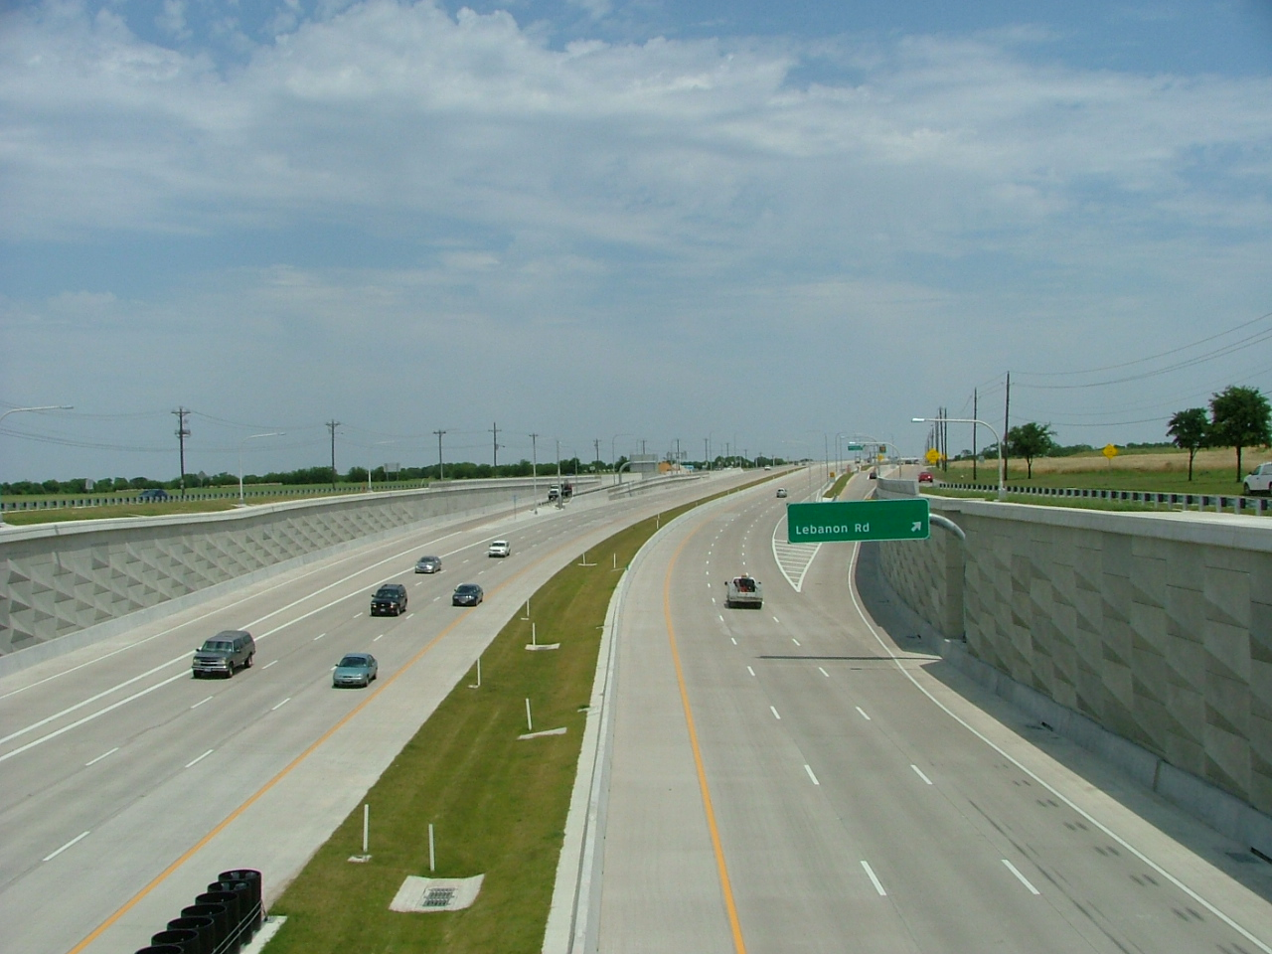
DNT 4th Lane
(SRT to U.S. 380)
Planning complete
Design underway
Construction mid-2022

Slide 16
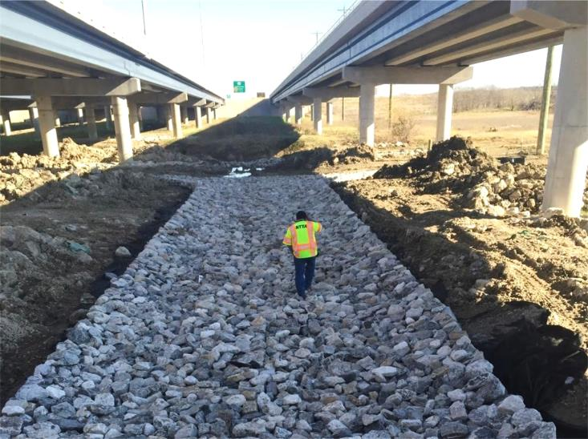
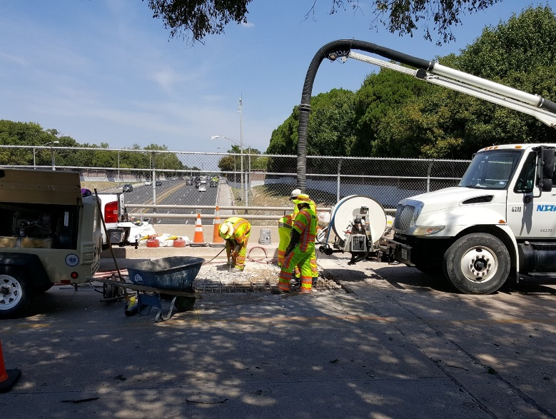
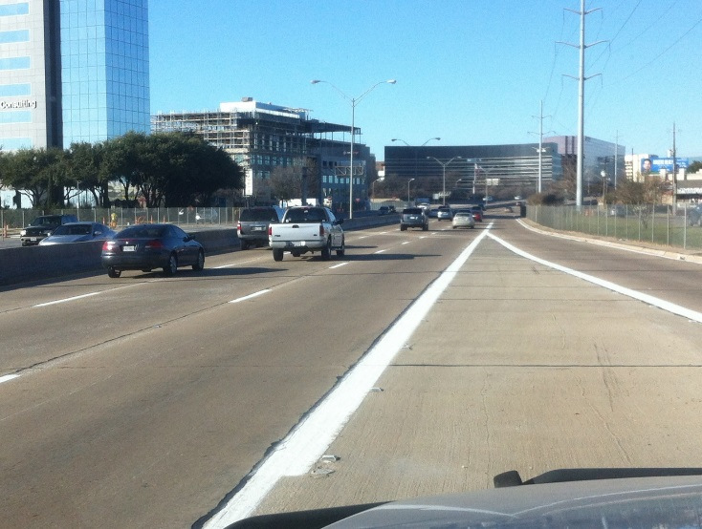
Routine Maintenance Projects
Striping
Erosion Control
Sign Replacements
Pavement Repair
Bridge Deck Repair
Issued throughout the year

Slide 18
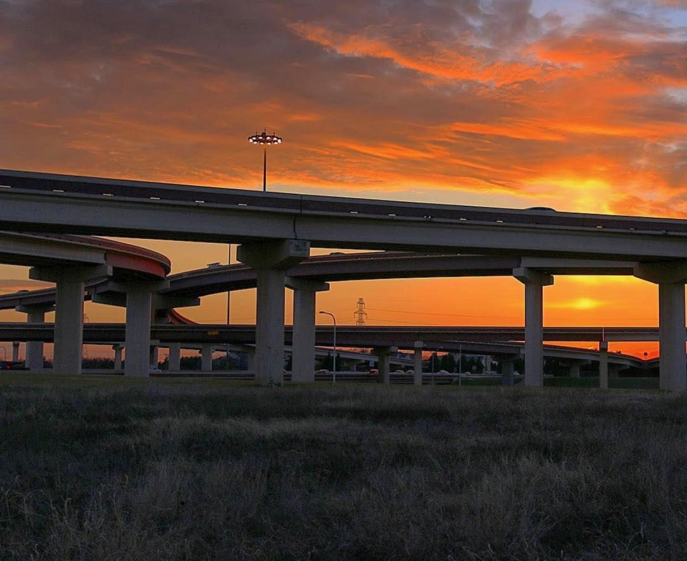
Maintenance Management Consultant
February 2021
Extension of Staff:
Planning, budgeting & design of routine maintenance and rehabilitation projects
Development of maintenance management systems
Review of GEC annual inspection
Specialized inspections of major assets
GASB 34 reporting
Maintenance Rating Program inspections

Slide 19
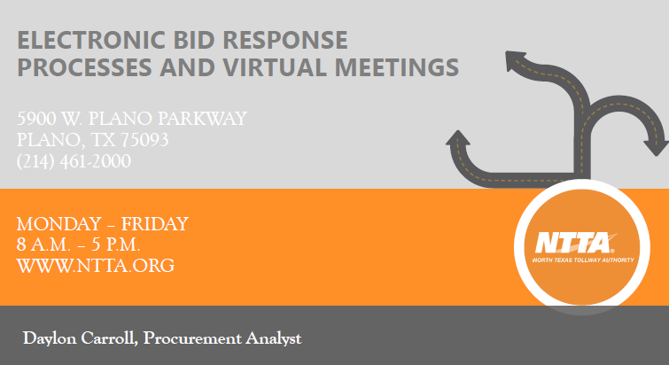

Slide 20
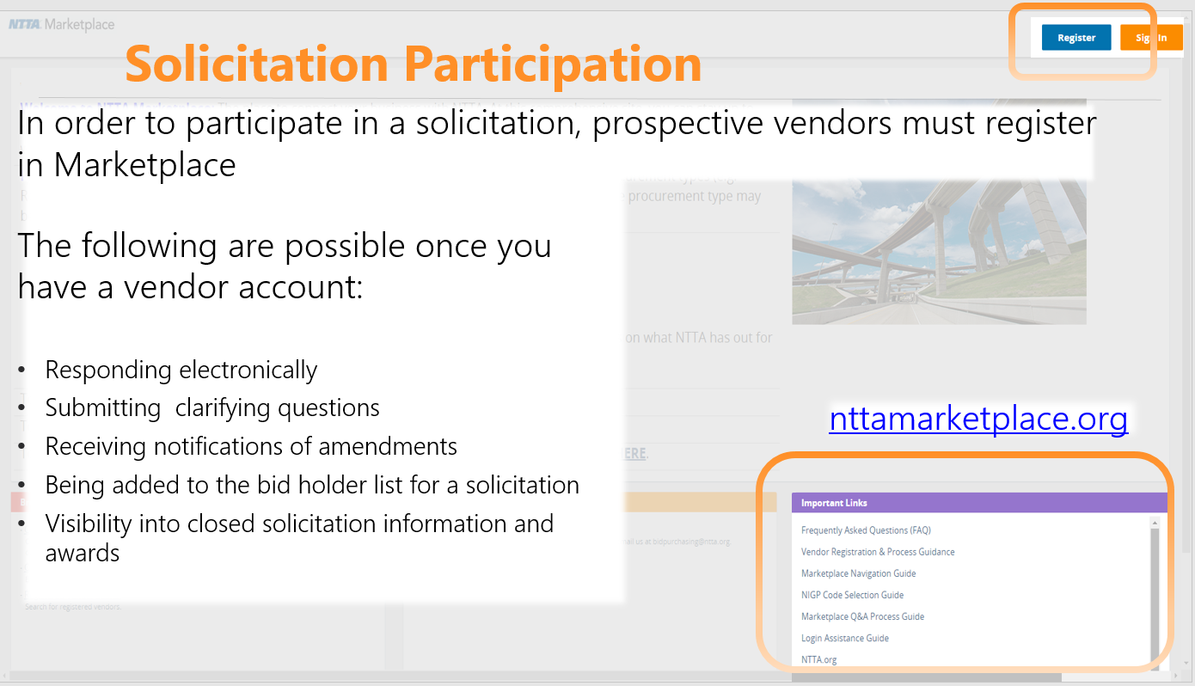

Slide 21
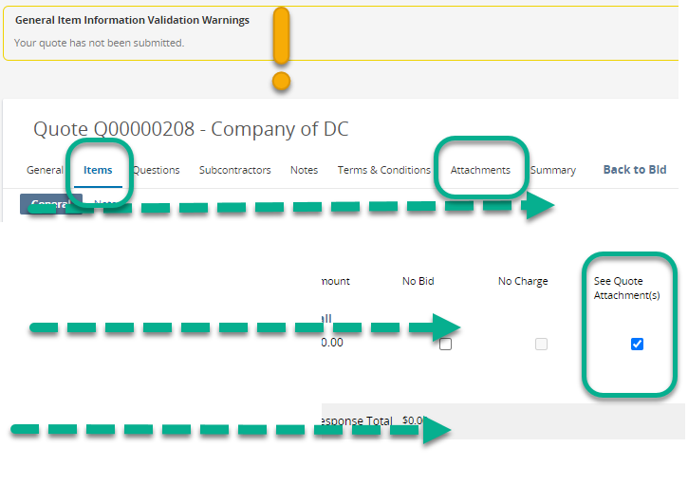
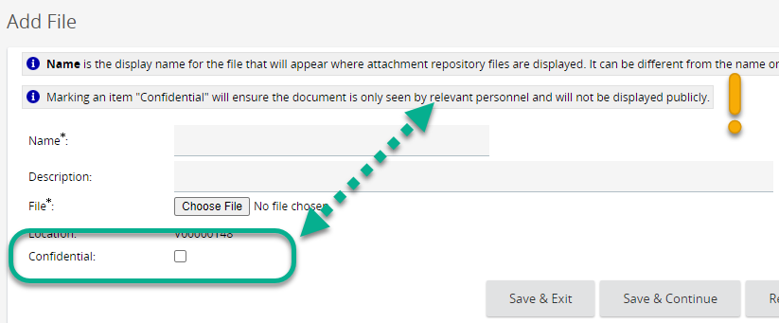
Electronic Response – Important Steps
While on the Attachments tab
The “Confidential” check box controls whether a document can be seen by the general public once the contract is awarded.
If “confidential” only NTTA staff will see the attachment
While on the Items Tab
You will need to check the “See Quote Attachment(s)” box for us.
This is a system workaround that we need your help accomplishing

Slide 22
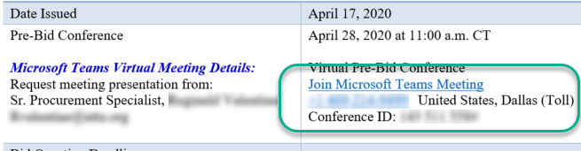
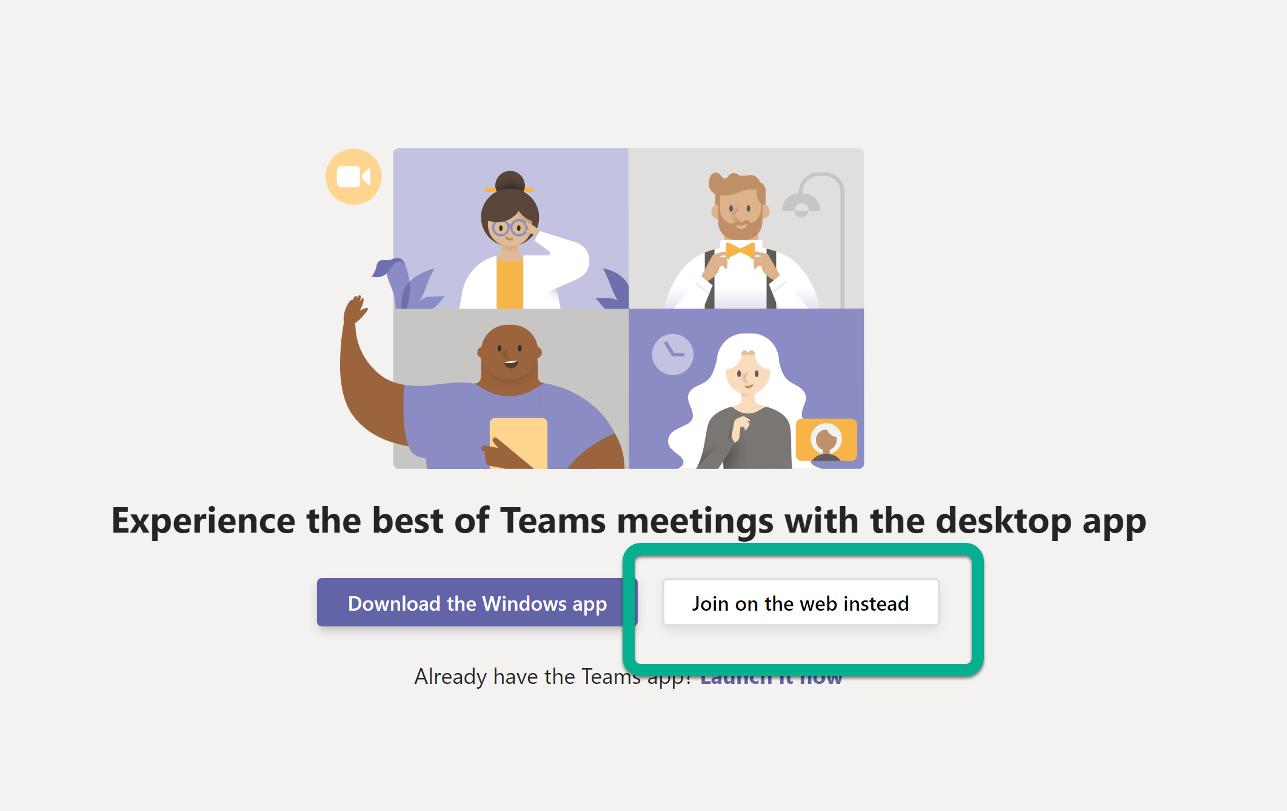
Locating & Joining Virtual Meetings
Any meeting information related to NTTA procurement opportunities can be found on the respective solicitation packet cover sheet.
Each procurement will have separate meeting information for its planned pre-conference and bid opening, if applicable.
Once on the meeting webpage, clicking “Join on the web instead” will enable you to enter the meeting.

Slide 23
14

Slide 24
Polling Question #1
Have you attended a CIP event in the past?
Yes
  Workshop
  Class
No

Slide 25

624 Six Flags Drive, Suite 100
Arlington, TX 76011
817-640-0606 phone
817-640-6315 fax
www.nctrca.org
For Online Applications: https://nctrca.mwdbe.com

Slide 26
About NCTRCA
North Central Texas Regional Certification Agency (NCTRCA)
Represent 20+ governmental/associate member entities that are committed to enhancing the participation of disadvantaged, small, women, and minority owned businesses in public/governmental contracting and purchasing activities
Assist our member entities by validating that businesses are bona-fide disadvantaged, small, woman and minority-owned businesses
Provide education and counseling to assist businesses with the certification process
Member of the Texas Unified Certification Program (TUCP) which provides certification to the Federal Disadvantaged programs in Texas
  6 member agencies
  NCTRCA covers 16 counties in North Texas

Slide 27
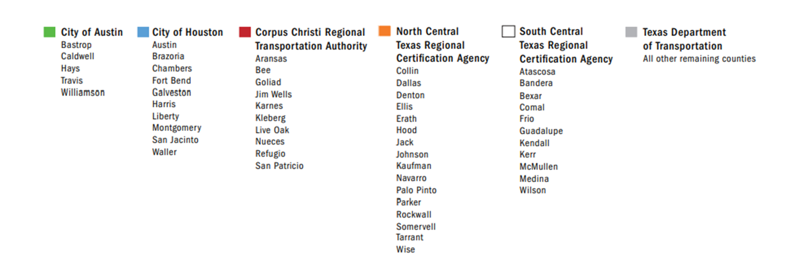
TUCP Certifying Agency Region Map

Slide 28























Member Entities

Slide 29
Types of Certification
Airport Concessionaire Disadvantaged Business Enterprise (ACDBE)
- Opportunity to bid on contracts issued by entities receiving federal funds through the Federal Aviation Administration (FAA), including at airports (airside, landside and off airport)
Disadvantaged Business Enterprise (DBE)
– Opportunity to bid on contracts issued by entities that receive federal aid from Federal Highway Administration, Federal Aviation Administration, United States Department of Transportation
Minority / Woman – Owned Business Enterprise (MBE / WBE)
– Opportunity to bid on contracts issued by local government
Small Business Enterprise (SBE)
– Opportunity to bid on contracts issued by local government (race and gender neutral)

Slide 30
Benefits of Certification
Benefits of Certification
Access to opportunities issued by government entities
Enhance marketing
Business development opportunities
Networking opportunities via outreach events

Slide 31
ACDBE/DBE Program
ACDBE/DBE Program
  The Disadvantaged Business Enterprise `(DBE) program is a federal program administered by the United State Department of Transportation (USDOT) through each State’s Unified Certification Program
  The goal is to ensure that eligible DBE firms can compete fairly for federally funded transportation-related projects
  NCTRCA is one of six members of the Texas Unified Certification Program (TUCP)
    NCTRCA
    SCTRCA
    TXDOT
    City of Austin
    City of Houston
    Corpus Christi Regional Transportation Authority
  The TUCP is responsible for vetting firms to ensure they meet the DBE/ACDBE eligibility requirements as defined by Title 49 Part 26 of the Code of the Federal Regulations (DBE) or Title 49 Part 23 of the Code of Federal Regulations (ACDBE)

Slide 32
ACDBE/DBE Certification Criteria
  Firm must be at least 51% owned and controlled by a socially and economically disadvantaged individual(s)
  The disadvantaged owners must be a United States Citizen or lawfully admitted permanent resident of the United States
  Firm must be organized as a for-profit business
  Firm must be physically located in the United States or it’s trust territories
  The firm must meet the U.S. Small Business Administration size standard requirements for a small business in its NAICS code industry(s)and does not have annual gross receipts that exceed $23.98 million for DBEs and $56.42 for ACDBEs in the 3 previous fiscal years
  Personal Net Worth for all owners claiming disadvantaged status for the DBE and/or ACDBE program must not exceed $1.32 million

Slide 33
ACDBE/DBE REQUIRED DOCUMENTS
Résumés (that include places of employment with corresponding dates), for all owners, officers, and key personnel of the applicant firm
Personal Net Worth Statement for each socially and economically disadvantaged owners comprising 51% or more of the ownership percentage of the applicant firm
Personal Federal tax returns for the past 3 years, if applicable, for each disadvantaged owner
Federal tax returns (and requests for extensions) filed by the firm and its affiliates with related schedules, for the past 3 years
Documented proof of contributions used to acquire ownership for each owner (e.g., both sides of cancelled checks)
Signed loan and security agreements, and bonding forms
List of equipment and/or vehicles owned and leased including VIN numbers, copy of titles, proof of ownership, insurance cards for each vehicle
Title(s), registration certificate(s), and U.S. DOT numbers for each truck owned or operated by your firm

Slide 34
ACDBE/DBE REQUIRED DOCUMENTS
Licenses, license renewal forms, permits, and haul authority forms
Descriptions of all real estate (including office/storage space, etc.) owned/leased by your firm and documented proof of ownership/signed leases
List of all employees, job titles, and dates of employment
Documented proof of any transfers of assets to/from your firm and/or to/from any of its owners over the past 2 years
DBE/ACDBE and SBA 8(a), SDB, MBE/WBE certifications, denials, and/or decertification, if applicable; and any U.S. DOT appeal decisions on these actions
Bank authorization and signatory cards
Schedule of salaries (or other remuneration) paid to all officers, managers, owners, and/or directors of the firm
Proof of warehouse/storage facility ownership or lease arrangements

Slide 35
ACDBE/DBE REQUIRED DOCUMENTS
In addition to the documents on the previous page, the following documents are required according to business structure:
Partnership or Joint Venture
Original and any amended Partnership or Joint Venture Agreements
Corporation or LLC
Official Articles of Incorporation
Both sides of all corporate stock certificates and your firm’s stock transfer ledger
Shareholders’ Agreement(s)
Minutes of all stockholders and board of directors meetings
Corporate by-laws and any amendments
Corporate bank resolution and bank signature cards
Official Certificate of Formation and Operating Agreement with any amendments (for LLCs)

Slide 36
ACDBE/DBE REQUIRED DOCUMENTS
Optional Documents to be Provided upon request
Per USDOT, NCTRA may require the submission of the following documents. If requested to provide these documents, you must supply them with your application or at the on-site visit.
Proof of citizenship
Insurance agreements for each truck owned or operated by your firm
Audited financial statements (if available)
Personal Federal Tax returns for the past 3 years, if applicable, for other disadvantaged owners of the firm
Trust agreements held by any owner claiming disadvantaged status
Year-end balance sheets and income statements for the past 3 years (or life of firm, if less than three years)
Suppliers
List of product lines carried
List of distribution equipment owned and/or leased

Slide 37
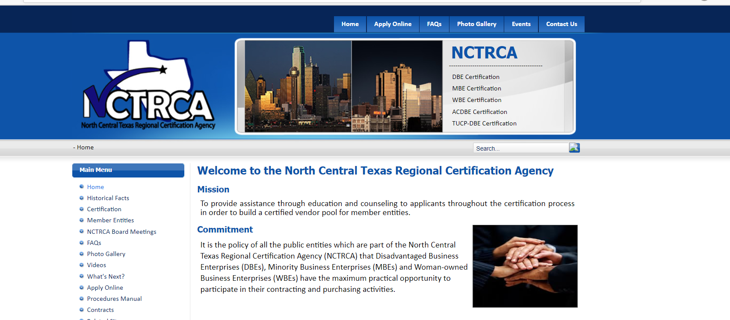
How to Apply
Visit nctrca.org

Slide 38
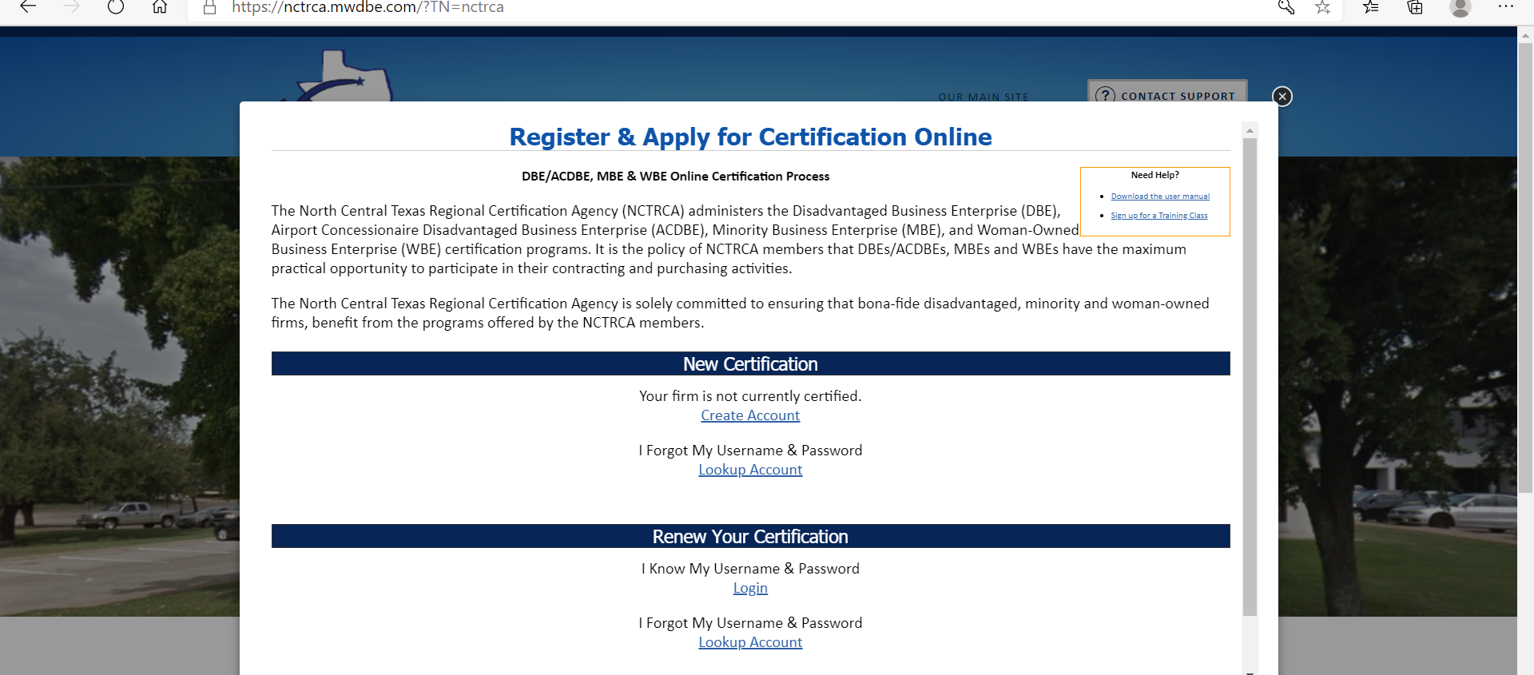
How to Apply

Slide 39
APPLICATIONS
  Prior to applying online – review the paper application for instructions at - http://nctrca.org/images/USDOT_NEW_DBE_Application112014.pdf
  Answer each question thoroughly
  Submit all required documents
  Failure to submit a complete application will delay process
  Detailed description of all services provided – include NAICS codes if known
  At least 90 days to process

Slide 40
You’re certified!
Now What?
Register as a vendor on each NCTRCA member’s website
Attend pre-bid meetings
Attend outreach events
Network, Network, Network

Slide 41
Contact Us
www.nctrca.org
Online applications:
https://nctrca.mwdbe.com
Email: mail@nctrca.org
Phone: 817.640.0606

Slide 42
Feel free to contact me:
YaLonda Lockett,
Executive Director
ylockett@nctrca.org

Slide 43
Polling Question #2
How did you hear about today’s event?

Slide 44
Getting ready to do business with Webber
Stella Vargas – Diversity Contract Compliance Manager

Slide 45

Introduce yourself
What does that mean?
  Do you have a capability statement? Is your DBE certification current? Do you have the NAICs for the type of work you’re bidding on?
  Are you able to perform work throughout Texas? North Texas only?
  Once you start bidding, do you know when you are making a profit?

Slide 46

Next Steps…
Send in your capability statement and your DBE certificate to webberdbe@wwebber.com
I will send the list of TxDOT projects that Webber anticipates bidding on in January, February and March 2021
Continue to stay safe and be well…

Slide 47

Stella Vargas
webberdbe@wwebber.com
M: 346.224.4659

Slide 48
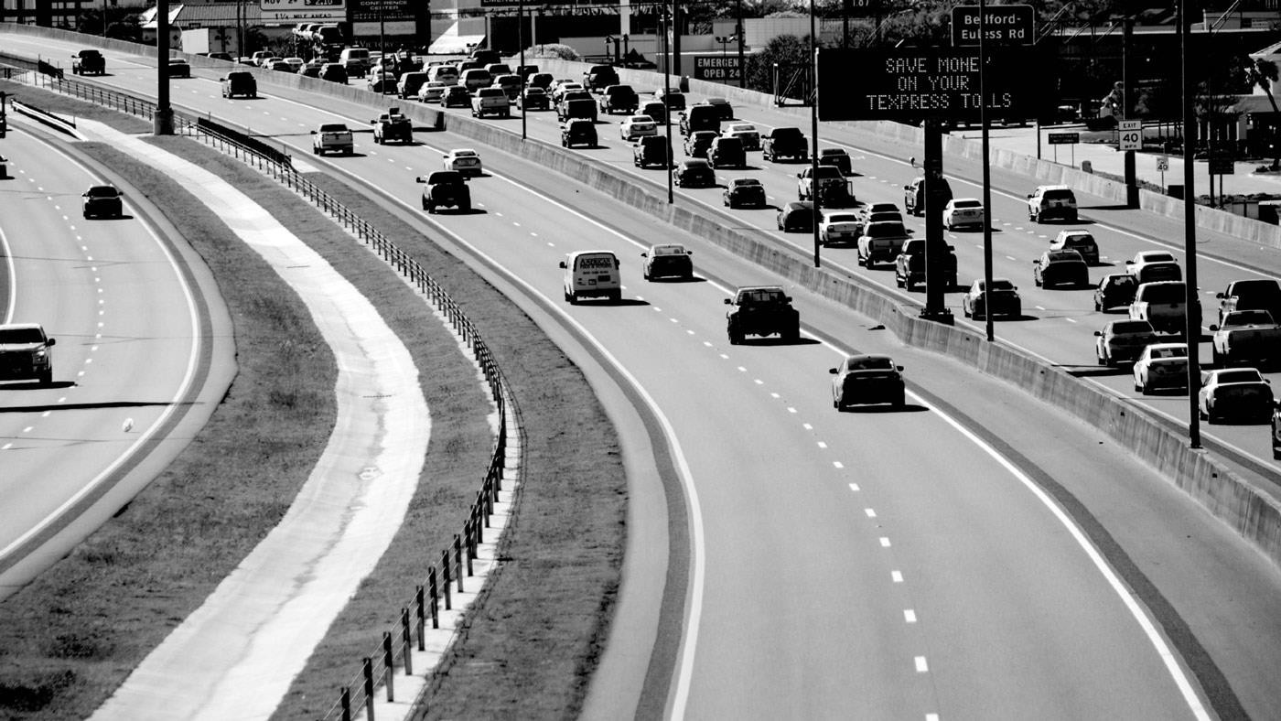


CIP Workshop for Heavy Highway Construction Firms
Angela Berry-Roberson
1

Slide 49


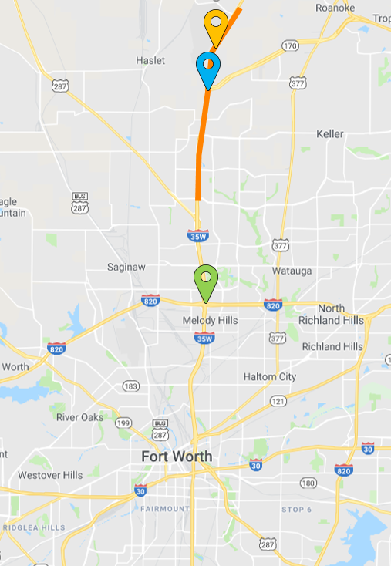

Current Project Opportunities
NORTH TARRANT EXPRESS 35W- SEGMENT 3C
Total Project Value: $601.7 M
Addition of Managed Lanes from North Tarrant
Parkway to Eagle Parkway (7 miles)
Project length: 2019-2023
DBE Contact: Yolanda Coleman
ycoleman@ferrovial.us

Slide 50
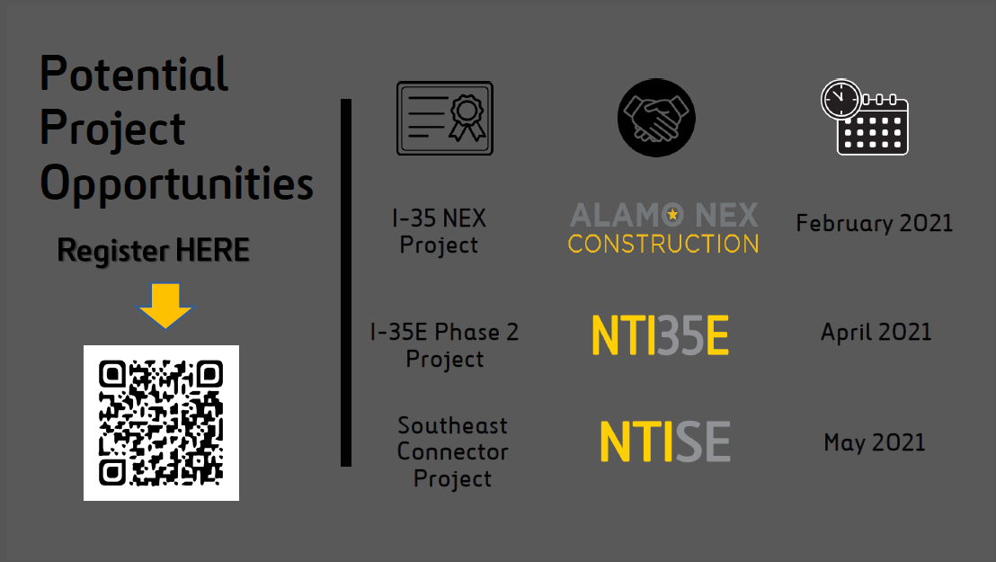

Slide 51

t
Potential Contracting Opportunities
Professional Services
Surveying
Miscellaneous Design Services Drainage Geotechnical Environmental
Utility Relocation Design*
Material Testing/QC Lab
Technical Design Engineering
CADD Support Services

Slide 52


Potential Contracting Opportunities Construction Services
Misc. Construction Services
Earthwork/ Land Clearing and Grubbing
Erosion Control
Landscaping
Demolition
Asphalt Paving
Trucking
Concrete Pavement
Bridge Construction
Drilled Shafts
Striping/Restriping
Mowing/Landscape Maintenance
Construction Materials
Furnish and Install Rebar
MSE Walls
Drainage
Traffic Control
Barriers, Guardrail, Fencing
Lighting/Lighting repair
Traffic Signals
Sound Walls
ITS and TCS Civil Work
Underground Utility
Relocation*
Potholing/Road repair
Routine Inspections
Dewatering

Slide 53


Slide 54
Polling Question #3
Are there any other topics that should be considered for upcoming CIP events?

Slide 55


TxDOT 635 East Project
CIP Webinar
November 12th, 2020
Spring 2020

Slide 56




Project Team

Slide 57

Project Overview
Project cost: $1.7 billion
Delivery method: Design-Build
Contract Term: Five Years
Project Awarded: 2019
Timeframe for construction: 2020 to 2024

Slide 58
Project Schedule
May 2019 | TxDOT awards the project to PLC
August 2019 | Start of project design and contract execution
Spring/Summer 2020 | Start of construction and utility work/relocations
Late 2024 | Substantial completion

Slide 59
Subcontracting Opportunities
MSE Walls
Precast Post and Panel Noise Walls
Cast-in-place Retaining Walls and Noise Walls
Slip-form Concrete Barrier
Metal Beam Guard Fence
Cross Street Civil Construction Packages
Bridge Decks
Storm Drains
Concrete Paving
Other small, miscellaneous goods and services
Sidewalks and ADA ramps
Misc. Concrete flatwork (riprap)

Slide 60
DBE Program Information
DBE Project Goal: 8% ($138,105,066)
DBE Certification
DBE Compliance
  49 CFR Part 26
    NAICS code
    Self-performance
    Employees
    Responsibilities include actually performing, supervising, and managing
    the work
    CUF Review

Slide 61
Registering for Solicitations– FILL OUT THE BIDDERS QUESTIONNAIRE!
Register via project website at www.635east.com
Email to bids@plclbj.com
Contact Adrienne Williams
for additional support at:
Adrienne.Williams@plclbj.com

Slide 62
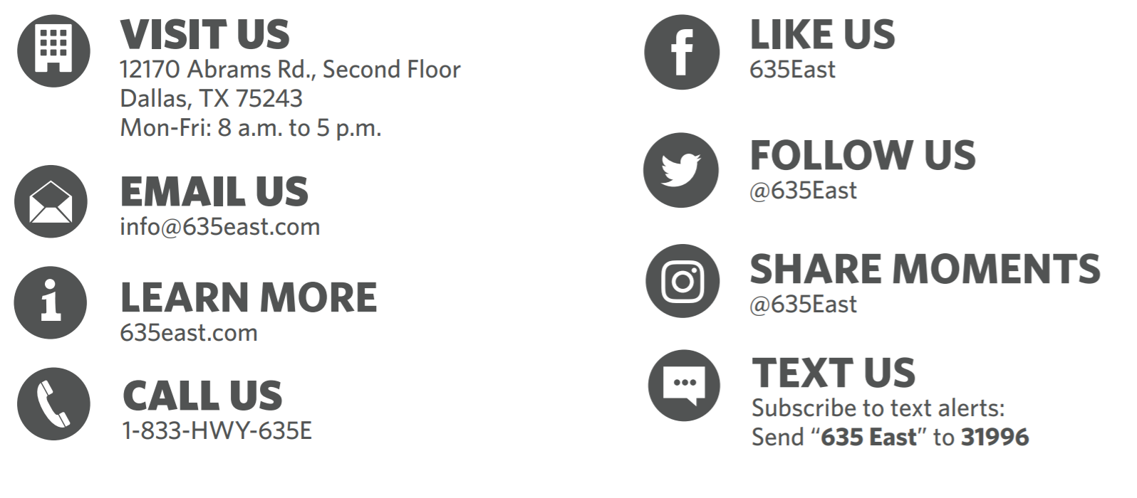
How to Stay Informed

Slide 63

Q & A Time
ANY QUESTIONS?
ANY COMMENTS?
Any Concerns?

Slide 64

End of Survey Reminder
Julio Florez
Vice President of Programs
Regional Hispanic Contractors Association (RHCA)

Slide 65

Closing Remarks
Moses Aito
Director of Business Diversity,
North Texas Tollway Authority (NTTA)

Slide 66
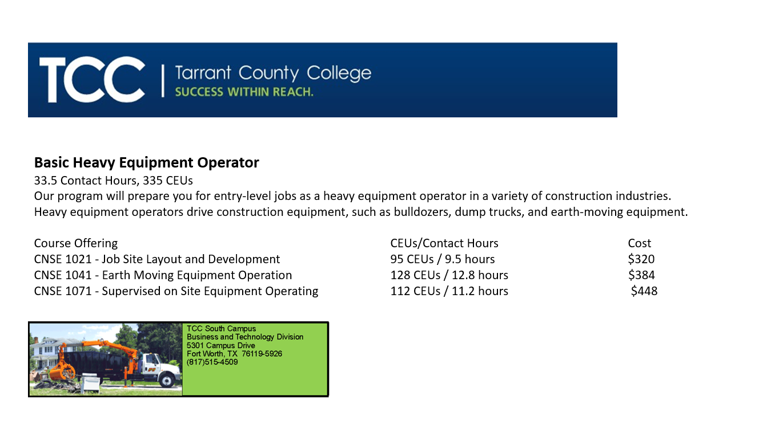

Slide 67
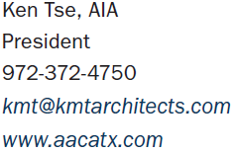
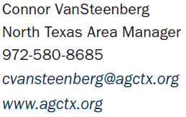
CIP Committee Members Contact Information

Slide 68
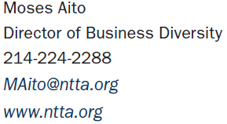
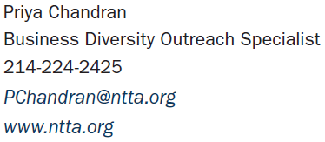
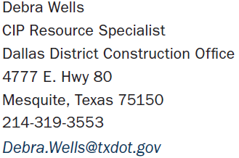
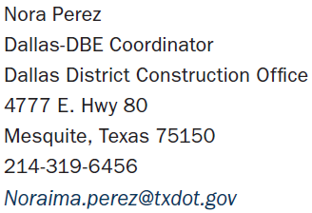
CIP Committee Members Contact Information

Slide 69
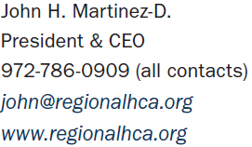
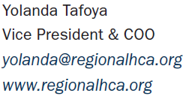
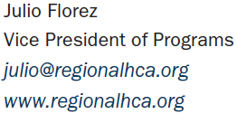
CIP Committee Members Contact Information

Slide 70
Virtual Networking Session
The webinar session will stay open for 20 minutes to network:
Share information and direct contact information amongst each other
Ask and answer questions that are private or in public chat
Engage with each other beyond CIP platform
All chat information, presentation and registration information will posted on CIP website www.keepitmovingdallas.com

Slide 71

Thank you for joining us!

