Slide 1
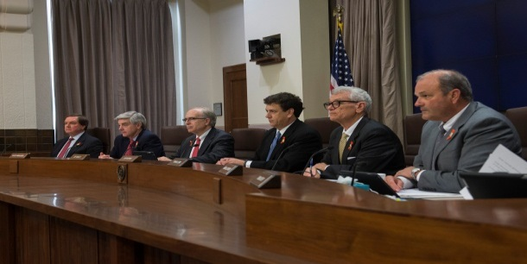
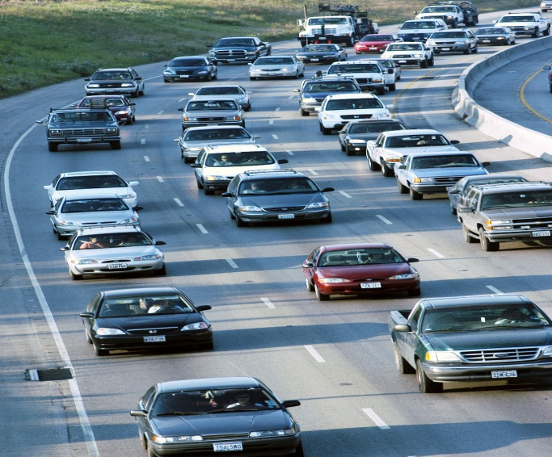
Dallas DISTRICT CURRENT/FUTURE CONSTRUCTION PROJECTS FISCAL Years 2017-2018
Denise Prather, P.E.-Dallas District Construction
CIP Construction/Contractors Workshop
March 9, 2018

Slide 2
INTRODUCTION
Denise Prather, P.E.
Dallas District Construction
214-319-3553
Denise.D.Prather@txdot.gov

Slide 3
Dallas District Areas
Notes:
The Dallas District has 7 counties: Collin, Dallas, Denton, Ellis, Kaufman, Navarro and Rockwall

Slide 4
STATE LET PROJECTS

Slide 5
Current State Let Construction Projects
Dallas District
137 Active Projects
Totaling:
$ 2,125,795,222.04

Slide 6
Upcoming State Let Construction Projects - FY 2018
Dallas District
51 Projects
Totaling:
$ 129,779,140

Slide 7
Upcoming State Let Construction Projects Type of Work:
Improve Traffic Signals
Replace Bridges and Approaches
Landscape Treatment of Right of Way Medians
Reconstruct Existing Pavement and Shoulders
Base Repair
Slope Failure Repair
Full Depth Concrete Repair
Install Guide Signs
Drainage Improvements
Flexible Pavement Repair
Replace Bridge Deck
Construct Sidewalks

Slide 8
LOCAL LET PROJECTS

Slide 9
Current Local-Let Construction Projects
Dallas District
32 Active Projects
Totaling:
$ 85,661,062.18

Slide 10
Upcoming Local Let Construction Projects for FY 2018
Dallas District
12 Projects
Totaling:
$ 21,815,775

Slide 11
Upcoming Local-Let Construction Projects Type of Work:
Bike and Pedestrian Improvements
Construct Sidewalks
Construct right turn lanes
Construct Hike and Bike Trail
Intersection Improvements
Safe Routes to Schools
Traffic Controls & Safety Treatments

Slide 12
Website: Letting Schedule
Go to: www.txdot.gov
Click On- “Business”
Go to: “Letting & Bids”
Click On: Letting Schedule
Go to: Letting Schedules-FY 2018
Click On: Current Statewide 12- Month Letting Schedule for FY 2018 by District
Click On: Fiscal Year 2018 Current Letting Schedule by District
Scroll Down: Dallas District
Easier than you thought!

Slide 13
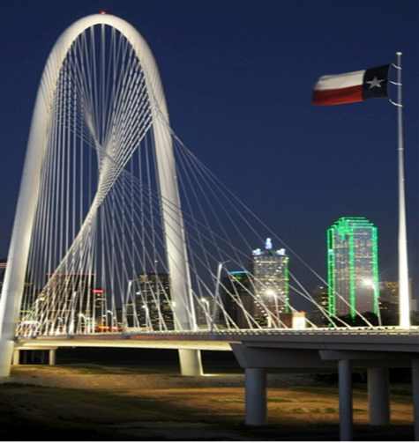
Questions/Answers
Questions?

