Slide 1

Welcome to
Cooperative Inclusion Plan
Navigating TxDOT Website

Slide 2

TxDOT Front Page Of Website

Slide 3
Tools Needed Working With TxDOT
Letting & Bids
Official & Unofficial Bids
Letting Schedule
Pre & Post Letting
Average Low Bid
Plans Online (Proposal & Addendums)
Unit Prices

Slide 4
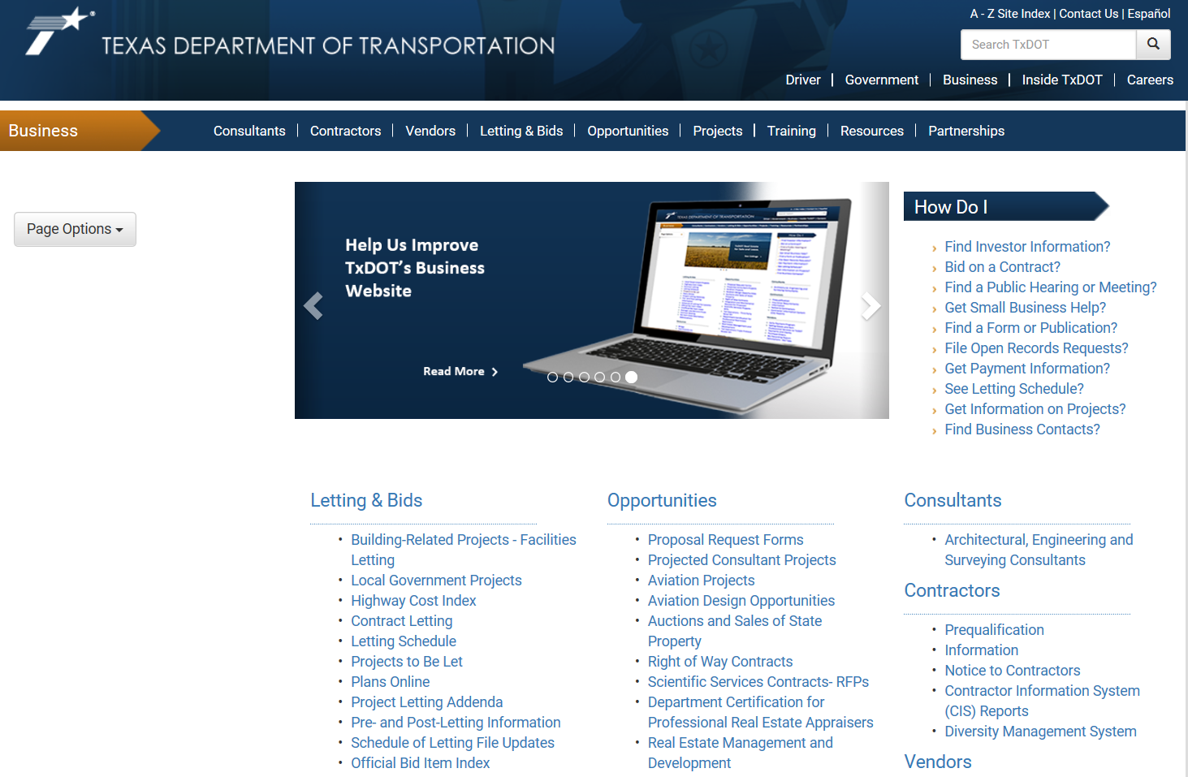
Letting & Bids

Slide 5
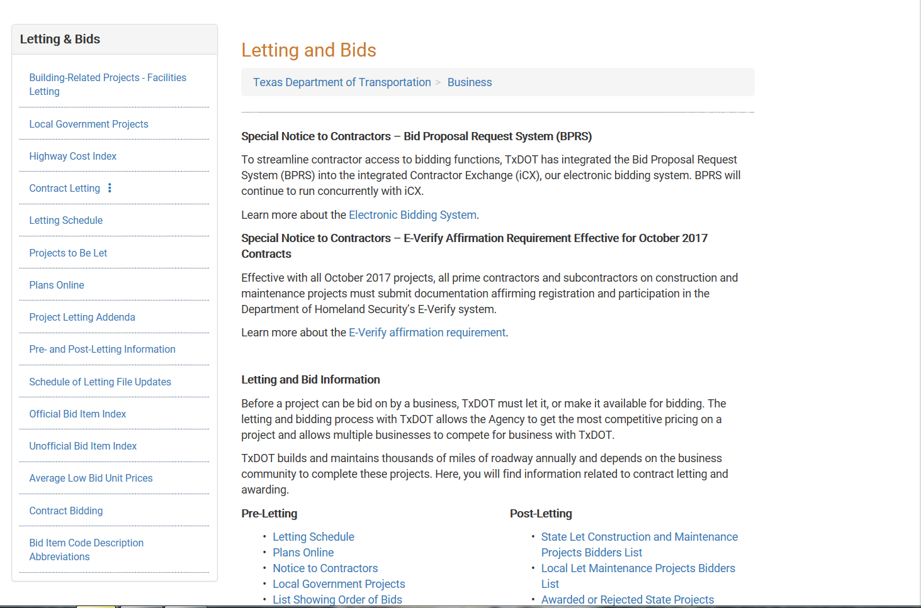
Working With TxDOT Tools

Slide 6
TxDOT Spec Book

Slide 7
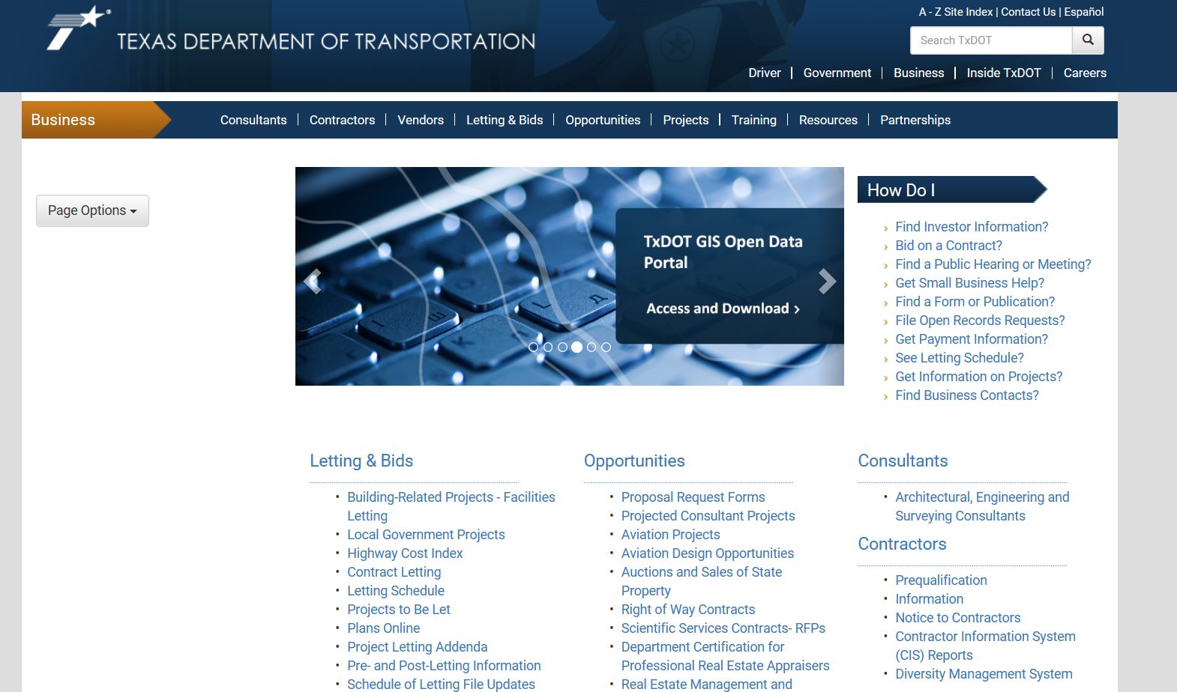
Finding The Spec Book

Slide 8
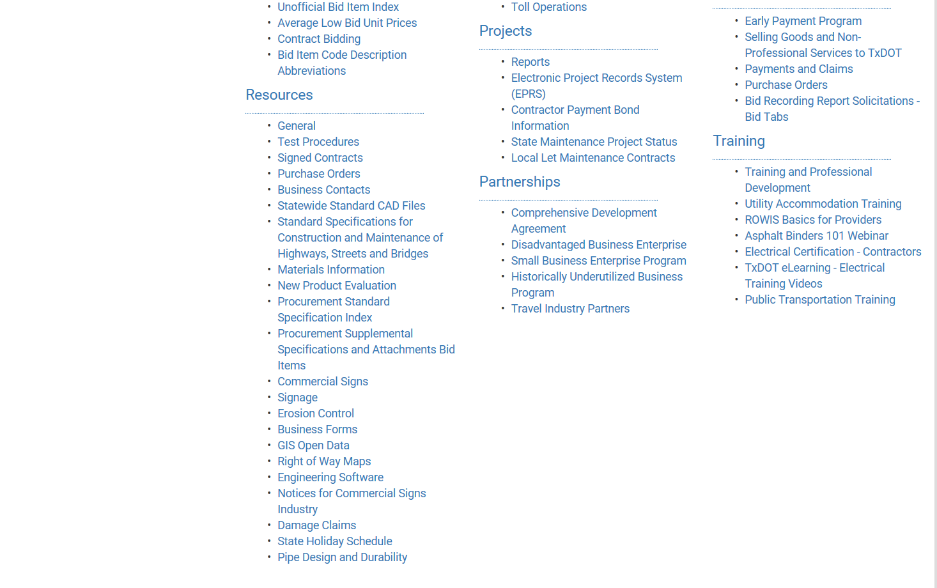
How to Find Spec Book?

Slide 9
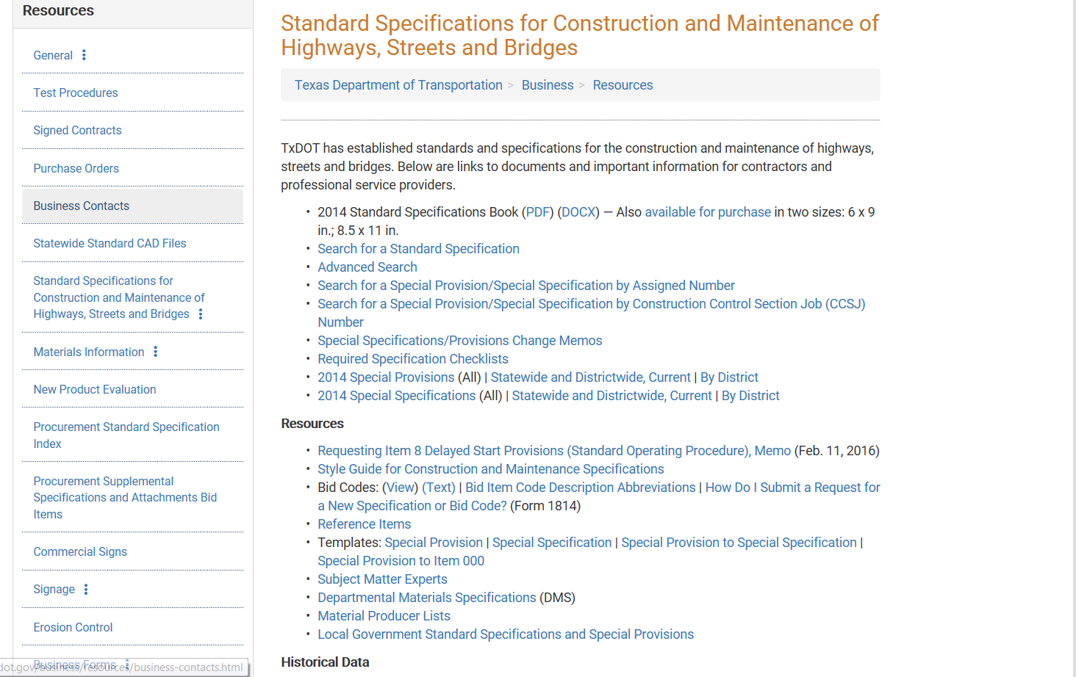
Spec Book Information

Slide 10
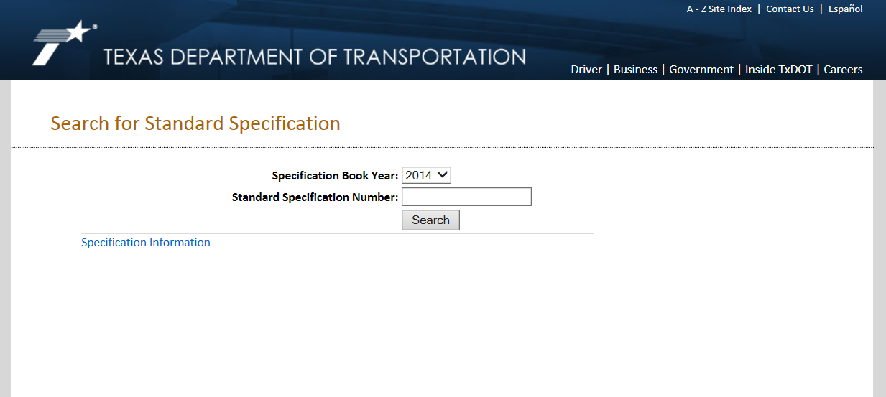
Search Specific Standard In Spec Book

Slide 11
Material

Slide 12
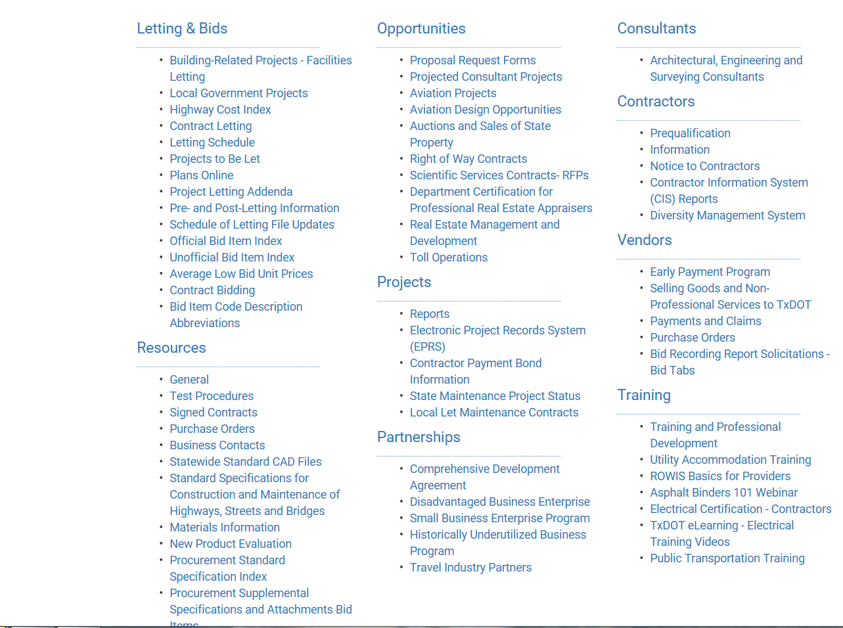
Finding Material Information

Slide 13
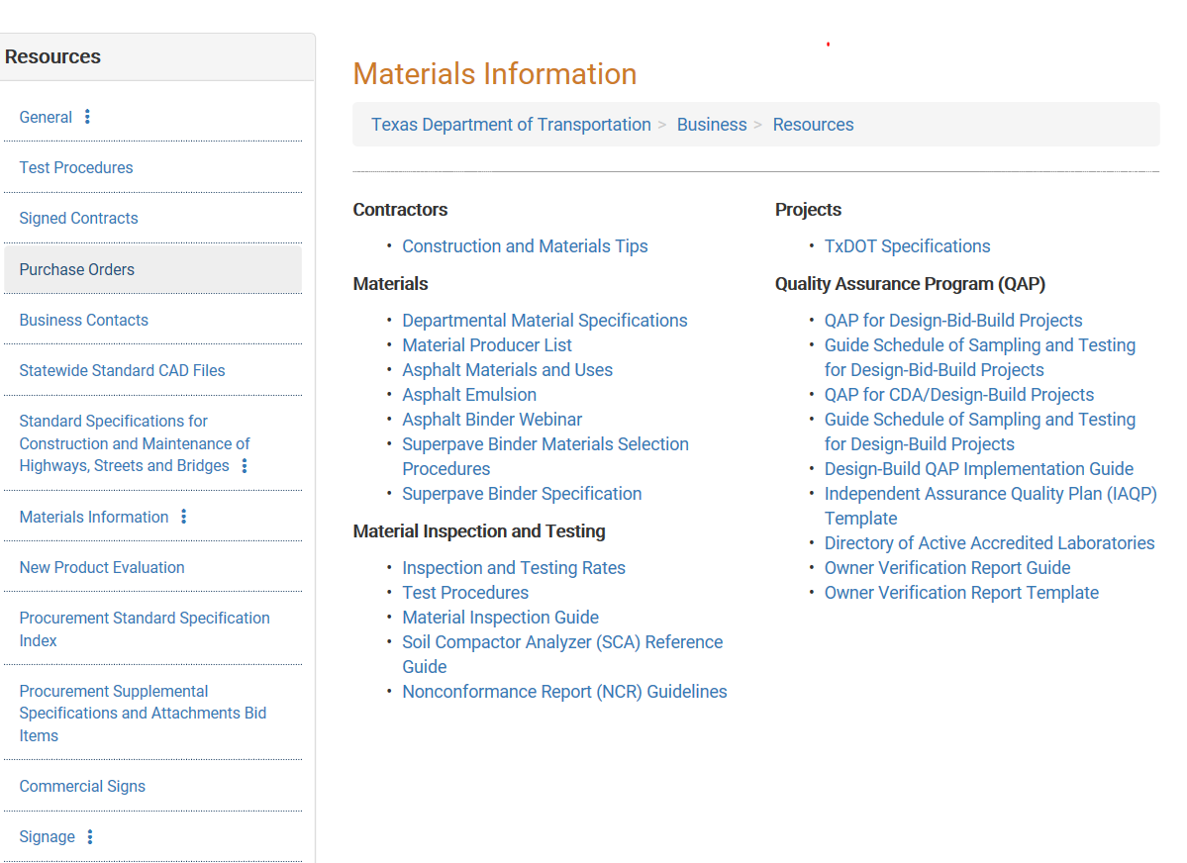
Material Information

Slide 14

Monthly Estimates

Slide 15
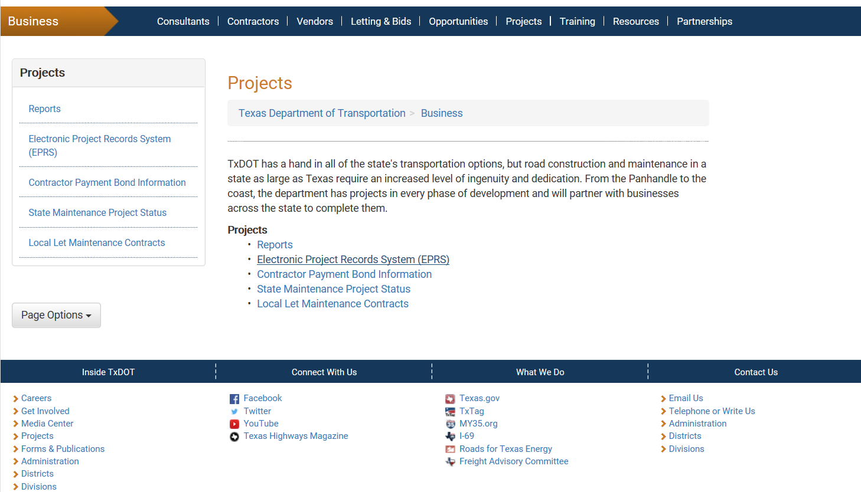
Finding Monthly Estimates

Slide 16
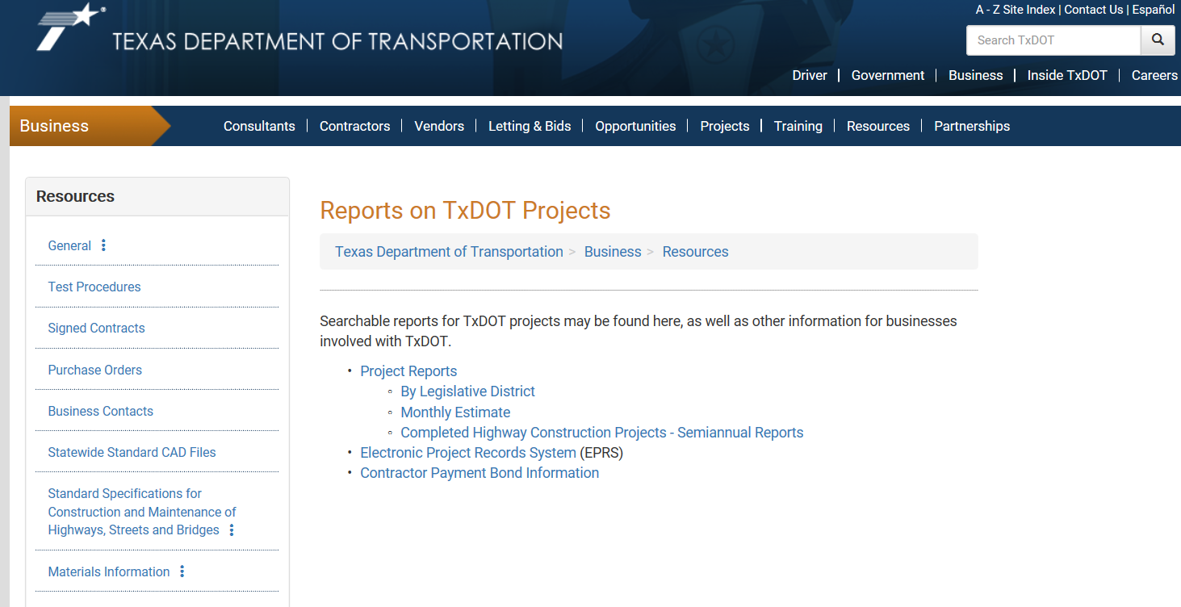
Monthly Estimates

Slide 17
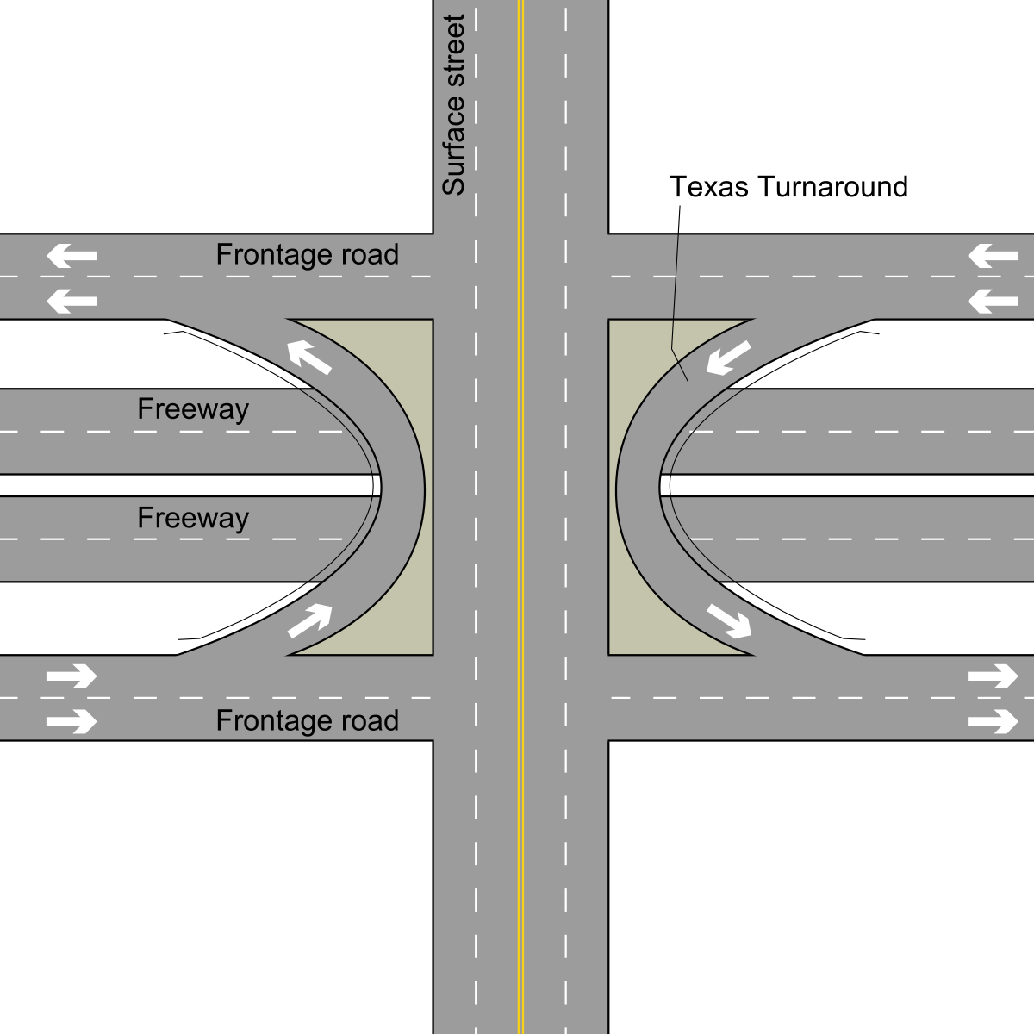
PEPS

Slide 18

PEPS Information

Slide 19
Upcoming CIP Classes & Workshops
2019 CIP Schedule
Here is the Updated CIP Classes/Location (All held at Dallas District TxDOT-DAL-Trans Bldg.) information:
Class #1: Navigating TxDOT Website (February 14, 2019)-@ Dallas District TxDOT 9am-10am (Registration 8:30am/Network Opportunities till 11am)
Class #2: TxDOT Compliance (CIV) (March 21, 2019)-@ Dallas District TxDOT 10:30am-11:45am (Registration 10am/Network Opportunities till 11am)
Class #3: TxDOT Construction Prequalification/NTTA Bidding Process (May 15, 2019)-@ Dallas District TxDOT 9:30am -11am (Registration 9am/Network Opportunities till 11am): Tentative WEB-EX/TBA
Class #4: TxDOT Spec Book & Field Implementation (June 20, 2019)-@ Dallas District TxDOT 3pm-5pm (Registration 2:30pm/Network Opportunities till 6pm)
Class #5: Working with Diversity Management System (August 22, 2019)- @ Dallas District TxDOT 4:00pm-5:00pm (Registration 3:30pm/Network Opportunities till 6pm)
Class #6: Bonding 101/Understanding Business Credit (September 19, 2019)- @ Dallas District TxDOT 9am-11am (Registration 8:30am/Network Opportunities till 11am)
The Updated CIP Workshops/Location (All held at Dallas District TxDOT) information:
Professional Workshop I (January 17, 2019)-Hosted by NTTA/@NTTA 9am-11:30am-DONE
Heavy Highway Construction Firms Workshop I (April 18, 2019)-Hosted by Dallas District TxDOT 9am-12pm (Registration 9am/Networking Opportunities till 12pm)@ Dallas District TxDOT
Professional Workshop II (July 18, 2019)-Hosted by NTTA/@NTTA 9am-11:30am
Heavy Highway Construction Firms Workshop II (October 17, 2019)-Hosted by Dallas District TxDOT 9am-12pm (Registration 9am/Networking Opportunities till 12pm)@ Dallas District TxDOT

