Slide 1
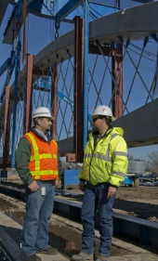
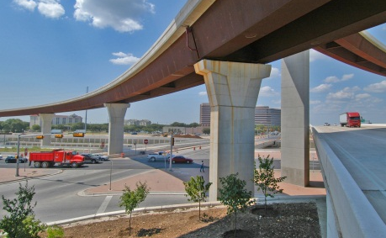
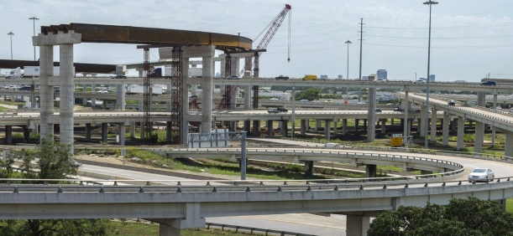
DISADVANTAGED BUSINESS ENTERPRISE (DBE) program
Heavy Highway Construction
Cooperative Inclusion Plan (CIP)
March 2019

Slide 2
civil rights DIVISION
Martha Arnold, Compliance Section

Slide 3
Regulatory Authority
Code of Federal Regulations (CFR)
Title 49 - Transportation
Subtitle A – Office of the Secretary of Transportation
Part 26—Participation By Disadvantaged Business Enterprises in Department of Transportation Financial Assistance Programs
49 CFR Part 26

Slide 4
Disadvantaged business enterprise
Disadvantaged Business Enterprise (DBE)
A for profit small business concern certified through the Texas Unified Certification Program, that is at least 51% owned by one or more individuals who are both socially and economically disadvantaged, and
Whose management and daily business operations are controlled by one or more of the socially and economically disadvantaged individuals who own it.

Slide 5
Texas unified certification program (TUCP)
Texas Unified Certification Program (TUCP)
certifying entities:
City of Austin
City of Houston
Corpus Christi Regional Transportation Authority (CCRTA)
North Central Texas Regional Certification Authority (NCTRCA)
South Central Texas Regional Certification Authority (SCTRCA)
Texas Department of Transportation (TxDOT)

Slide 6
Texas unified certification program (TUCP)
The TUCP provides “one stop shopping” for firms seeking certification in the federal DBE program in Texas.
A DBE certified by any one of the TUCP member entities is automatically DBE certified with TxDOT.
Only those DBEs listed in the TUCP DBE Directory are eligible to be used for DBE goal attainment.

Slide 7
Texas unified certification program (TUCP)
The TUCP Directory lists the firm’s name, address, phone number, and the most specific North American Industry Classification System (NAICS) code to describe the principal goods or services the DBE will provide.
The TUCP Directory is located in the Diversity Management System (DMS) located on TxDOT’s website at https://txdot.txdotcms.com/.

Slide 8
NAICS Codes
49 CFR Part 26.71(n)(1-2)
The types of work a firm can perform must be described in terms of the most specific available NAICS code for that type of work.
In addition to NAICS code, a descriptor from a classification scheme of equivalent detail and specificity may be applied.
A correct NAICS code is one that describes, as specifically as possible, the principal goods or services which the firm would provide to DOT recipients. Multiple NAICS codes may be assigned where appropriate.
Firms and recipients must check carefully to make sure that the NAICS codes cited in a certification are kept up-to-date and accurately reflect work which the UCP has determined the firm's owners can control.

Slide 9
NAICS Codes
POPULAR NAICS Codes
237310 – Highway, Street, & Bridge Construction
237310 – Asphalt Paving (i.e. highway, road, street, public sidewalk)
237310 - Concrete Paving (i.e., highway, road, street, public sidewalk)
237310 – Guardrail Construction
238120 – Structural Steel and Precast Concrete Contractors
238210 – Electrical Contracting
238910 – Drill Shaft (i.e., drilled building foundations) Construction
238990 – All Other Specialty Trade Contractors
423320 – Brick, Stone, and Related Construction Material Merchant Wholesalers
484121 – General Freight Trucking, Long-Distance, Truckload
541330 – Engineering Services
561730 – Landscaping Services

Slide 10
TXDOT WORK CATEGORIES
Asphalt – includes hot-mix, seal coats, surface treatments, etc.
Aviation
Banks Owned By Minorities
Concrete Paving & Incidentals – includes joint concrete pavement, continuously reinforced concrete pavement
Earthwork, Base and Subbase – includes preparing ROW, clearing, removing old concrete, roadway and channel excavation, embankments, etc.
Fencing – includes wire, chain link, & metal beam guard fence, metal bridge railing, etc.
Hauling – includes hauling of base material, gravel, sand, hot-mix, etc.
Illumination – includes placement of conduit and wire, poles, roadway and bridge lights, etc.
Landscaping – includes roadside planting, erosion control, sodding, seeding, etc.
Major Structures – includes structural excavation, drill shafts, piling, concrete for columns, bents, abutments, slabs, structural steel, rebar, etc.

Slide 11
TXDOT WORK CATEGORIES
Material Suppliers – supplier of construction materials, safety supplies, etc.
Minor Structures – includes reinforced concrete pipe, inlets, manholes, sewers, box culverts, sidewalks, driveways, riprap, curb and gutter, concrete bridge railing, etc.
Miscellaneous
Painting – includes painting of structural steel and concrete structures
Professional Services – Engineering, Architecture, and Surveying
Public Transit
Rest Areas – includes steel, masonry or wood fabrication and erection, electrical wiring, plumbing, etc.
Traffic Control Devices includes traffic signals, signs, barricades, pavement markers, buttons, striping, etc.
Truck Owner-Operators
Underground and Utility Work – includes PVC pipe, underground conduit, utility telephone lines, etc.

Slide 12
GOAL ATTAINMENT & UTILIZATION PLANS
Prime contractors are required to submit DBE Utilization Plans (UP) through the Diversity Management System (DMS) no later than five (5) calendar days after letting (bid day).
The prime contractor shall utilize the DBEs listed in the prime’s Utilization Plan (UP).
Race-conscious DBE participation.
The DBE must be certified at the time of the commitment.
The DBE must be certified in the NAICS code applicable to the kind of work the firm would perform on the contract.
The DBE must confirm its participation through DMS.
Notes:
Enter information from spec book regarding prime’s default of contract

Slide 13
GOAL ATTAINMENT & UTILIZATION PLANS
Prime enters into a contractual arrangement with the DBEs listed in the UP specifying the work to be performed and the compensation for the work.
Subcontract Agreement or Purchase Order (P.O.).
The DBE must be certified at the time the subcontract or P.O. is executed.
Subcontract Agreements or Purchase Orders must be made available upon request.
Notes:
Enter information from spec book regarding prime’s default of contract

Slide 14
GOAL CREDIT & COUNTING
Types of DBE Participation
Subcontractors – 100% credit
Must perform 30% of work with its own forces.
Any work subcontracted to a non-DBE will not count.
Material Suppliers
Manufacturers – 100% credit (alter or fabricate product)
Regular Dealers – 60% credit
Selling from inventory.
Own and operate distribution equipment.
Packagers, Brokers, Manufacturer’s Representatives, Transaction Expediters
Fees or Commissions only
Fees or Transportation Charges for the Delivery
Do not count the cost of the materials or supplies
Notes:
The DBE who leases trucks from a non-DBE is entitled to credit for the total value of the transportation services provided by non-DBE lessees not to exceed the total value of transportation services provided by DBE-owned trucks on the contract
Packagers & Brokers
Fees or commission
Transportation charges
Do not count the cost of the materials or supplies

Slide 15
GOAL CREDIT & COUNTING
Types of DBE Participation
DBE Trucking Firms – 100% credit
May lease trucks from both DBEs and non-DBEs.
Limited credit allowed for the use of leased non-DBE trucks.
Manage and supervise the entire trucking operation.
Own and operate at least one (1) fully licensed, insured, and operational truck used on the contract.
Receives credit for using trucks it owns, insures, and operates using drivers it employs.
If the DBE leases trucks from a non-DBE truck leasing company and uses its own employees as drivers – 100% credit
Notes:
The DBE who leases trucks from a non-DBE is entitled to credit for the total value of the transportation services provided by non-DBE lessees not to exceed the total value of transportation services provided by DBE-owned trucks on the contract
Packagers & Brokers
Fees or commission
Transportation charges
Do not count the cost of the materials or supplies

Slide 16
GOAL CREDIT & COUNTING
Commercially Useful Function (CUF)
The DBE must be performing a CUF.
Credit is only counted if the prime has paid the DBE for the work performed.
No credit will be given for any materials, supplies, or equipment the DBE obtains from the prime or the prime’s affiliates.
If a CUF is not performed, goal credit will be denied.

Slide 17
COMMERCIALLY USEFUL FUNCTION (CUF)
Commercially Useful Function definition
A DBE performs a Commercially Useful Function (CUF)
when it is responsible for the execution of the work of the
contract and is carrying out its responsibilities by actually:
performing
managing and
supervising the work involved.

Slide 18
COMMERCIALLY USEFUL FUNCTION (CUF)
Commercially Useful Function definition
To perform a CUF, the DBE must be responsible, with respect
to materials and supplies used on the contract for:
negotiating price;
determining quality and quantity;
ordering the material;
installing (where applicable) and
paying for the material itself.
Only when a DBE meets all of the requirements should DBE credit be counted for the procurement of the items by the DBE.

Slide 19
COMMERCIALLY USEFUL FUNCTION (CUF)
Daily Monitoring
Document the work performed by DBEs.
Compare the work being performed with the work identified in the commitment agreement.
Observe the work the DBEs are performing on the project.
Determine if the DBE has a full time superintendent or foreman supervising the work.
Document the name of the superintendent or foreman.
Determine if the DBE has its own employees to perform the work.
Determine if the DBE is using equipment it owns, rents, or leases.
Identify the logo or name on the equipment being used by the DBE.

Slide 20
COMMERCIALLY USEFUL FUNCTION (CUF)
CUF project-related documents that may be requested:
Executed subcontract agreement or purchase order
Certified payrolls
Invoices
Cancelled checks for material payments
Material tickets / delivery slips
Trucking logs
Delivery tickets
Equipment title of ownership and/or lease agreements

Slide 21
TERMINATION & SUBSTITUTION
Any terminating or substituting of a DBE listed in the approved UP:
Requires prior Departmental approval
Documentation required
Demonstrate that the DBE was not willing or able to perform (e.g., Good Cause).
The prime must make a good faith effort to find another DBE to the extent needed to meet the goal.

Slide 22
TERMINATION & SUBSTITUTION
Good Cause:
Failure or refusal to execute a written subcontract;
Failure or refusal to perform the subcontract that is consistent with normal industry standards;
The DBE firm goes out of business or exhibits credit unworthiness;
The DBE voluntary withdraws;
The DBE is ineligible to receive DBE credit for the type of work performed;
Other
The prime must provide the DBE with written notice of its intent and allow the DBE 5 days to respond.
Notes:
The prime not providing the DBE with a realistic schedule is not sufficient for DBE substitution, replacement, or termination.
Prior to terminating or removing a DBE subcontractor named in the commitment, the contractor must demonstrate to the satisfaction of the Department that the originally designated DBE was not able or willing to perform.

Slide 23
GOOD FAITH EFFORTS (GFE)
Good Faith Efforts (GFE)
A Contractor who cannot meet the Contract goal, in whole or in part, must make adequate good faith efforts to obtain DBE participation as so stated and defined in 49 CFR Part 26, Appendix A.
A GFE evaluation begins with the amount of work made available.
Quality of Efforts – not necessarily the quantity.
Actively and aggressively trying to meet the goal

Slide 24
GOOD FAITH EFFORTS (GFE)
GFE Considerations:
Soliciting the participation of DBEs (time considerations)
Providing interested DBEs with the plans, specifications, and contract requirements.
Assisting interested DBEs in obtaining bonding, lines of credit, or insurance as required by the contract.
Assisting interested DBEs in obtaining necessary equipment, supplies, materials, or related assistance or services.
Effectively using the services of available minority/women community organizations; minority/women contractors’ groups

Slide 25
PROMPT PAYMENT
Prompt Payment
Prompt payment applies to all tiers of subcontractors and suppliers.
Requires contractors to pay subcontractors and suppliers for work performed within 10 days after receiving payment from the Department for work that has been satisfactorily completed.
Pay any retainage on a subcontractors work within 10 days after satisfactory completion of all the subcontractors work.
TxDOT does not withhold retainage on prime contractors.
Contractors are allowed to withhold retainage on subcontractors.
Payment may only be withheld if a dispute exists.

Slide 26
PROMPT PAYMENT
Monthly Progress Payments
The contractor is required to submit monthly reports to the District reporting payments to all DBE subcontractors and suppliers.
Projects let prior to February 2017: the contractor must submit the DBE Progress Report Form SMS.4903.
Projects beginning with the February 2017 Letting:
Each month the contractor is required to timely report payments in DMS even if the payment is zero ($0).
Each month the DBE must timely confirm the payment in DMS even if the payment is zero ($0).
The audit will lock for that month if the payment is not reported or confirmed in a timely manner.

Slide 27
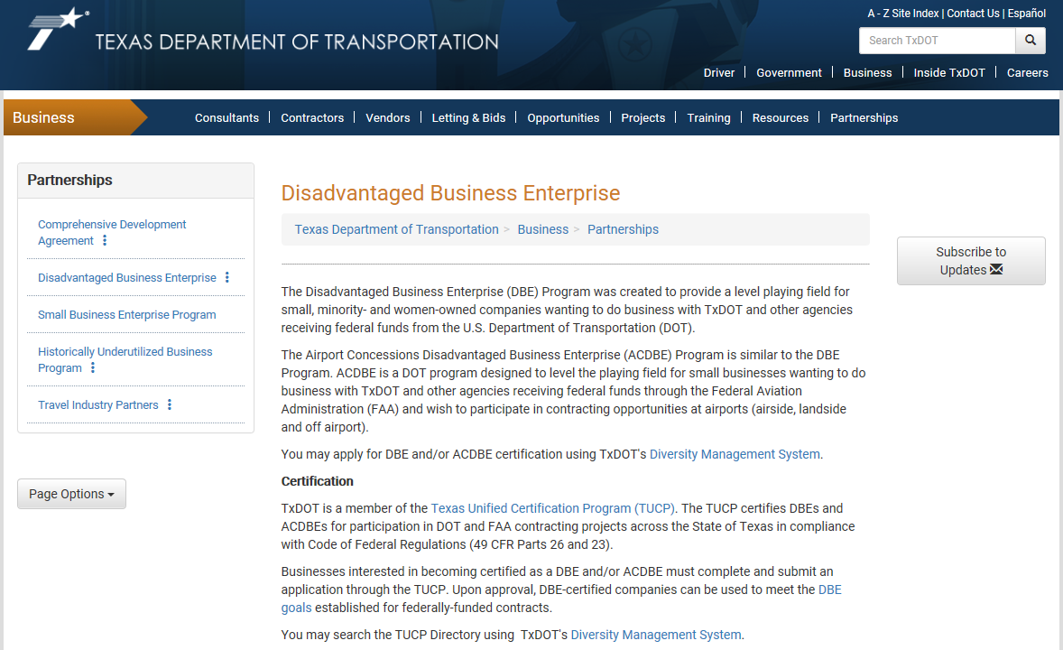
RESOURCES
https://www.txdot.gov/business/partnerships/dbe.html

Slide 28
RESOURCES
http://ftp.dot.state.tx.us/pub/txdot-info/bop/dbe/dbe-contractors.pdf

Slide 29
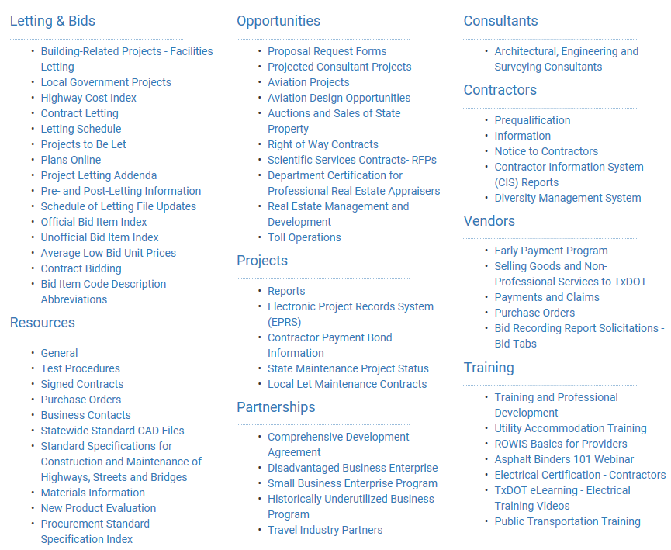
RESOURCES
TxDOT web page: txdot.gov/business.html

Slide 30
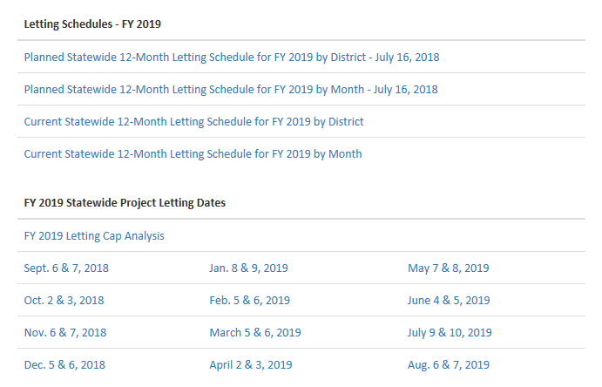
RESOURCES
Letting Schedule

Slide 31
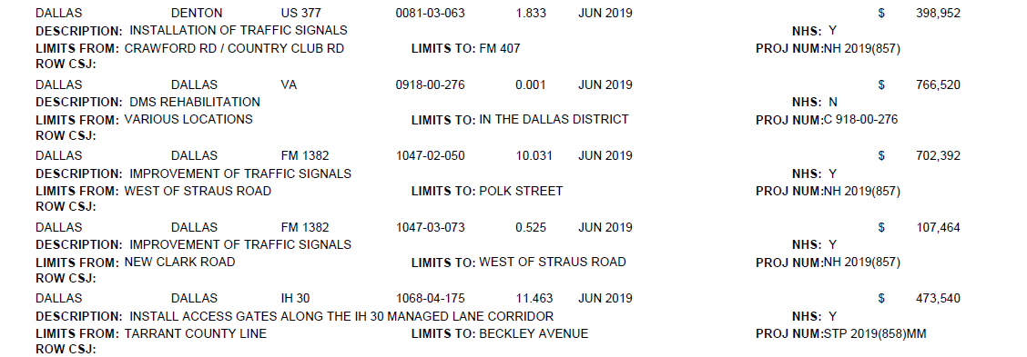
RESOURCES
Current Statewide 12-Month Letting Schedule for FY 2019 by District

Slide 32
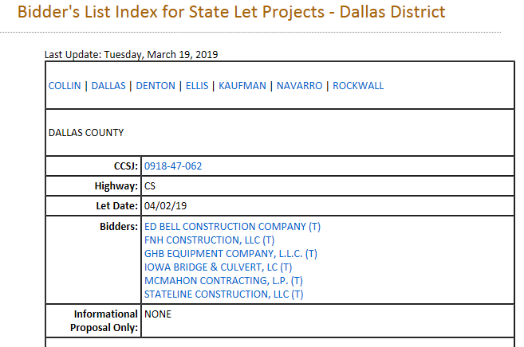
RESOURCES
State Let Construction and Maintenance Projects Bidders List

Slide 33
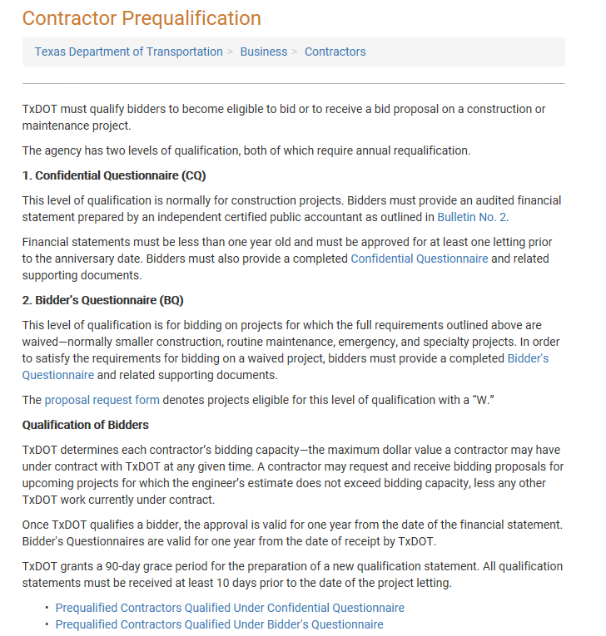
RESOURCES
Contractors

Slide 34
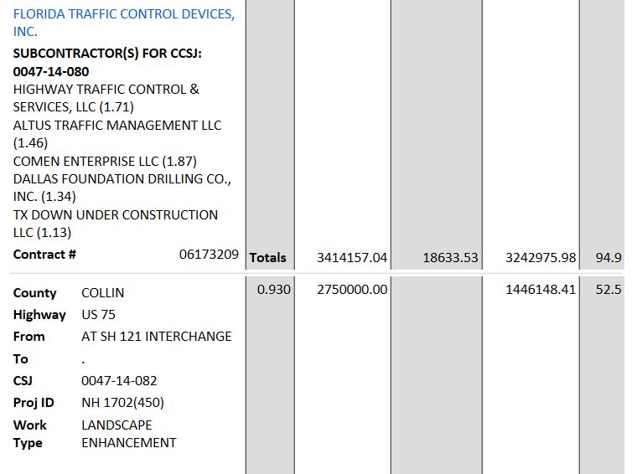
RESOURCES
Monthly State Let Construction Report for Dallas District as of March 19, 2019

Slide 35
QUESTIONS
QUESTIONS?

