Slide 1
NORTH TEXAS TOLLWAY AUTHORITY

Slide 2
PROCUREMENT SERVICES 5900 W. Plano Parkway Plano, TX 75093 (214) 461-2000 Monday – Friday 8 a.m. – 5 p.m. www.NTTA.org

Slide 3
What Does NTTA Purchase?
Roadway:
Construction
Maintenance
Infrastructure
Professional Services:
Architecture
Engineering
Temporary Contract Labor
Training
Information Technology:
Services
Hardware/Software
Other:
Vehicles
Building Improvements
Materials & Supplies
Tools
Landscaping
Uniforms
Advertising & Marketing
NTTA Annual Spend
$250M - $450M

Slide 4
Responding to an Opportunity
Register on www.nttamarketplace.org
Earn D/M/W/SBE certified, if applicable
Download solicitation package www.nttamarketplace.org
Attend pre-submittal conference
READ the entire solicitation and Ask questions if something isn’t clear.
Be comprehensive: Answer all requirements and complete every form
Be responsive: Have required bonds, insurance, etc.

Slide 5
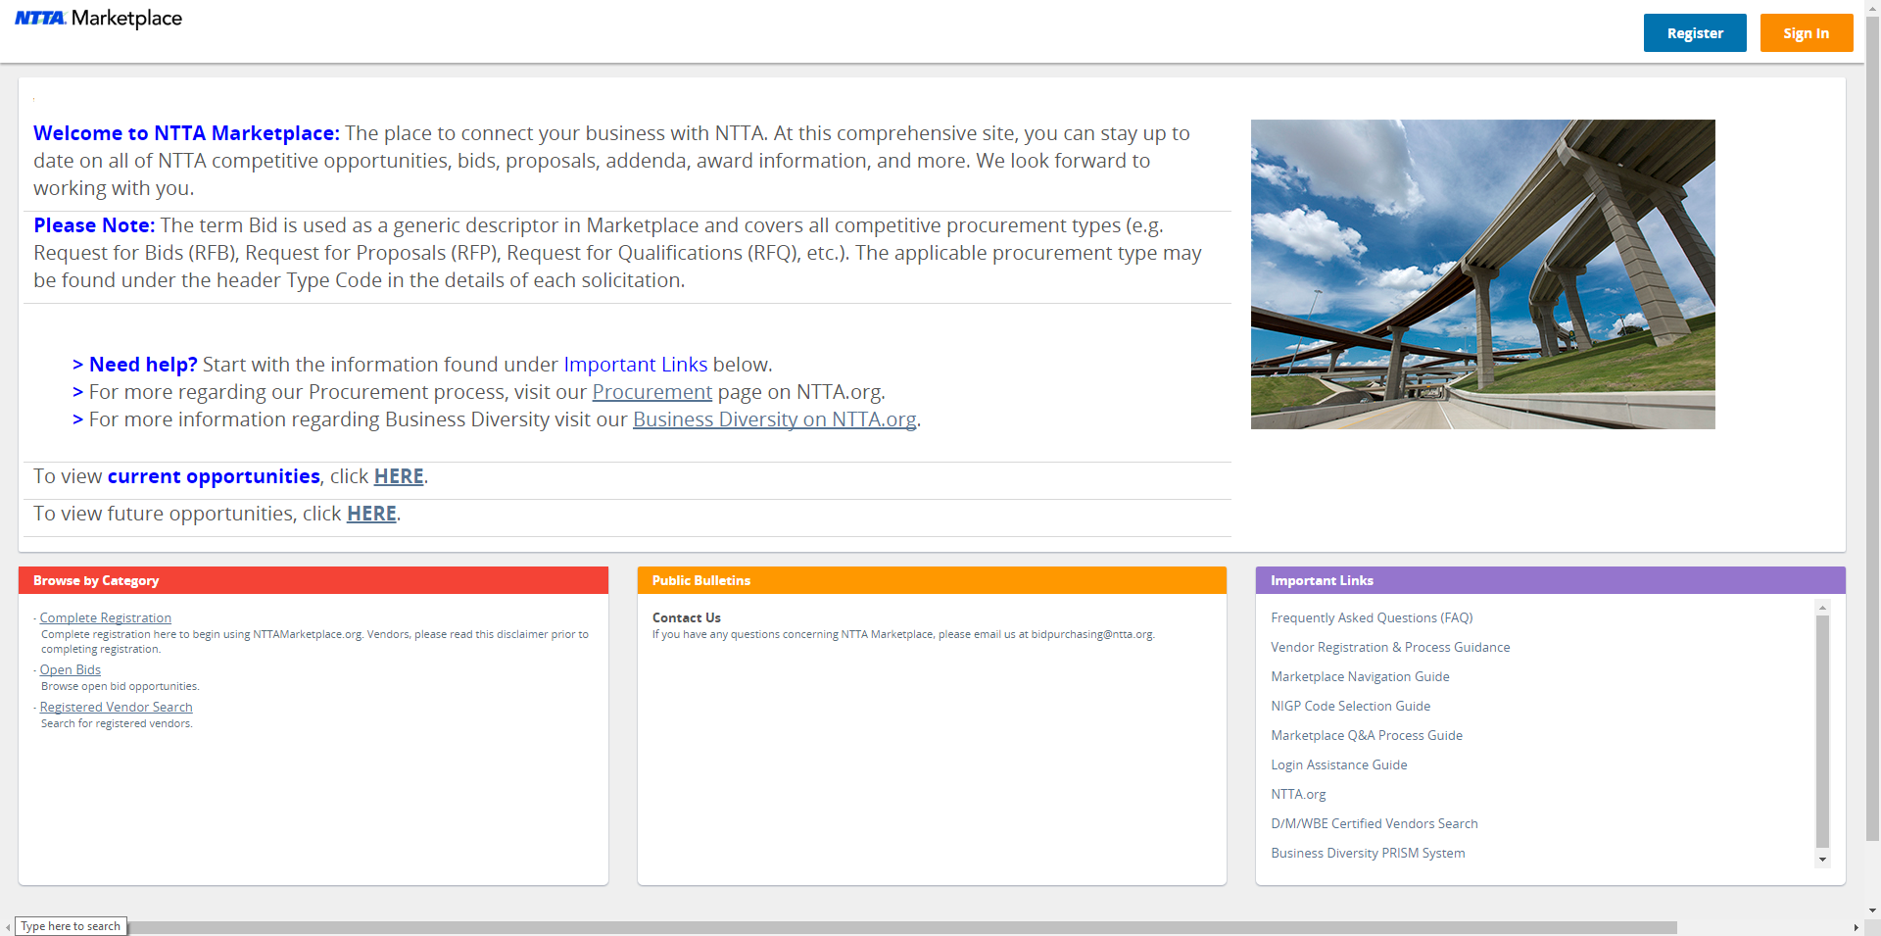
NTTA Marketplace
www.NTTAMarketplace.org -
Location of details for competitive procurement opportunities

Slide 6
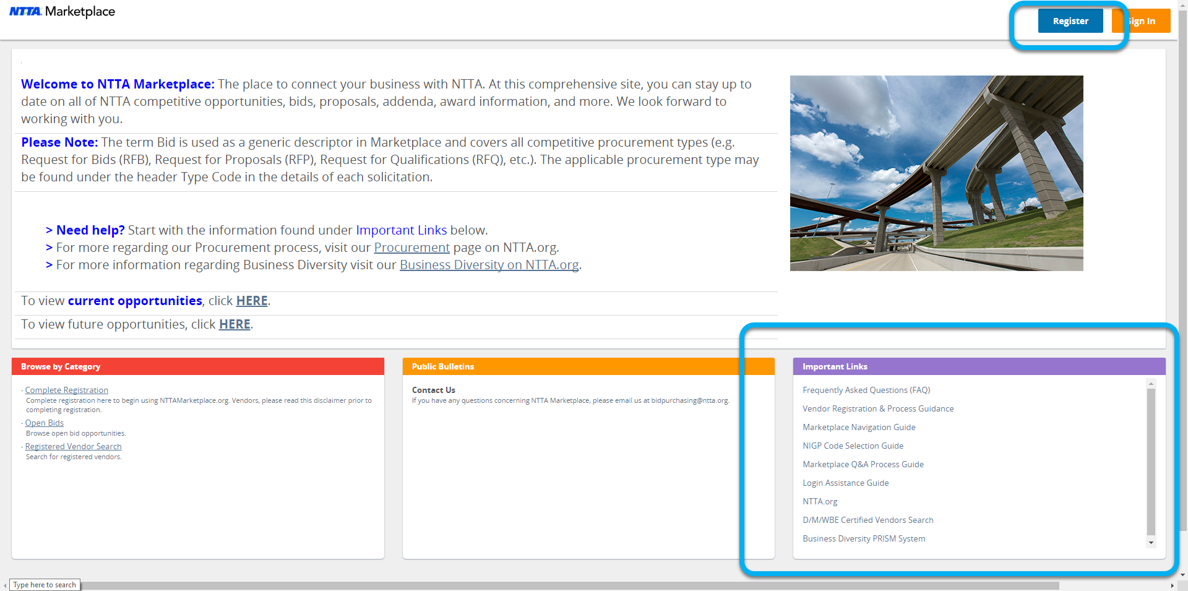
Vendor Registration
Registration is necessary for participation in procurements
The Important Links section of the log in page provides process guidance & helpful information
The registration process starts with the blue register button in the top right hand corner.
Questions?
bidpurchasing@ntta.org

Slide 7
D/M/WBE Program Recognized Certifications
Notes:
These are the certifications NTTA recognizes in our D/M/WBE program. If you are using a firm that does not have one of these certificates it means you may use them but their participation will not count towards the minority aspirational goal. To further assist you in being successful and understanding NTTA’s policy on Business Diversity and the role of the Business Diversity at Department the following are resources you may review.
MOVE TO FINAL SLIDE 10 D/M/WBE Resources

Slide 8
QUESTIONS?

