Slide 1
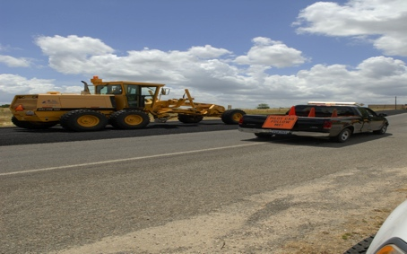
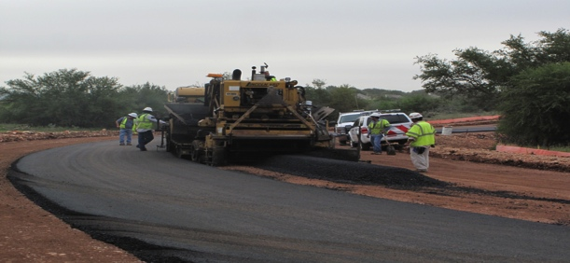
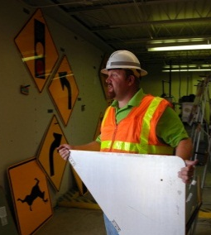
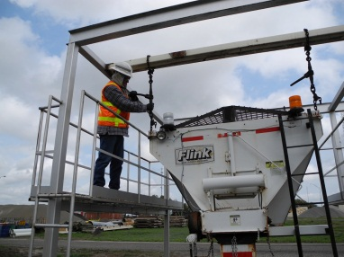
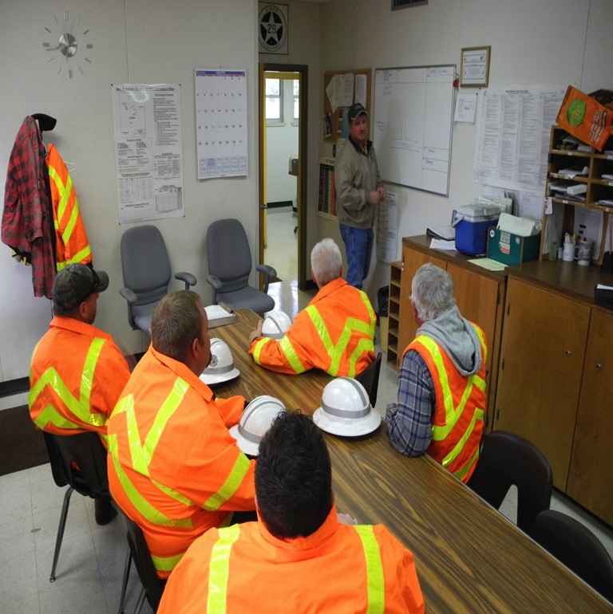
TXDOT DALLAS DISTRICT CONTRACTED MAINTENANCE
Jennifer Godina
Contract Administration Manager

Slide 2
Table of contents
1
DALLAS DISTRICT MAINTENANCE SECTIONS
3
2
DALLAS COUNTY MAINTENANCE SECTIONS
4
3
CONSTRUCTION VS. MAINTENANCE
5
4
MAINTENANCE CONTRACT LETTING
7
5
TxDOT WEBSITE NAVIGATION, CONTRACTOR PREQUALIFICATION, and E-VERIFY CERTIFICATION
6-9
6
TxDOT STANDARDS and SPECIFICATIONS
10
7
CONTACT
11

Slide 3
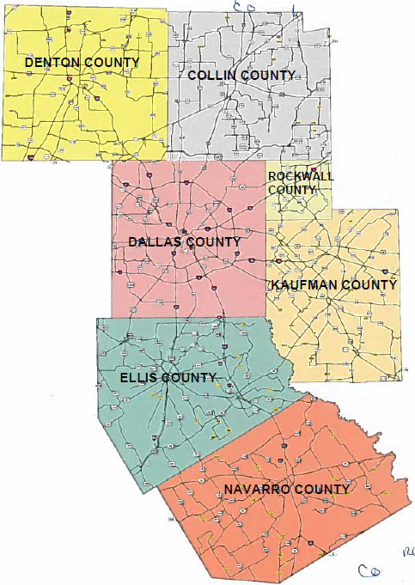
Dallas District Maintenance Sections

Slide 4
CONSTRUCTION VS. MAINTENANCE CONTRACTS
CONSTRUCTION | MAINTENANCE
FEDERAL FUNDS | STATE FUNDS

Slide 5
MAINTENANCE CONTRACT LETTING
STATE LET | LOCAL LET
Maintenance Contracts >/= $300,000
Maintenance Contracts with an Engineer’s Estimate at or over $300,000 are required by Texas Administrative Code to be State let.

Slide 6
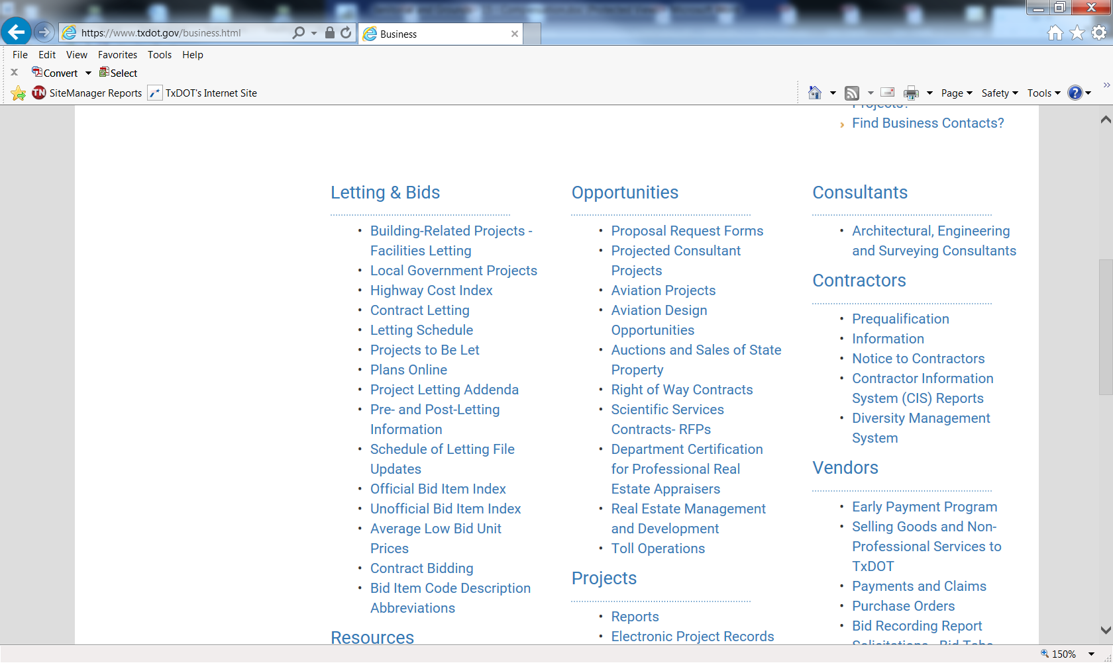
TxDOT Website Navigation
21 Days Prior to Letting
8 Weeks Prior to Letting

Slide 7
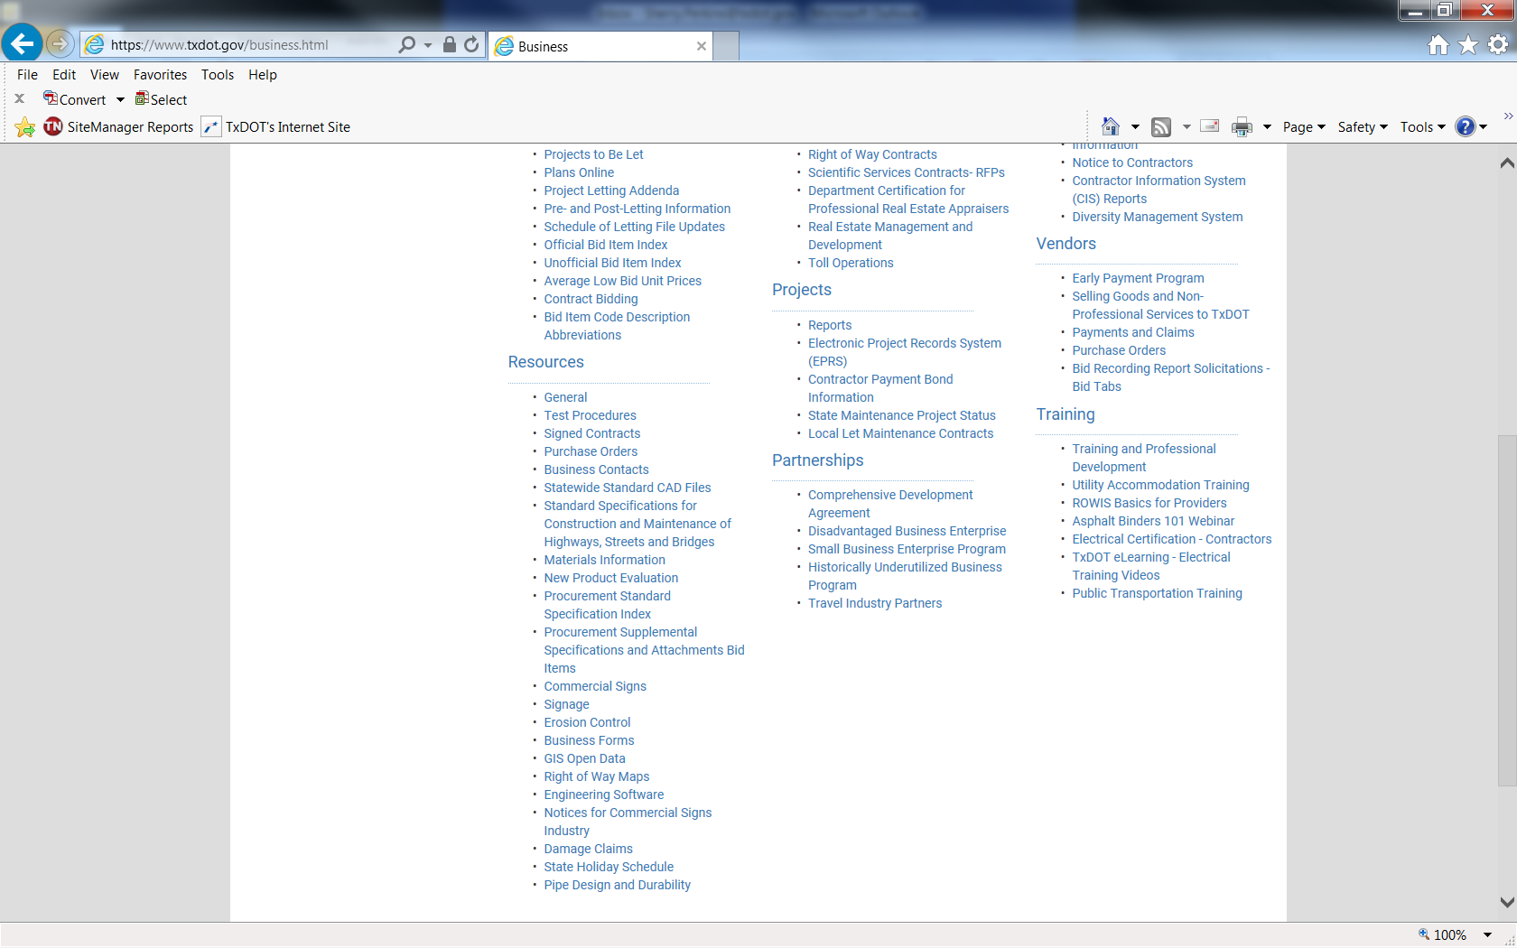
2014 Standards and Specifications
2014 Standard Specifications for Construction and Maintenance of Highways, Streets, and Bridges. The “Spec Book” is available online from the website, or you may obtain a copy from TxDOT Publications at 512-416-3176, or by contacting Ashleigh Cross at 214-320-6289.

Slide 8
CONTRACTOR PREQUALIFICATION
Confidential Questionnaire (CQ)
Bidder’s Questionnaire (BQ)
This level of qualification is normally for construction projects. Bidders must provide an audited financial statement
This level of qualification is for bidding on projects for which the full requirements for a Confidential Questionnaire are waived—
normally smaller construction, routine maintenance, emergency, and specialty projects. In order to satisfy the
requirements for bidding on a waived project, bidders must provide a completed Bidder's Questionnaire and related
supporting documents.
The proposal request form denotes projects eligible for this level of qualification with a “W.”
Visit the TxDOT website
Business
Prequalification
https://www.txdot.gov/business/contractors/contractor-prequalification.html
TxDOT must qualify bidders to become eligible to bid or to receive a bid proposal on a construction or maintenance project. The agency has two levels of qualification, both of which require annual requalification.

Slide 9
E-VERIFY CERTIFICATION
Pursuant to Texas Transportation Code §223.051, all TxDOT contracts for construction, maintenance, or improvement of a highway must include a provision requiring Contractors and subcontractors to use the U.S. Department of Homeland Security’s E-Verify system to determine employment eligibility. By signing the contract, the Contractor certifies that prior to the award of the Contract:
the Contractor has registered with and will, to the extent permitted by law, utilize the United States Department of Homeland Security’s E-Verify system during the term of the Contract to determine the eligibility of all persons hired to perform duties within Texas during the term of the agreement; and
the Contractor will require that all subcontractors also register with and, to the extent permitted by law, utilize the United States Department of Homeland Security’s E-Verify system during the term of the subcontract to determine the eligibility of all persons hired to perform duties within Texas during the term of the agreement.
Violation of this requirement constitutes a material breach of the Contract, subjects a subcontractor to removal from the Contract, and subjects the Contractor or subcontractors to possible sanctions in accordance with Title 43, Texas Administrative Code, Chapter 10, Subchapter F, “Sanctions and Suspension for Ethical Violations by Entities Doing Business with the Department.”

Slide 10
2014 Standard Specifications for Construction and Maintenance of Highways, Streets and Bridges
ROUTINE MAINTENANCE CONTRACT NAMES
Bridge Preventative Maintenance - Bridge Repair | Debris Removal | Litter Removal | Retroreflectorized Pavement Markings and Markers
Bridge Repair – Roadway | Flexible Pavement Structure Repair | Miscellaneous Concrete Repair | Roadway Illumination Maintenance
Cross Drain Structures Repair or Replacement | Full Depth Concrete Repair | Non-Site Specific Sign Replacement and Refurbishing | Roadside Mowing
Cleaning & Reshaping Ditches | General Maintenance – Managed Lane | On Call Traffic Control Services | Seal Coat & Pavement Markings
Cleaning & Sealing Joints and/or Cracks | Graffiti Removal | Pothole Repair | Specialty Markings
Cleaning and Sweeping Highways & Debris Removal | Guard Fence & Cable Barrier Repair | Raised Pavement Markers | TPWD – Rehabilitation of Roadways – Denton State Park
Culvert Extension/Replacement and Cross Drainage | HHSC – Rehabilitation of Roadways - Terrell State Hospital | Removal and Disposal of Driftwood and Debris | Traffic Signal & Preventative Maintenance
DADS – Rehabilitation of Roadways – Denton State Support Living Center | Inlet and Flume Drainage System Cleaning | On-Call Retroreflectorized Pavement Markings | Tree & Brush Removal and Trimming
 |  |  | Vegetation Management

Slide 11
QUESTIONS AND CONTACT INFORMATION
FOR ADDITIONAL INFORMATION AND QUESTIONS PLEASE CONTACT:
JENNIFER GODINA
CONTRACT ADMINISTRATION MANAGER
DALLAS DISTRICT CONTRACTED MAINTENANCE
214-320-6640
Jennifer.Godina@txdot.gov

