Slide 1
PEPS Division
CIP Workshop on Professional Services
February, 19 2020

Slide 2
Mission
Mission
Work with our TxDOT customers and external partners to procure the most qualified consultants to deliver effective solutions for Texas
Goals
Deliver the right projects
Focus on the Customer
Foster Stewardship
Optimize System Performance
Preserve our Assets
Promote Safety
Value our Employees
Professional Engineering Procurement Services represents the consolidated procurement organization supporting engineering, architectural and surveying contracts
Values
People, Accountability, Trust, Honesty

Slide 3
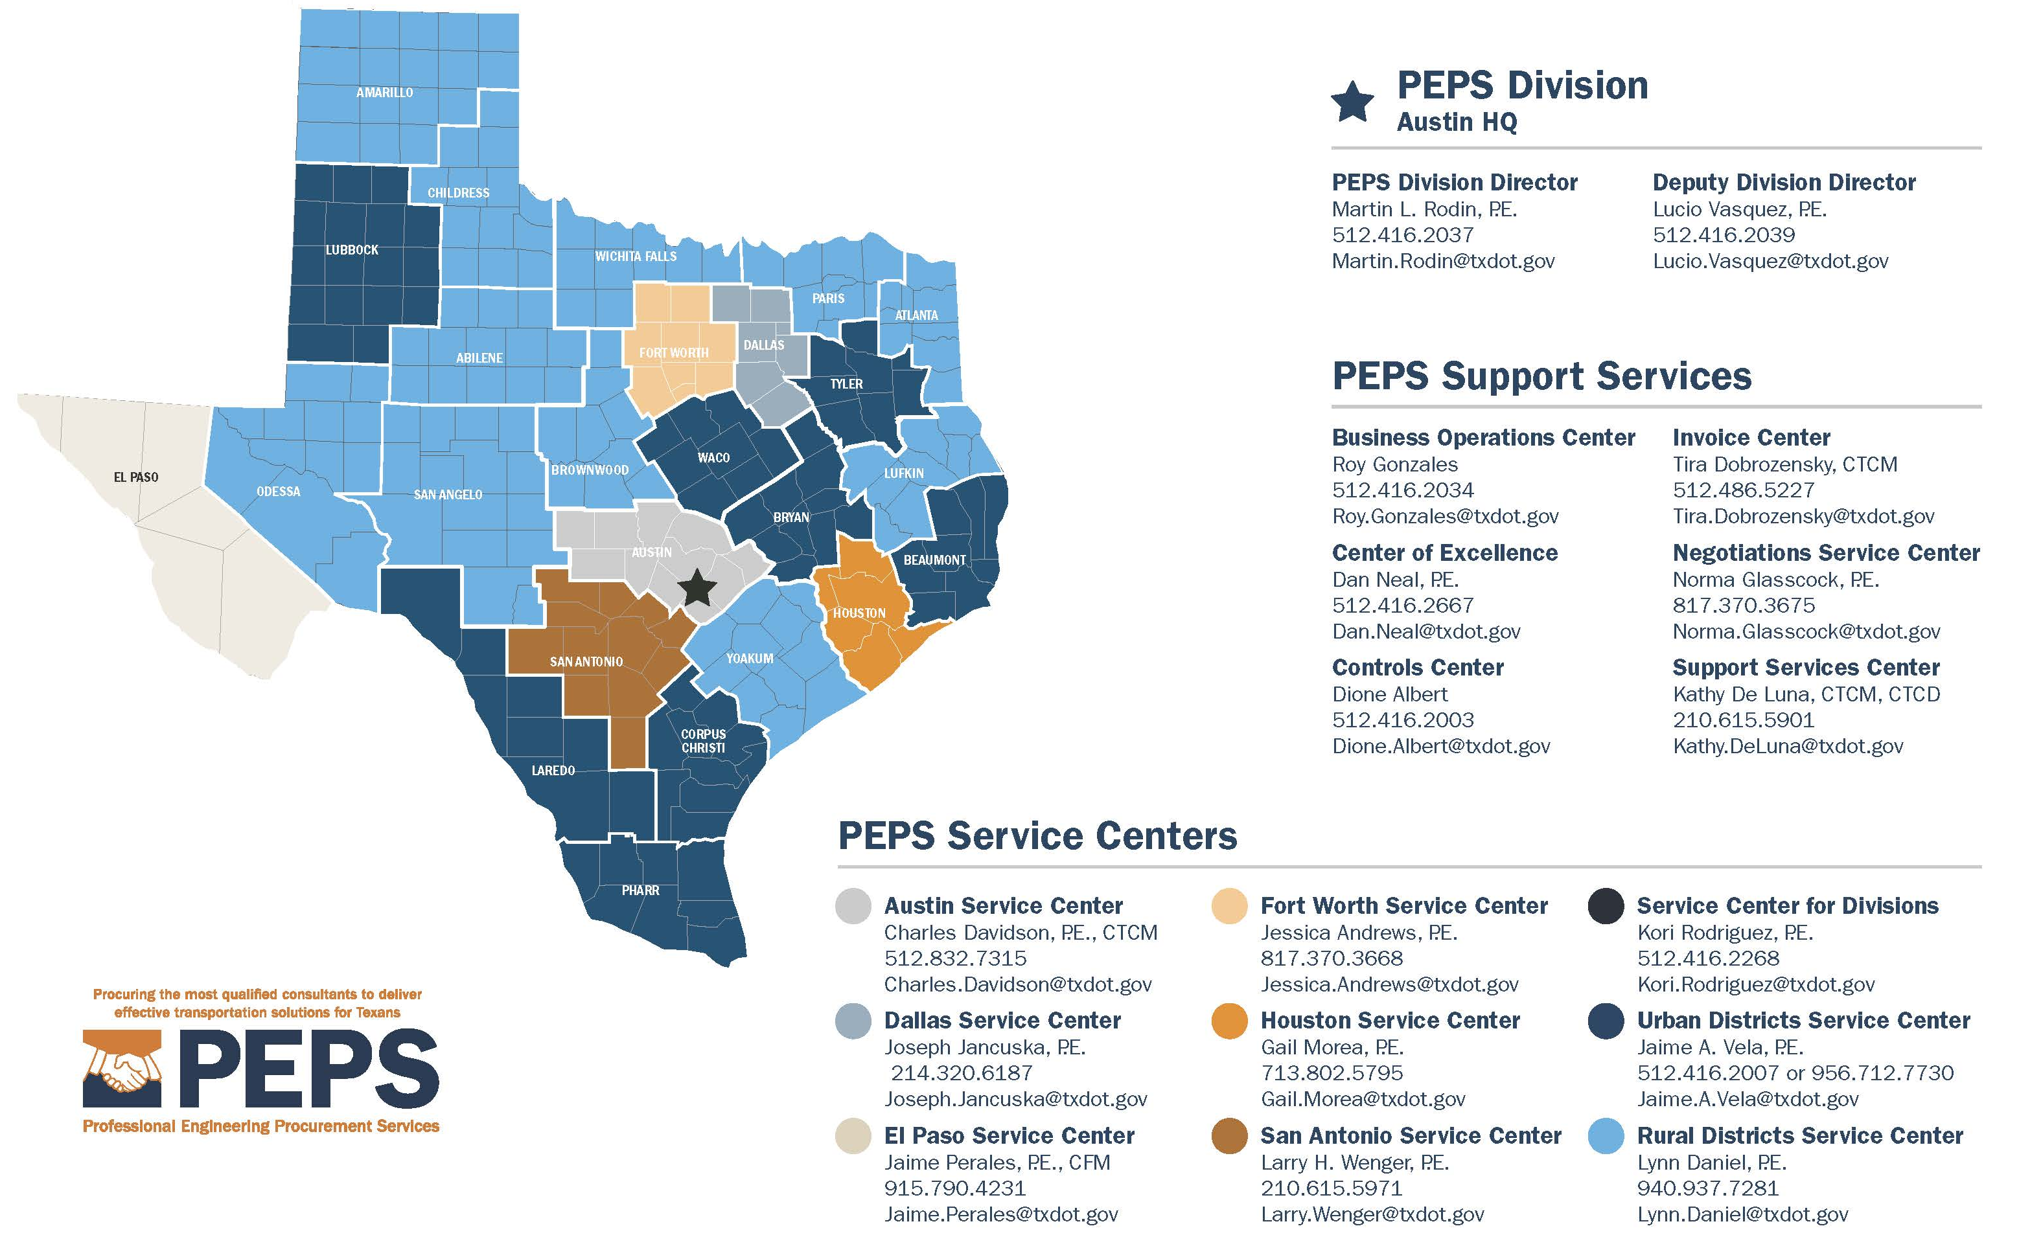
Operational Structure

Slide 4
FY2020 Procurement Plan
SERVICE TYPE | ANNUAL PROCUREMENT
Architecture | $32,000,000
Bridge Inspection | $42,000,000
Bridge On/Off Replacement | $45,000,000
Construction Engineering Inspection (CEI) | $260,215,000
CPM Scheduling Support | $8,000,000
Engineering | $9,000,000
Engineering Facilities | $32,000,000
Environmental | $1,000,000
GEC/PMC | $199,500,000
Geotechnical | $20,000,000
Hydraulics & Hydrology | $35,000,000
Materials Engineering | $7,000,000
Owner Verification, Testing and Inspection (OVTI) | $45,000,000
Planning | $19,000,000
PS&E | $327,800,000
Program Management Consultant (PMC) | $80,000,000
Schematic | $8,000,000
Schematic / Environmental | $116,000,000
Schematic / Environmental / PS&E | $43,300,000
Signal Timing | $6,000,000
Surveying | $83,000,000
Traffic & Revenue | $30,000,000
Traffic Engineering | $21,000,000
Utility Engineering | $37,000,000
Independent Engineer | $3,500,000
Owner Verification Testing (OVT) | $6,000,000
Procurement Engineering | $30,000,000
GRAND TOTAL FY 2020 | $1,546,315,000

Slide 5
FY2021 Procurement Plan
SERVICE TYPE | ANNUAL PROCUREMENT
Architecture | $32,000,000
Bridge Inspection | $42,000,000
Bridge On/Off Replacement | $45,000,000
Construction Engineering Inspection (CEI) | $260,215,000
CPM Scheduling Support | $8,000,000
Engineering | $9,000,000
Engineering Facilities | $32,000,000
Environmental | $1,000,000
GEC/PMC | $199,500,000
Geotechnical | $20,000,000
Hydraulics & Hydrology | $35,000,000
Materials Engineering | $7,000,000
Owner Verification, Testing and Inspection (OVTI) | $45,000,000
Planning | $19,000,000
PS&E | $327,800,000
Program Management Consultant (PMC) | $80,000,000
Schematic | $8,000,000
Schematic / Environmental | $116,000,000
Schematic / Environmental / PS&E | $43,300,000
Signal Timing | $6,000,000
Surveying | $83,000,000
Traffic & Revenue | $30,000,000
Traffic Engineering | $21,000,000
Utility Engineering | $37,000,000
Independent Engineer | $3,500,000
Owner Verification Testing (OVT) | $6,000,000
Procurement Engineering | $30,000,000
GRAND TOTAL FY 2020 | $1,546,315,000

Slide 6
Getting Started
HOW DO I
GET STARTED?

Slide 7
How do I get started?
Be registered as a business with the State of Texas
http://comptroller.texas.gov
https://www.sos.state.tx.us
Be registered as engineering or survey firm with the Texas PE/LS Board or architectural firm with the Texas Board of Architectural Examiners
http://engineers.texas.gov
https://www.tbae.texas.gov
Obtain precertification with TxDOT http://www.txdot.gov/business/consultants/architectural-engineering-surveying/getting- started/precertification.html
Become administratively qualified with TxDOT http://www.txdot.gov/business/consultants/architectural-engineering-surveying/getting- started/administrative-qualification.html
Check the TxDOT webpage for listing of projected contracts and Pre-RFQ/RFP meetings
Submit your qualifications

Slide 8
TxDOT Home Page (www.txdot.gov)

Slide 9
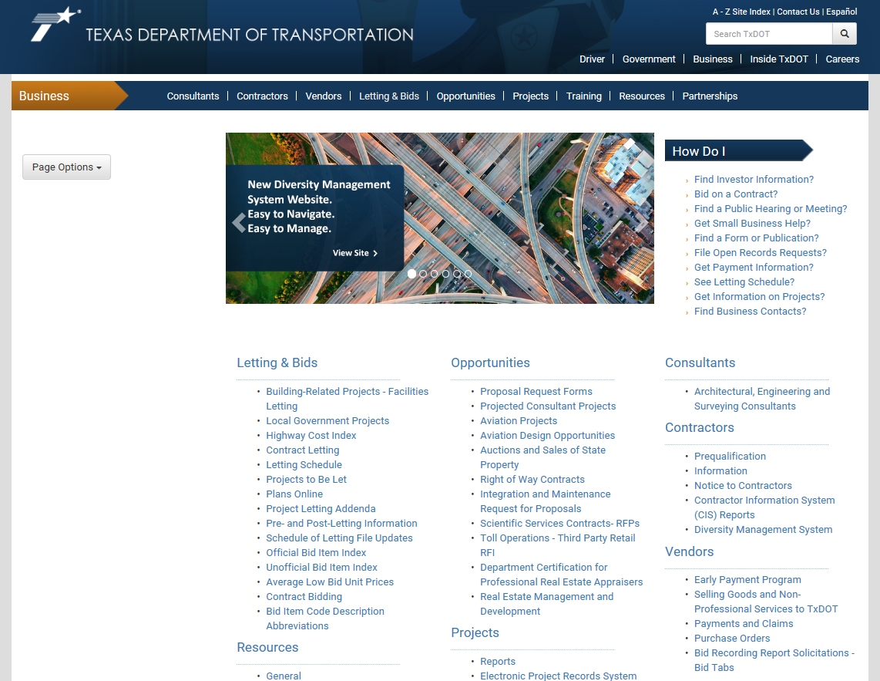
PEPS Site

Slide 10
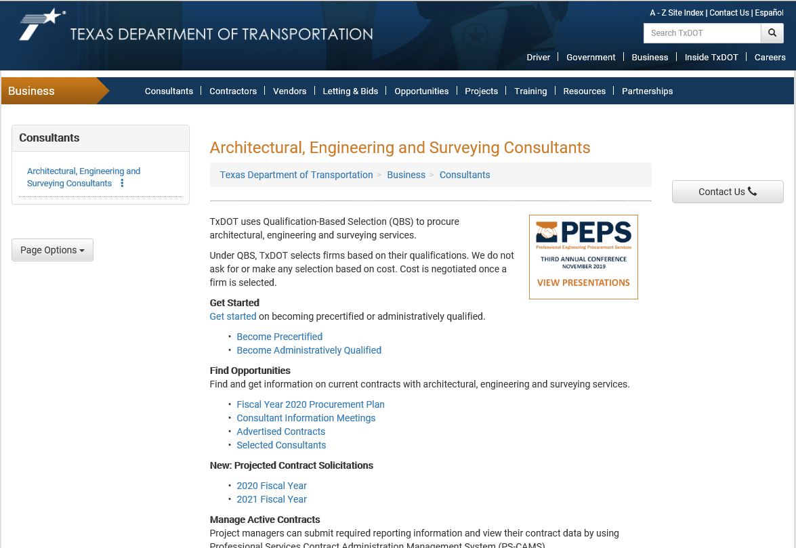
PEPS Site Overview and Demonstration

Slide 11
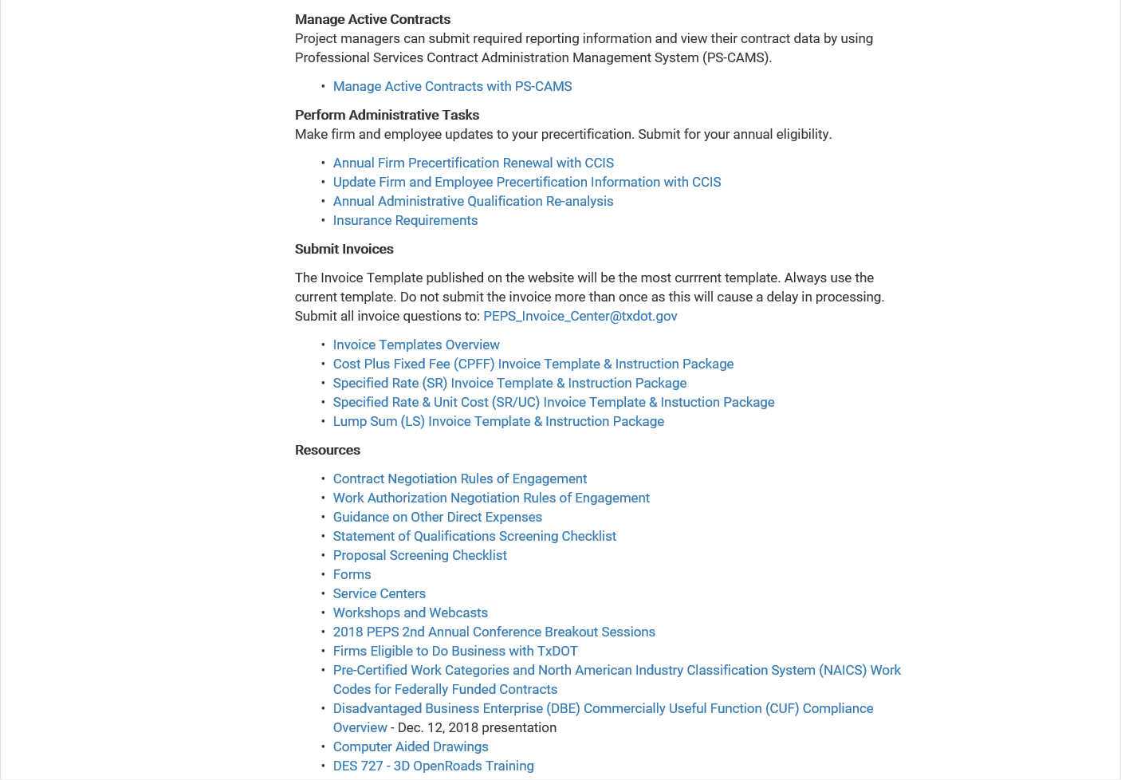
PEPS Site Overview and Demonstration

Slide 12
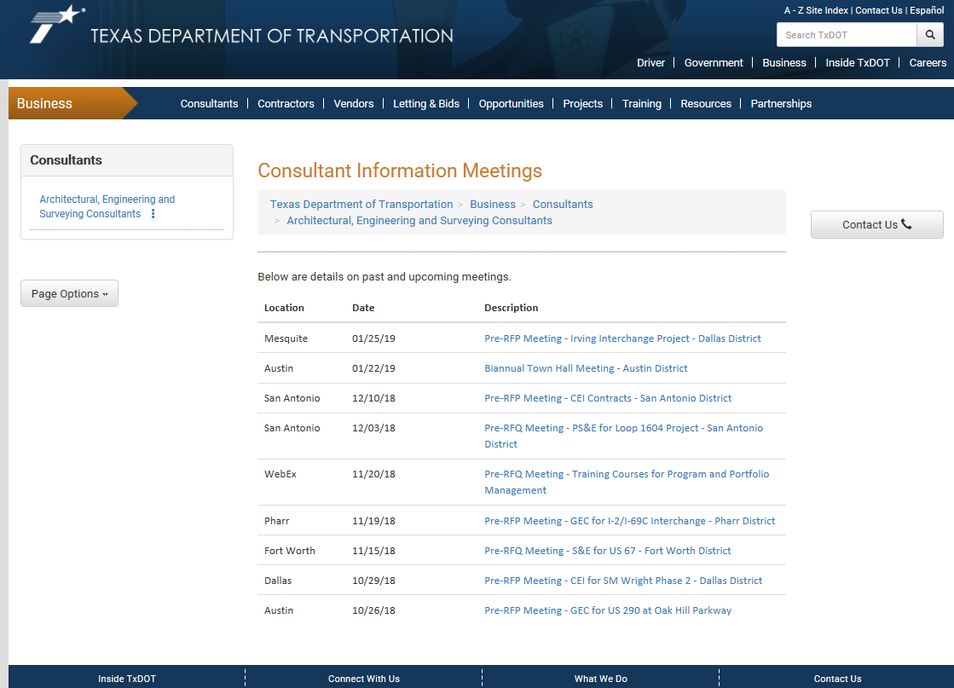
Consultant Information Meetings (Pre-RFQ/RFP or Group Debriefs)

Slide 13
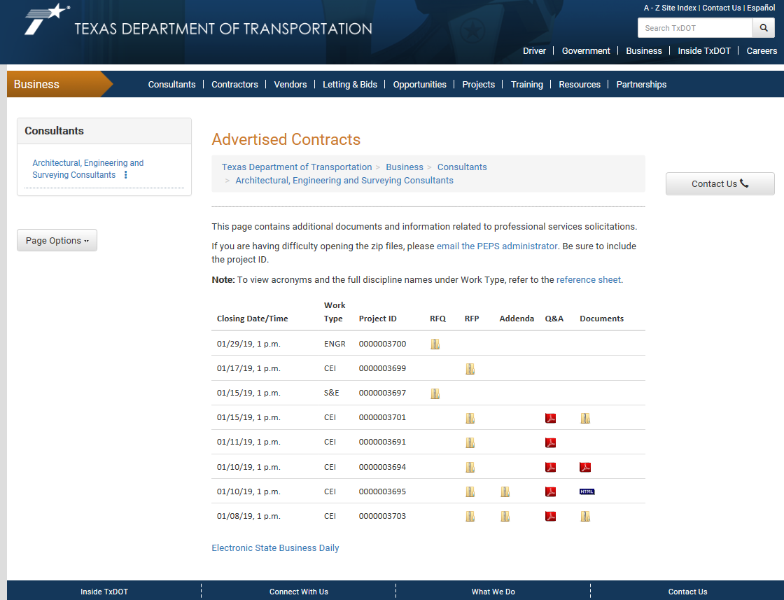
Advertised Contracts

Slide 14
Selected Consultants

Slide 15
Fiscal Year Wave Plan

Slide 16
FY 20 Procurements-Dallas & Fort Worth Opportunities
FY 20 Wave III (Apr-Aug)
Bridge On/Off Replacement ID
Used for various projects in the Dallas and Fort Worth Districts
Owner Verification Testing (OVT) SD
Southeast Connector project in the Fort Worth District
FY 20 Wave IV (Jul-Nov)
Critical Path Method (CPM) / Construction Scheduling Services (CSS) ID
Used for various projects in the Dallas District
PS&E ID
Used for various projects in the Fort Worth District
Schematic / Environmental SD
FM 1187 project in the Fort Worth District
SD: Specific Deliverable
ID: Indefinite Deliverable
THE ABOVE PROCUREMENTS ARE SUBJECT TO CHANGE

Slide 17
FY 21 Procurements-Dallas & Fort Worth Opportunities
FY 21 Wave I (Oct-Feb)
Traffic Engineering ID
Used for various projects in the Dallas District
PS&E ID
Used for various projects in the Dallas District
Utility Engineering ID
Used for various projects in the Dallas District
Schematic / Environmental SD
Used for the FM 917 project in the Fort Worth District
Independent Engineering ID
Used for North Tarrant Express (NTE) project in the Fort Worth District
SD: Specific Deliverable
ID: Indefinite Deliverable
THE ABOVE PROCUREMENTS ARE SUBJECT TO CHANGE

Slide 18
FY 21 Procurements-Dallas & Fort Worth Opportunities
FY 21 Continued…
FY 21 Wave II (Jan-May)
Schematic / Environmental ID
Used for various projects in the Dallas District
Schematic / Environmental SD
Used for the FM 730 project in the Fort Worth District
SD: Specific Deliverable
ID: Indefinite Deliverable
THE ABOVE PROCUREMENTS ARE SUBJECT TO CHANGE

Slide 19
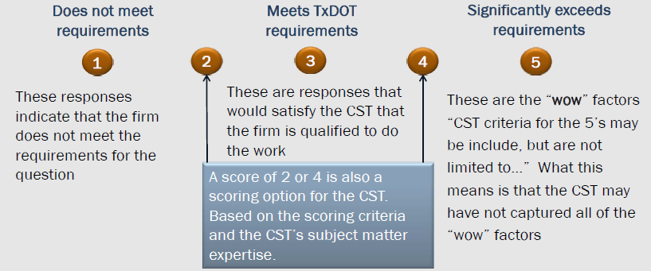
Procurement Tips
These responses
indicate that the firm
does not meet the
requirements for the
requested content.
Responses that are scored
in this area indicated that
the firm is qualified to do
the work.
These are the “wow” factors.
“CST criteria for a significantly
exceeds scoring may include,
but is not limited to…”
A score of 2 or 4 is also a
scoring option for the CST.
These scores are based on the scoring criteria and the CST’s subject matter expertise.

Slide 20
Procurement Tips Continued…
Submit on time
Ask for a debrief
Ask questions
Showcase your PM and TL
Check your forms and QA/QC your work
Focus on challenges and solutions
Procurement
Tips
Keep alert to amendments
Be clear, concise, and technical
Use your best examples
Don’t use the space for marketing

Slide 21
QUESTIONS?
 | Today

