Slide 1
Prequalification
Instructions for New Contractors
Construction Division
May 15th 2019

Slide 2
WWW.TXDOT.GOV

Slide 4
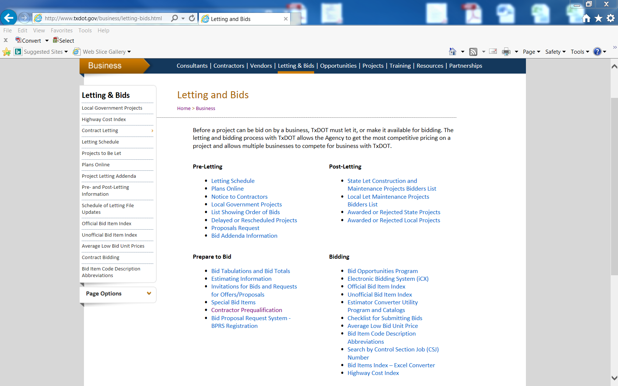

Slide 5
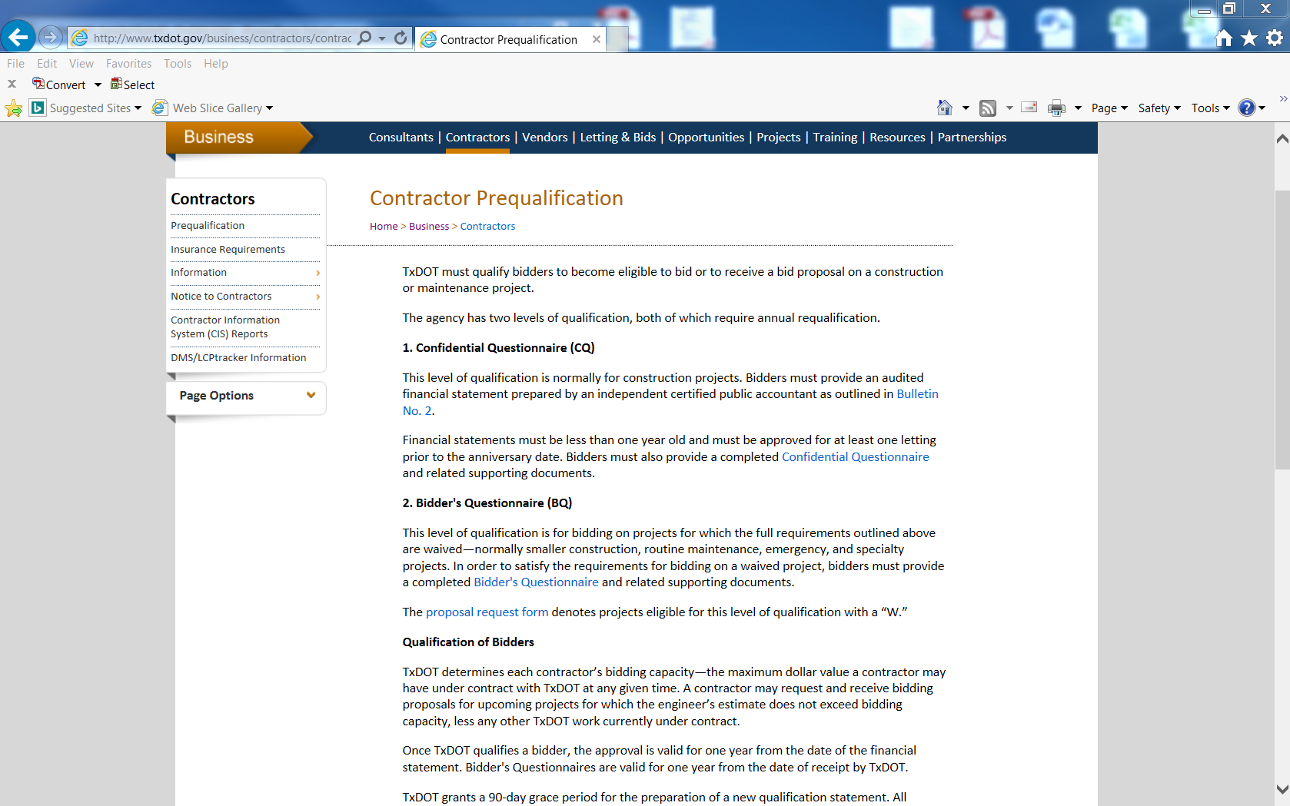

Slide 6
General information
All prime contractors must be prequalified by TxDOT.
Subcontractors do not need to be prequalified.
TxDOT determines contractor bidding capacity based on multiple factors.

Slide 7
Confidential Questionnaire
Standard requirement on most Construction projects.
Requires audited financial statements.
Bidding Capacity is derived from the contractor’s net working capital (current assets – current liabilities) multiplied by a factor determined by the department.

Slide 8
Bidder’s questionnaire
Qualifies contractor to bid on Waived projects.
Waived projects include small construction, routine maintenance, emergency, and specialty projects.
Default bidding capacity of $300,000.
If financials are submitted this number can substantially raise depending on working capital and completed projects.
Detail information on the bidding capacity is located on page 3 of the Bidder’s Questionnaire.

Slide 9
Process and timeframe
Contractors are required to submit their prequalification paperwork 10 days in advance of a project they wish to bid.
If financial statements are included, they must be prepared by a CPA firm and must be no older than one year.
Upon receipt, TxDOT will reach out and walk you through the process.

Slide 10
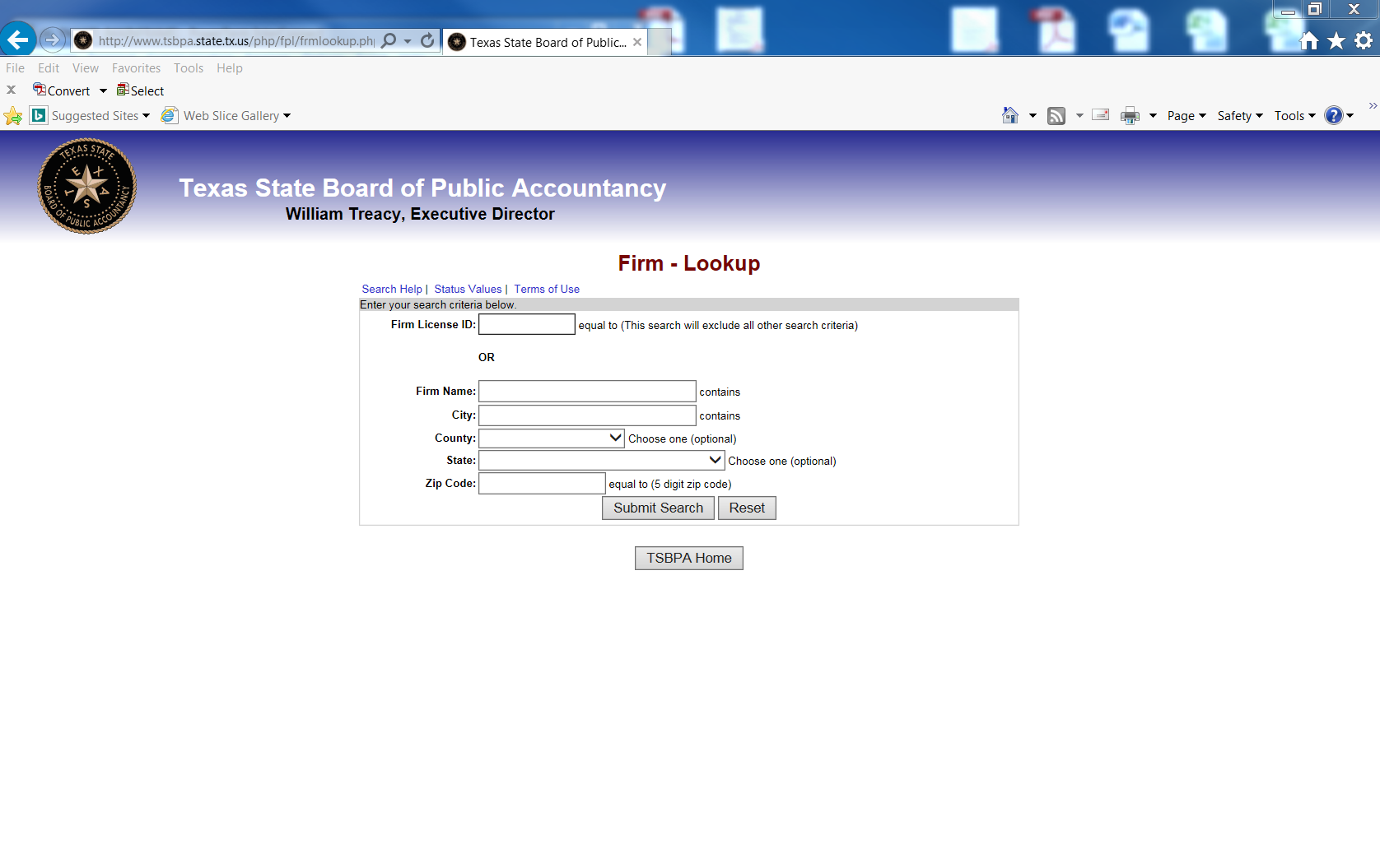
CPA license
You can validate a CPA firm’s license by visiting the Texas State Board of Public Accountancy website and selecting firm lookup.
http://www.tsbpa.state.tx.us/php/fpl/frmlookup.php

Slide 11
Electronic bidding system
During the qualification process, an electronic bidding system account will be created
This will allow contractors to request bid authorizations, whether they choose to bid by paper or electronically
This will also allow contractors to submit bids electronically
Electronic Bid Bonds will need to be setup to bid electronically. The initial set up of the electronic bonding process can take as much as a week.

Slide 12
Electronic bidding system
TxDOT uses the Integrated Contractor Exchange (iCX) as the TxDOT Web-based Electronic Bidding System.
Easy to use system.
No setup required.
Functional system.
Alerts and notifications.
Allows contractors to login and request authorization to bid.
Allows contractors to bid electronically should they be inclined.
https://www.txdot.gov/business/letting-bids/ebs.html

Slide 13
Bidding by Electronic vs. Paper
Substantially increased chance of bid being deemed successful.
Functionally easier to receive and submit bid.
Automatic notifications are provided to contractors whom are set up to bid electronically.

Slide 14
Commonly asked questions
Question: What causes a contractor to be denied/rejected?
Answer: A questionnaire not being filled out completely will delay the process. Denial or failure to qualify will happen when a contractor is not responding to our request for information.
Notes:
We will send several notices requesting the information. If we do not receive a response or the requested information after several attempts we will discontinue the prequalification process. This does not prevent the contractor from resubmitting their documents at a later date.

Slide 15
Question: What are the most frequent documents missing from the application?
Answer: For the initial qualification, resume's, Organizational documents for LLCs/Corps. For renewal qualification, Assumed Name Certificates if qualifying under a different name.

Slide 16
Question: What are some red flags in an applicants paperwork ?
Answer: Not submitting complete financial statements, pages missing from the document, refusal to provide certain information (SSN), expired status with the Texas Secretary of State or an expired Assumed Name Certificate.

Slide 17
Questions?

