Slide 1
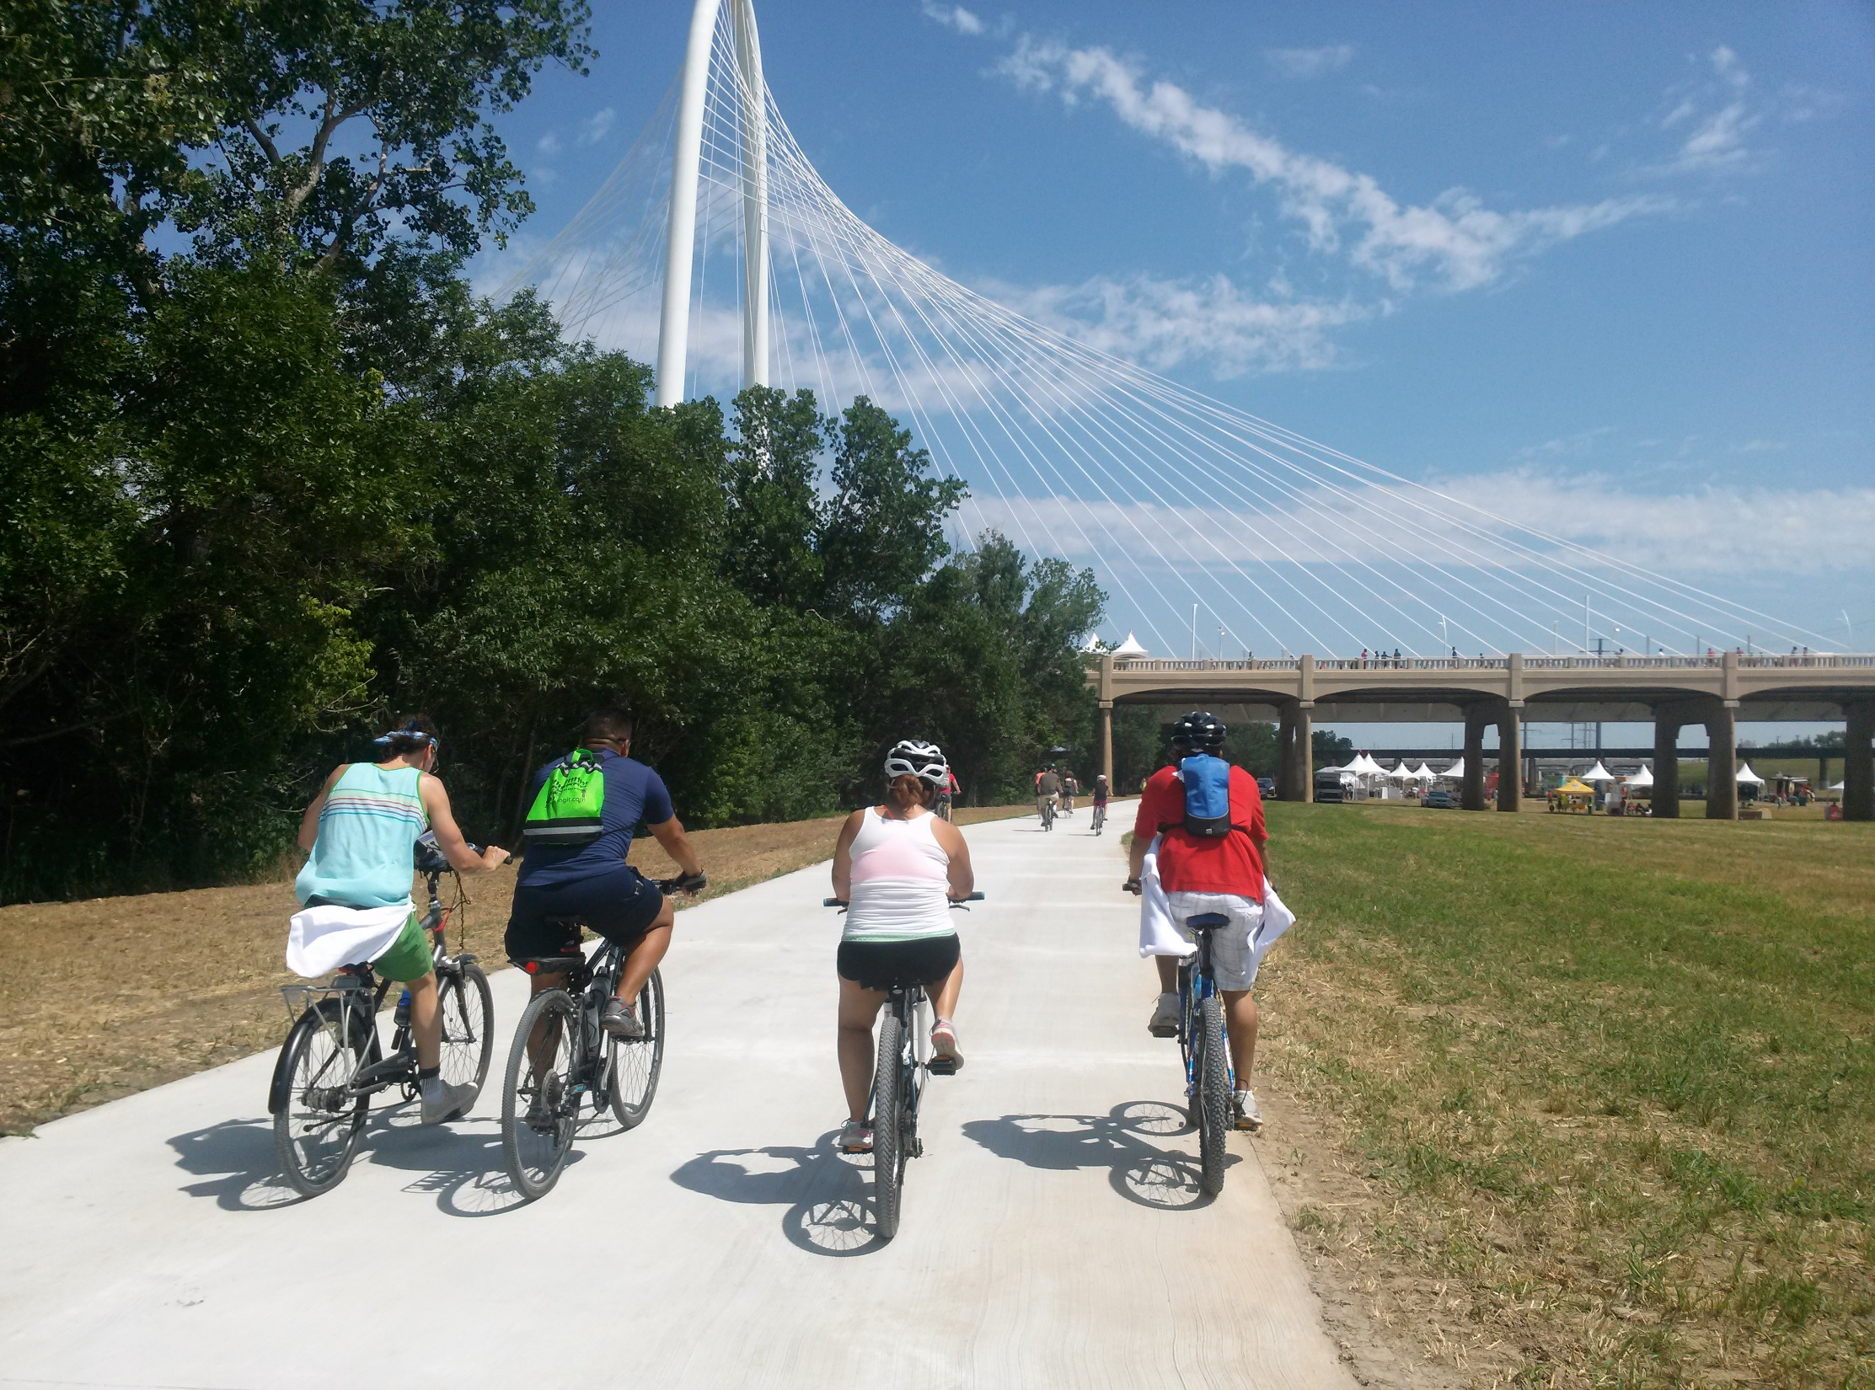


Trails and Bikeways Planning and Implementation in North Texas
TxDOT Bicycle Hearing | November 2022
Notes:
Add RTC logo if necessary

Slide 2
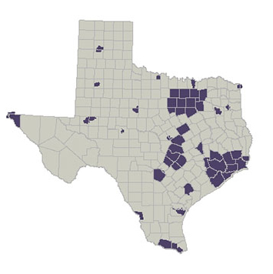
Texas Metropolitan Planning Organizations (MPO)
Abilene
Amarillo
Austin
Beaumont-Port Arthur
Brownsville/Harlingen/McAllen
Bryan-College Station
Corpus Christi
Dallas-Fort Worth
El Paso
Houston-Galveston
Killeen-Temple
Laredo
Longview
Lubbock
Midland/Odessa
Required of metropolitan areas with populations greater than 50,000
23 in Texas
420 in the U.S.
San Angelo
San Antonio-Bexar County
Sherman-Denison
Texarkana
Tyler
Victoria
Waco
Wichita Falls

Slide 3
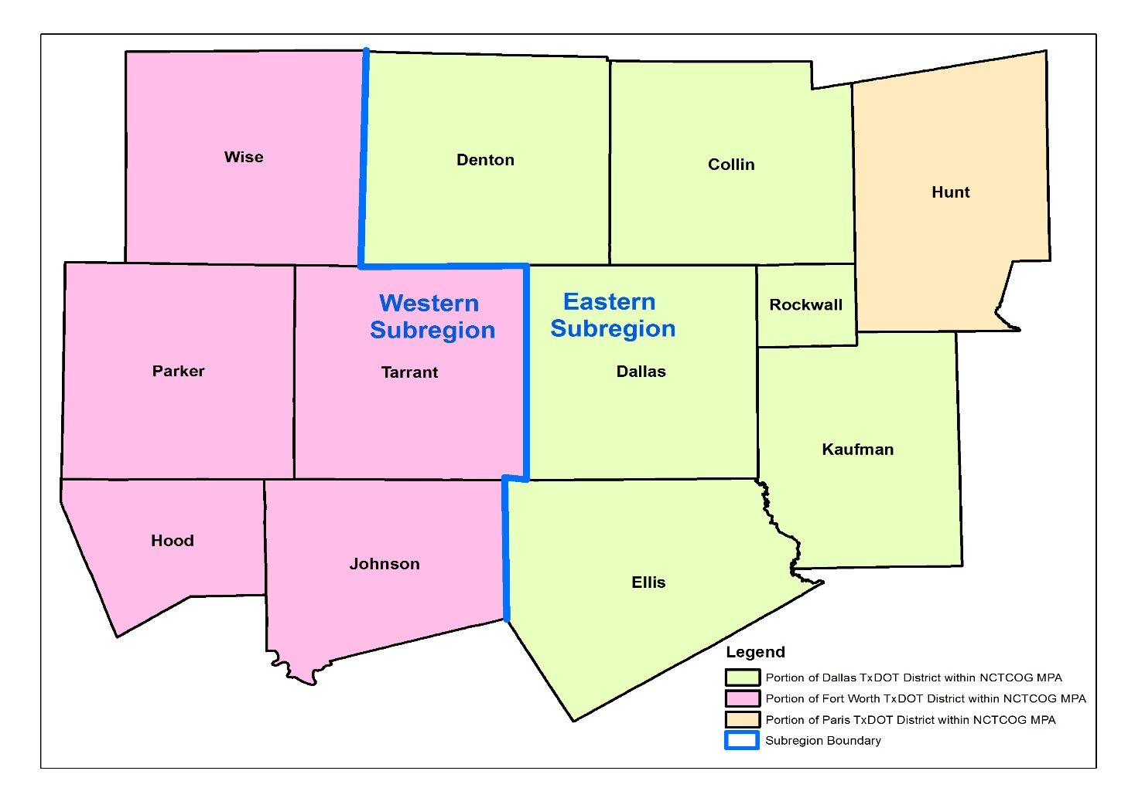
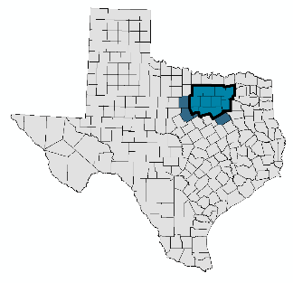
North Central Texas Council of Governments
Metropolitan Planning Organization (MPO) for the Dallas-Fort Worth Region
Portions of three TxDOT Districts
Dallas District
Fort Worth District
Paris District

Slide 4
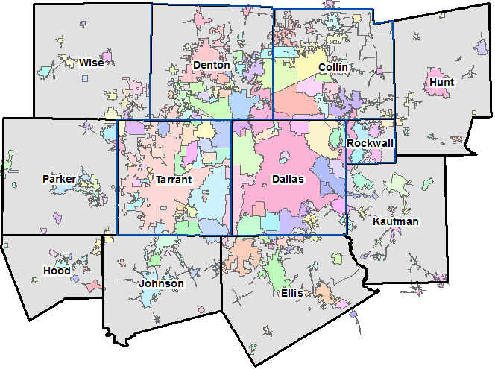
North Central Texas Council of Governments
Metropolitan Planning Organization for the Dallas-Fort Worth Region
Metropolitan Planning Area (MPA)
209 cities
13 cities larger than 100,000 pop.
MPA Population
2020 Estimate = 7.7 million
2045 Forecast = 11.4 million

Slide 5
Monthly Trail Usage: Covid-19 Impact
(Percent Change 2019 vs 2020)
Source: NCTCOG, collected at 8 sites located in Plano, North Richland Hills, Denton, Dallas, Fort Worth, and Allen.
Note: Baseline is March 2019-February 2020; no adjustments for weather were applied.
Source: NCTCOG - collected at 8 sites located in Plano, North Richland Hills, Denton, Dallas, Fort Worth, and Allen.
Note: No adjustments for weather were applied.
Trails and Bikeways Planning and Implementation in North Texas
5

Slide 6
Monthly Trail Usage
Source: NCTCOG, collected at 8 sites located in Plano, North Richland Hills, Denton, Dallas, Fort Worth, and Allen.
Note: Baseline is March 2019-February 2020; no adjustments for weather were applied.
Note: trail usage impacted in Feb 2021 by week-long winter storm.
Note: total usage impacted in July 2022 by extreme hot weather.
Increase in Full Week Trail Usage vs Baseline
Aug
-1%
2021
2022

Slide 7
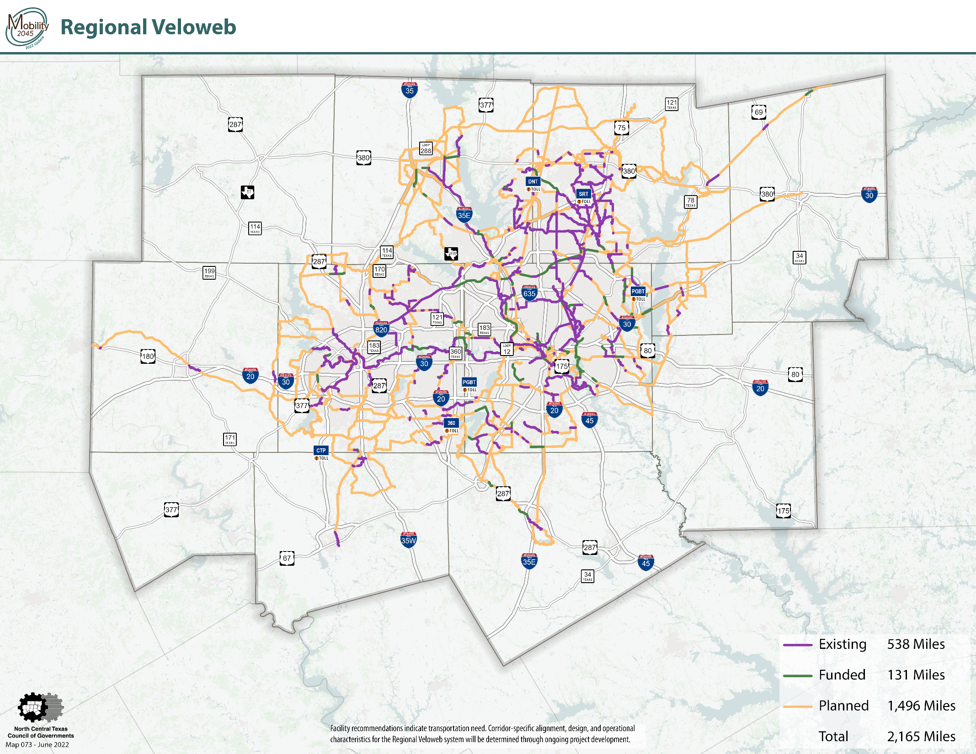

Slide 8
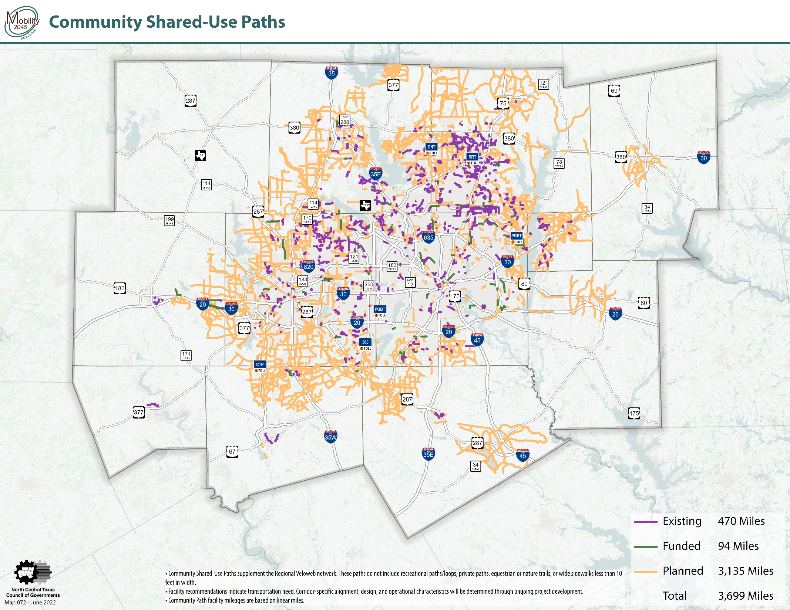

Slide 9
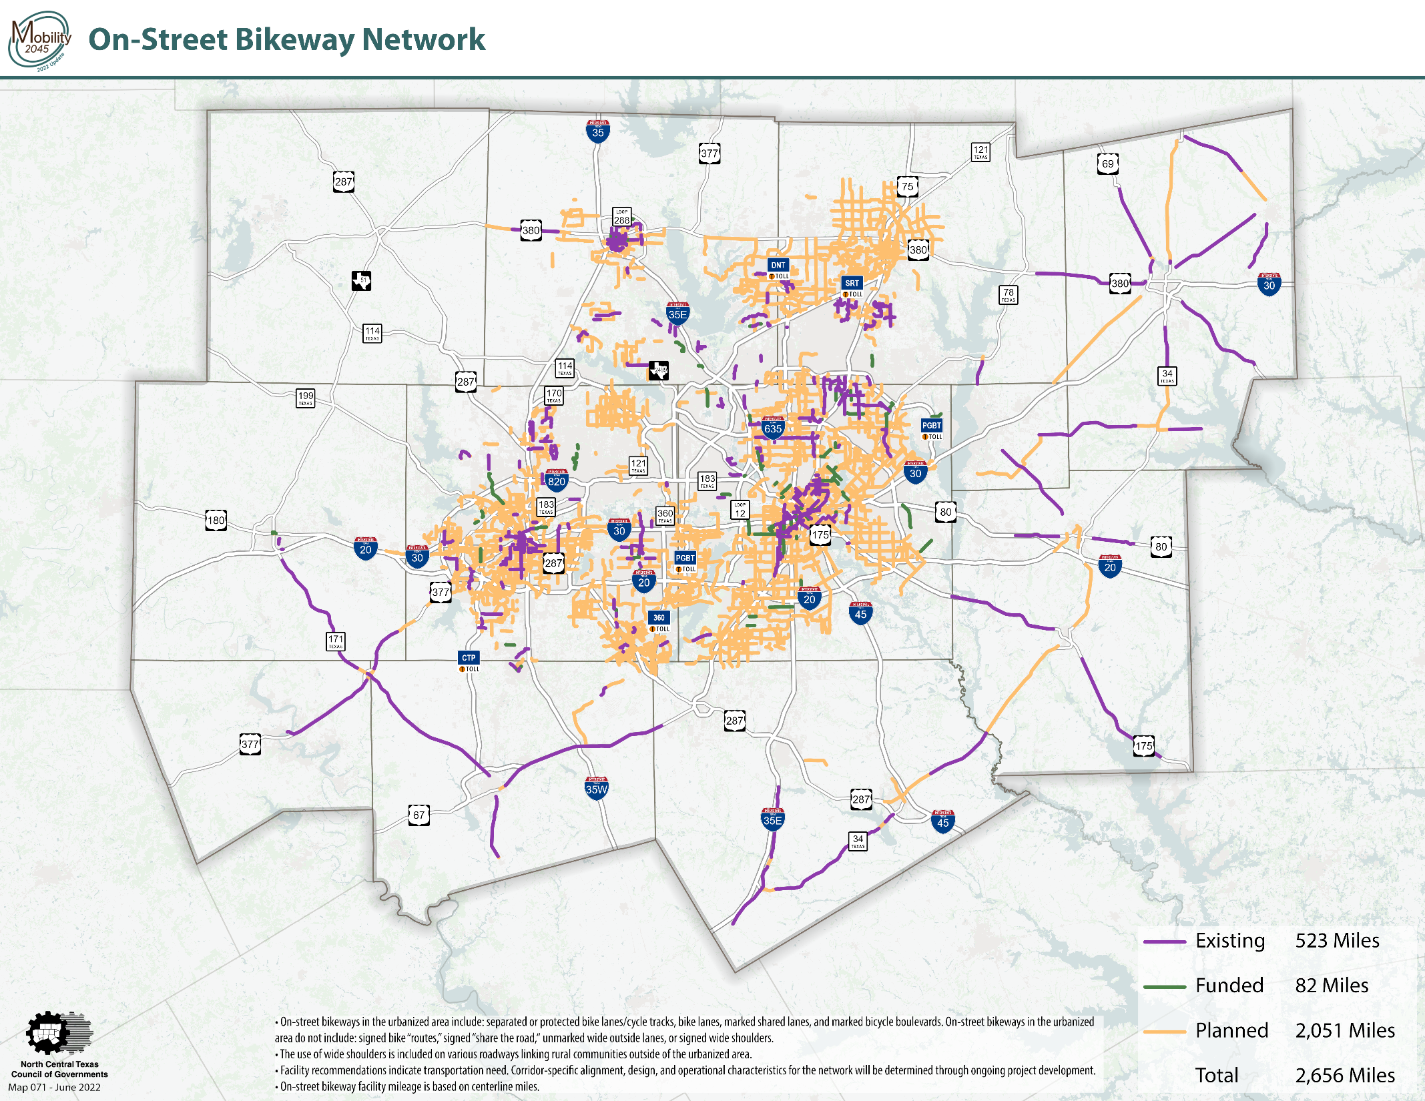

Slide 10
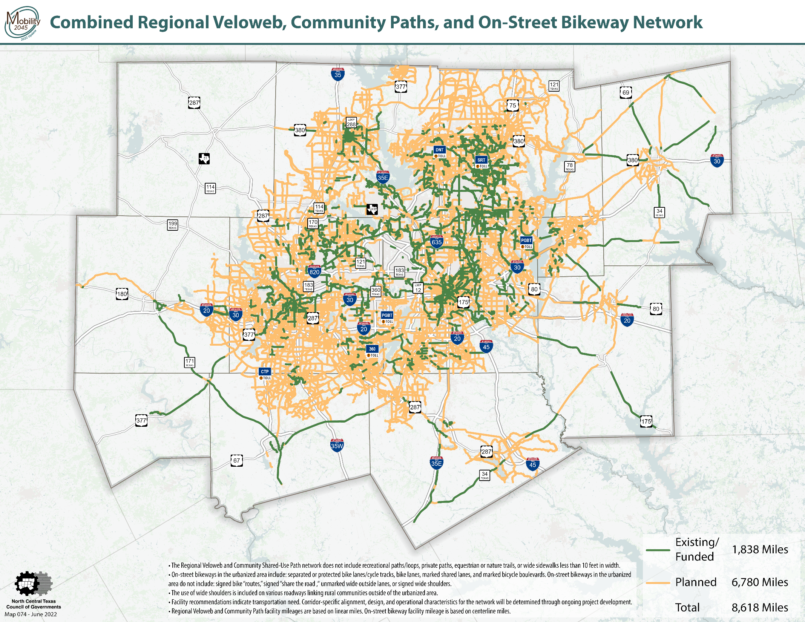

Slide 11
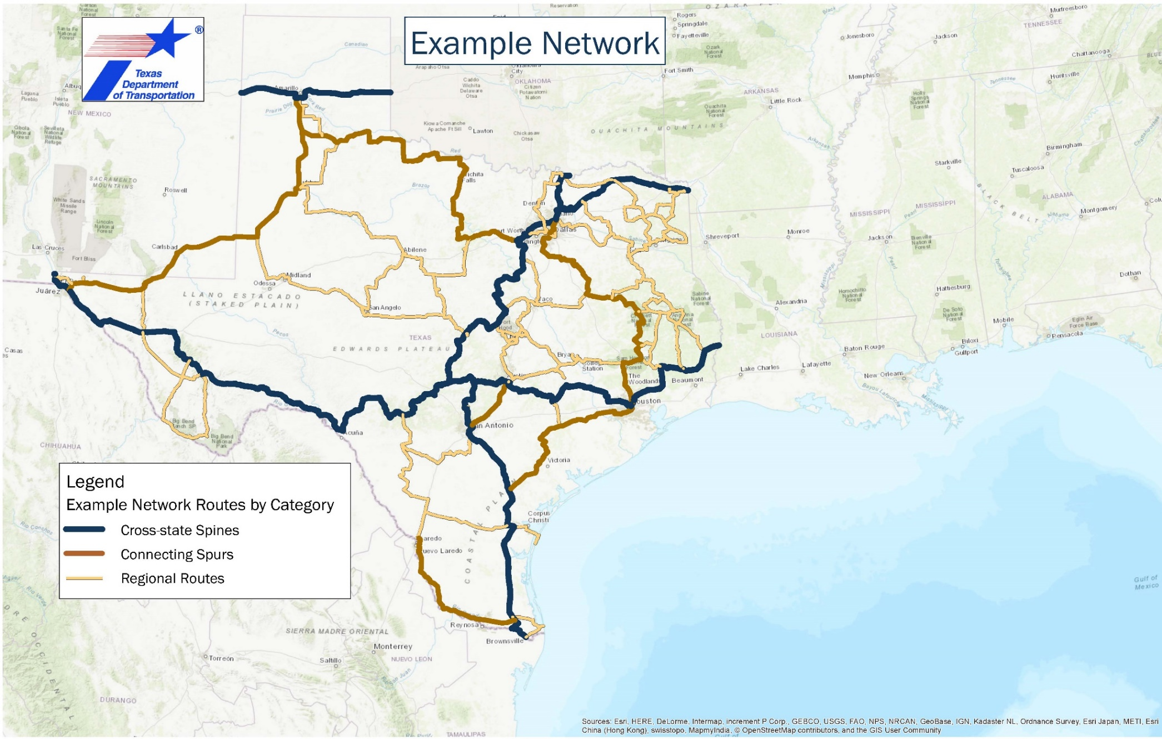
TxDOT’s Bicycle Tourism Trails Study
Trail alignments in the DFW metropolitan area are part of TxDOT’s Bicycle Tourism Trail Example Network

Slide 13
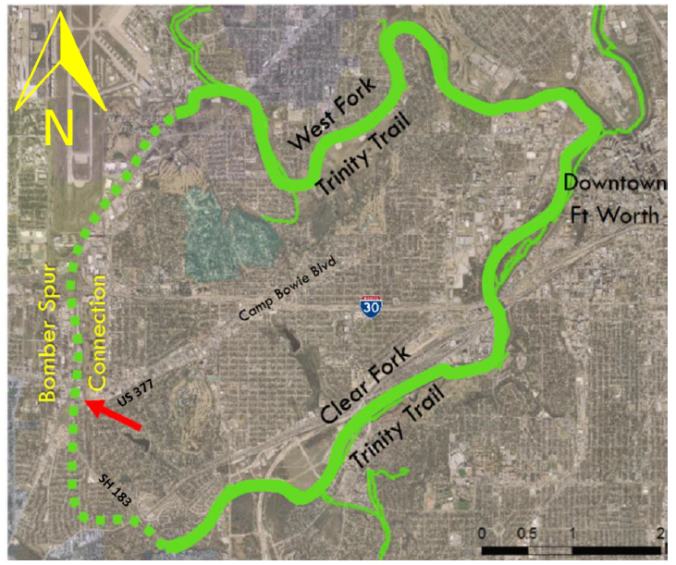
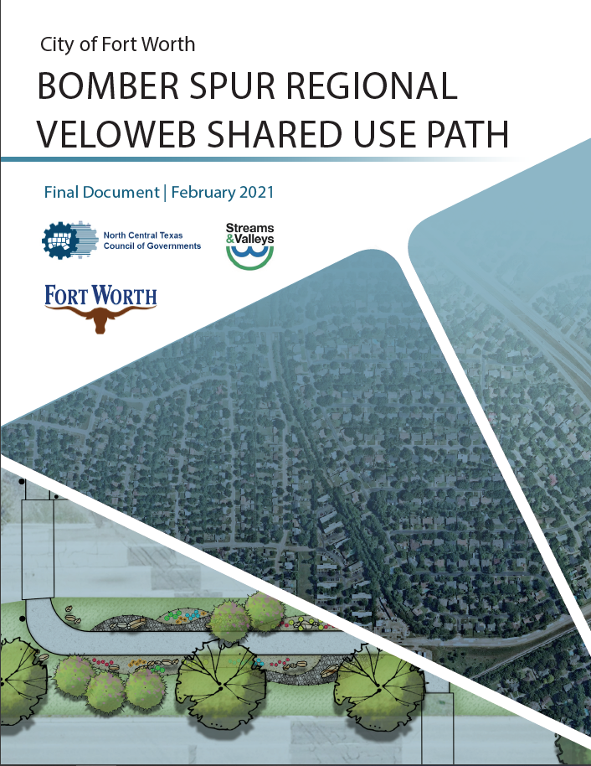
Fort Worth Bomber Spur Trail (Prelim. Engineering)
Trails and Bikeways Planning and Implementation in North Texas
13

Slide 14
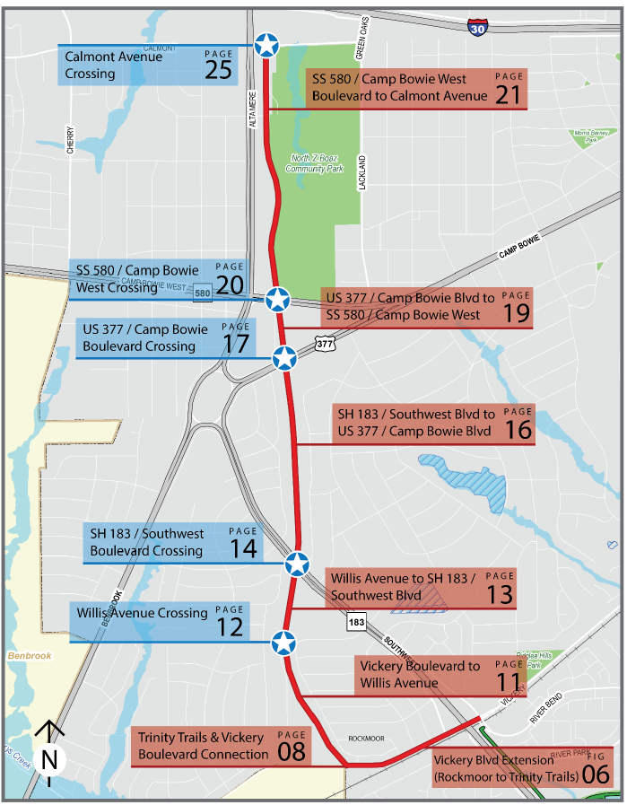
Fort Worth Bomber Spur Trail
(Preliminary Engineering and Construction Funding)
Funded for construction
Project Limits:
Calmont Ave. to SH 183/W Vickery Blvd. intersection (3.1 miles)
Scope of Preliminary Design:
  12 ft.-wide hard surface path
  Roadway crossings and safety measures
  30 percent design
  Right-of-way and easement requirements
Partnership:
  City of Fort Worth, Streams & Valleys, Inc.
  and NCTCOG
14

Slide 15
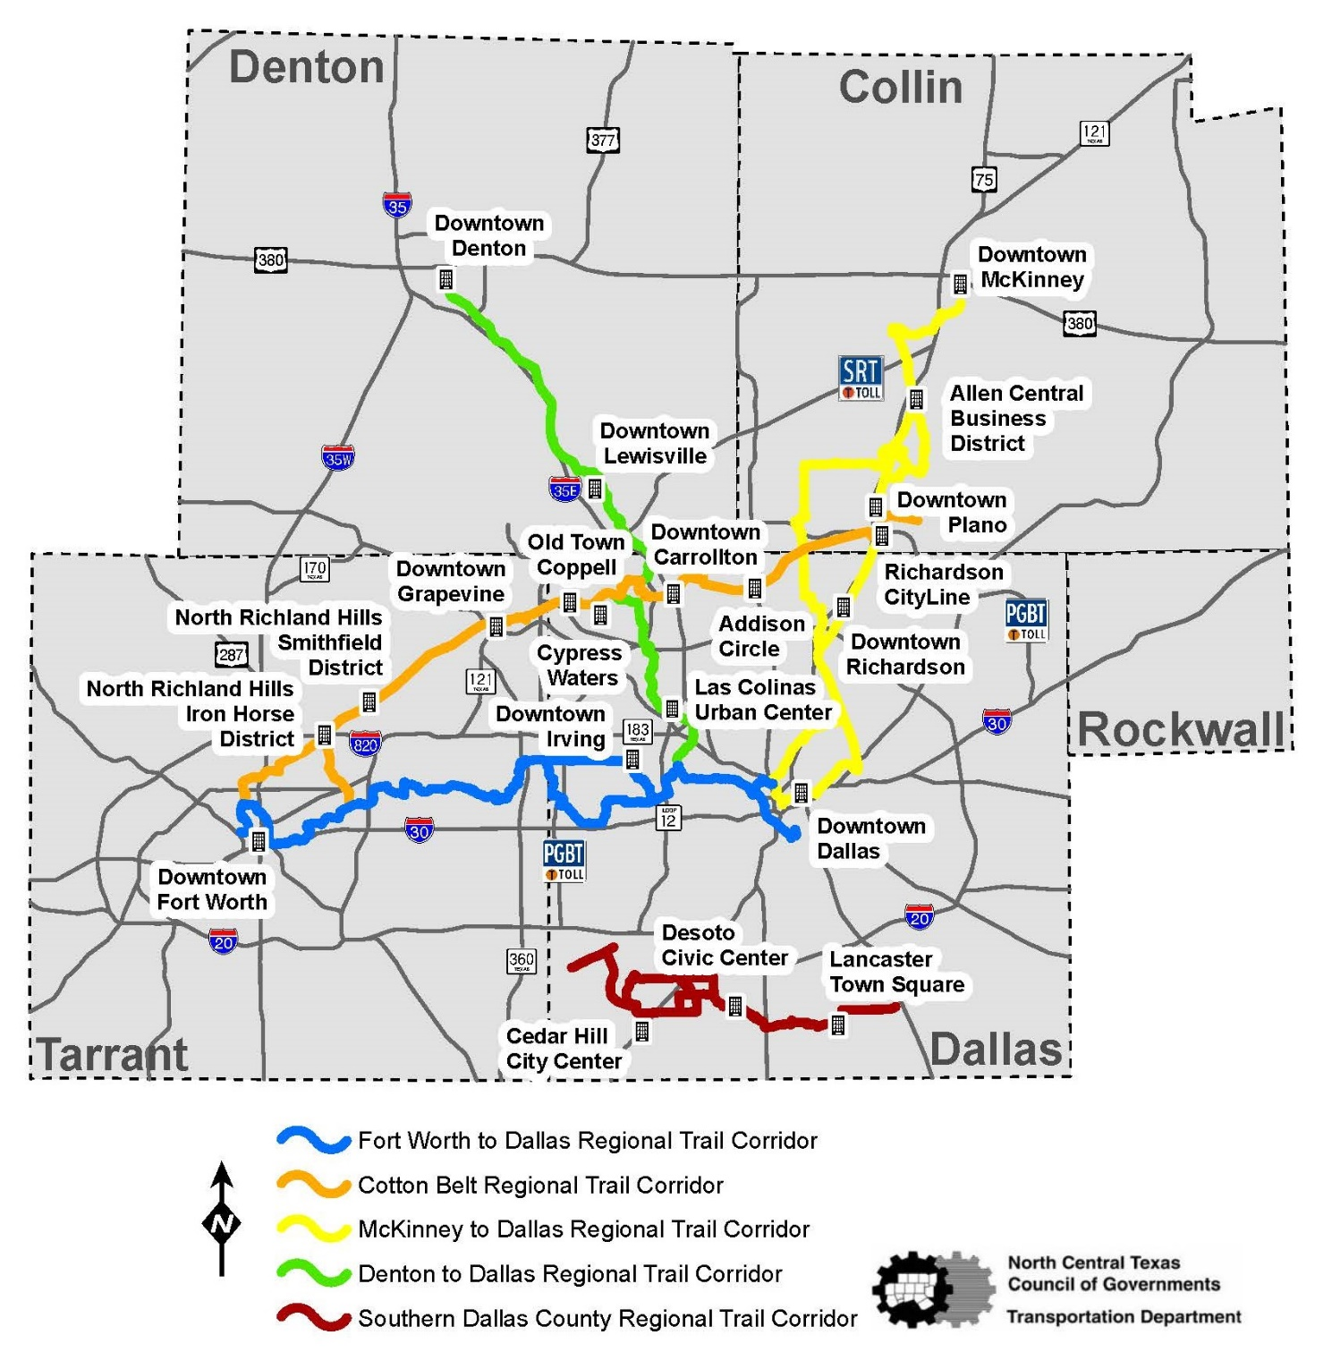
Highlighted Regional Trail Corridors
Existing/Funded | Planned | Total
63 miles | 3 miles | 66 miles
42 miles | 15 miles | 57 miles
63 miles | 16 miles | 79 miles
45 miles | 7 miles | 52 miles
20 miles | 18 miles | 38 miles
Trails and Bikeways Planning and Implementation in North Texas
15

Slide 16
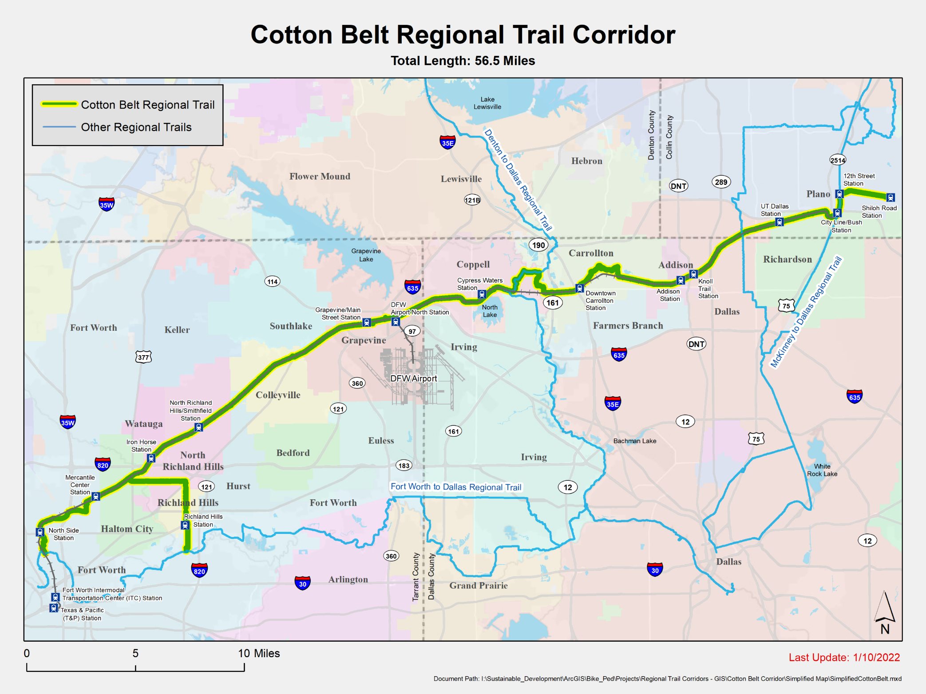
Cotton Belt Regional Veloweb Trail
Engineering Design Underway by DART
nctcog.org/CottonBeltTrail
Project Area | 56.5 miles
Counties | 3
Cities | 12
TEXRail Stations | 5
DART Silver Line Stations | 9
Existing Trail | 21.3 miles
Funded Trail | 20.4 miles
Planned Trail | 14.8 miles
Trails and Bikeways Planning and Implementation in North Texas

Slide 17
Highlighted Regional Trail Corridors
Existing/Funded | Planned | Total
63 miles | 3 miles | 66 miles
42 miles | 15 miles | 57 miles
63 miles | 16 miles | 79 miles
45 miles | 7 miles | 52 miles
20 miles | 18 miles | 38 miles
Trails and Bikeways Planning and Implementation in North Texas
17

Slide 18
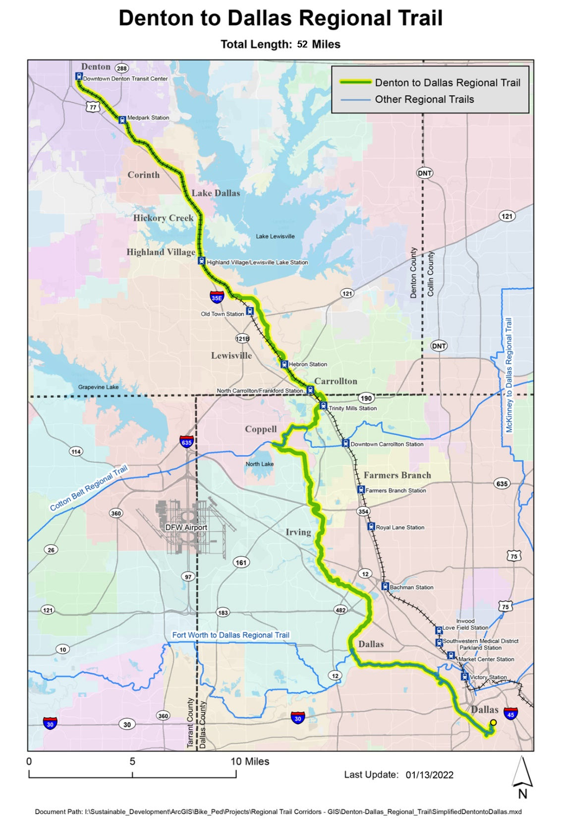
Denton to Dallas
Regional Veloweb Trail
nctcog.org/Den_DallasTrail
Project Area | 52 miles
Counties | 2
Cities | 9
Light Rail and Commuter Rail Stations | DART Green Line and DCTA A-Train
Existing Trail | 36 miles
Funded Trail | 9 miles
Planned Trail | 7 miles
Preliminary Engineering (completed in 2020)
Approx. 8 mi. from DCTA Hebron Station to
Campion Trail (Coppell/Irving) and 3 miles of trail connections
  Transportation Agencies: DCTA, DART, TxDOT, NTTA
  Cities: Lewisville, Carrollton, Coppell, Dallas
  Counties: Denton Co. and Dallas Co.
Trails and Bikeways Planning and Implementation in North Texas
18

Slide 19
Highlighted Regional Trail Corridors
Existing/Funded | Planned | Total
63 miles | 3 miles | 66 miles
42 miles | 15 miles | 57 miles
63 miles | 16 miles | 79 miles
45 miles | 7 miles | 52 miles
20 miles | 18 miles | 38 miles
Trails and Bikeways Planning and Implementation in North Texas
19

Slide 20
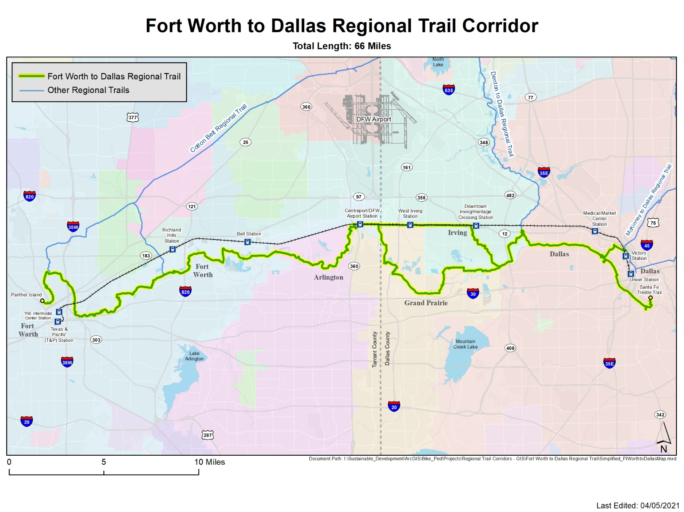
Fort Worth To Dallas Regional Veloweb Trail
nctcog.org/FWtoDALtrail
DFW Discovery Trail
Project Area | 66 miles
Counties | 2
Cities | 5
TRE Rail Stations | 3
Existing Trail | 50 miles
Funded Trail | 13 miles
Planned Trail | 3 miles
The segments connecting Fort Worth, Arlington, and Grand Prairie to CentrePort TRE rail station anticipated to start construction in 2023.
Trails and Bikeways Planning and Implementation in North Texas
20
20

Slide 21
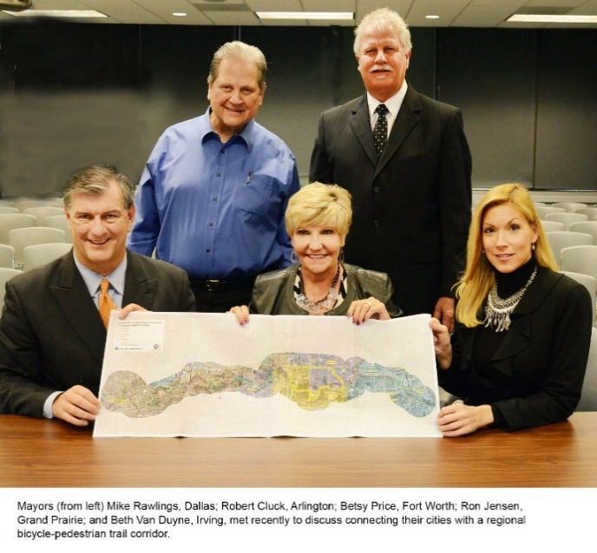
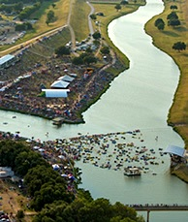
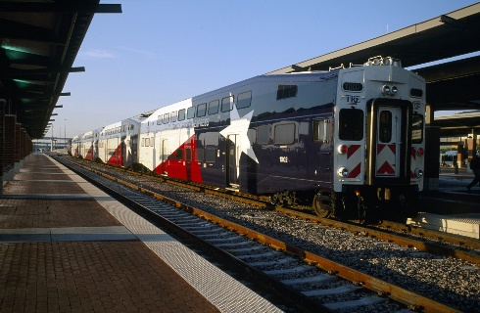
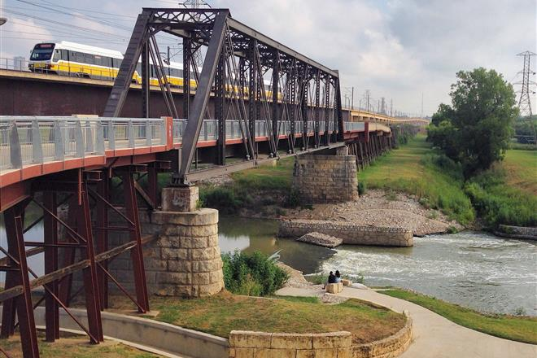
Regional Collaboration
Fort Worth to Dallas Regional Trail (recently named “DFW Discovery Trail”
Dec. 1996: Included within the Metropolitan Transportation Plan (Mobility 2020) 2013: Five city Mayors met and committed to implement the Regional Veloweb alignment (24.5 miles needed funding) Currently funded: Continuous 63-mile southern alignment connecting the five cities (from Panther Island in Fort Worth to Victory Park and Santa Fe Trestle Trail in Dallas)
Santa Fe
Trestle Trail
Dallas
Panther
Island
Fort Worth
CentrePort
TRE Rail
Station
Arlington
Grand Prairie
Irving
Trails and Bikeways Planning and Implementation in North Texas
21

Slide 22
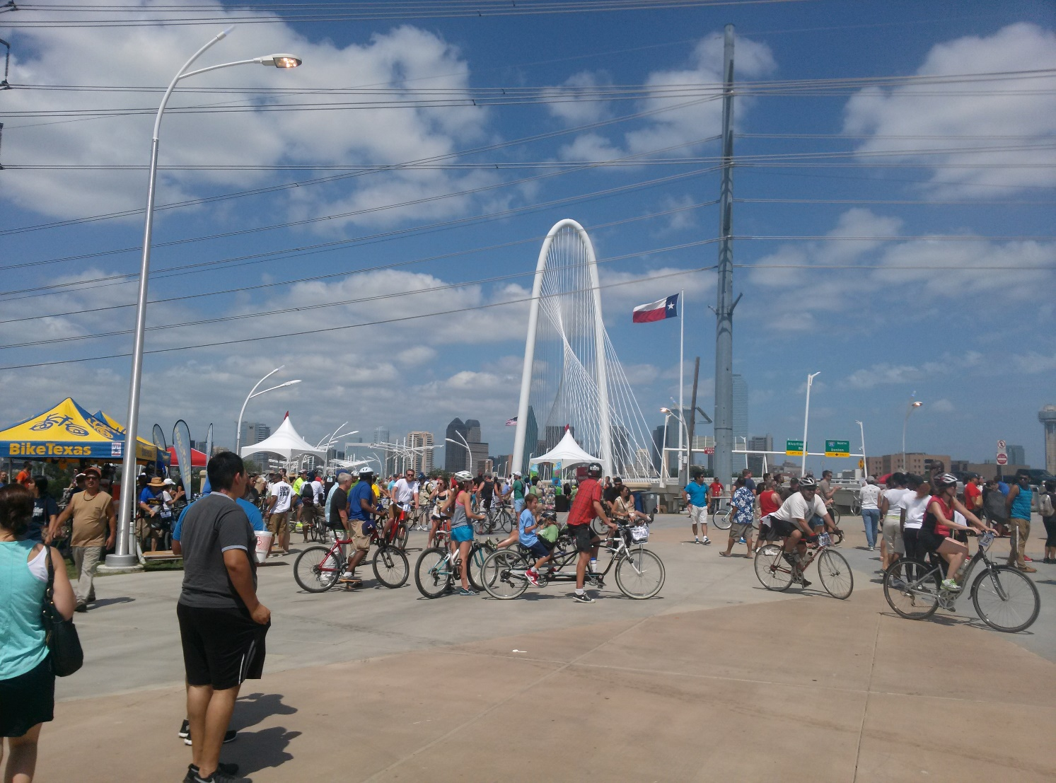
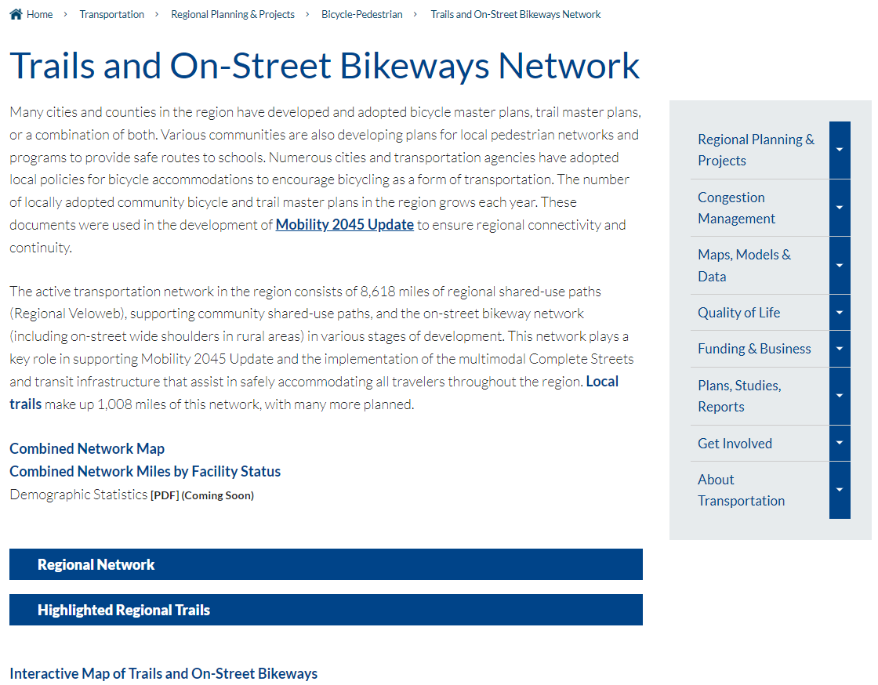
Regional Network: nctcog.org/Veloweb
Trails and Bikeways Planning and Implementation in North Texas
22

Slide 23
TxDOT 2023 TA Call-for-Projects Overview
Schedule – Preliminary Application open 12/2/22 – 1/27/23; 10/23 award
Available Funding – $250M through FY 2025 for all population areas
TxDOT may apply at the request of an eligible project sponsor
Four Project Categories – community-based, large-scale, enhancements, and planning for bicycle and pedestrian infrastructure
Selection Criteria – safety, connectivity, readiness, equity, community support
Match Options – TDCs (economic criteria), state funds (district discretion)
Outreach – webinars (posted online), virtual/in-person workshops (Nov/Dec)
Check TxDOT Bicycle and Pedestrian Funding Page for Updates
Information is subject to change before December 2nd
Trails and Bikeways Planning and Implementation in North Texas
23

Slide 24


Contact Us
Karla Windsor, AICP
Senior Program Manager
kweaver@nctcog.org | 817-608-2376
Kevin Kokes, AICP
Program Manager
kkokes@nctcog.org | 817-695-9275
Daniel Snyder, AICP
Senior Transportation Planner
dsnyder@nctcog.org | 817-608-2394
Julie Anderson
Senior Transportation Planner
janderson@nctcog.org | 817-704-5625
Cauner McDonald
Planner II
cmcdonald@nctcog.org | 817-433-0460
Erik van Bloemen Waanders
Planner II
ewaanders@nctcog.org | 817-704-5641

